Slide 1
Starter: Translate amendments into your own words
13th Amendment (1865) : Neither slavery nor involuntary servitude, except as a punishment for crime whereof the party shall have been duly convicted, shall exist within the United States, or any place subject to their jurisdiction.
14th Amendment (1868): All persons born or naturalized in the United States, and subject to the jurisdiction thereof, are citizens of the United States and of the State wherein they reside. No State shall make or enforce any law which shall abridge the privileges or immunities of citizens of the United States; nor shall any State deprive any person of life, liberty, or property, without due process of law; nor deny to any person within its jurisdiction the equal protection of the laws.
15th Amendment (1870): The right of citizens of the United States to vote shall not be denied or abridged by the United States or by any State on account of race, color, or previous condition of servitude.

Slide 2
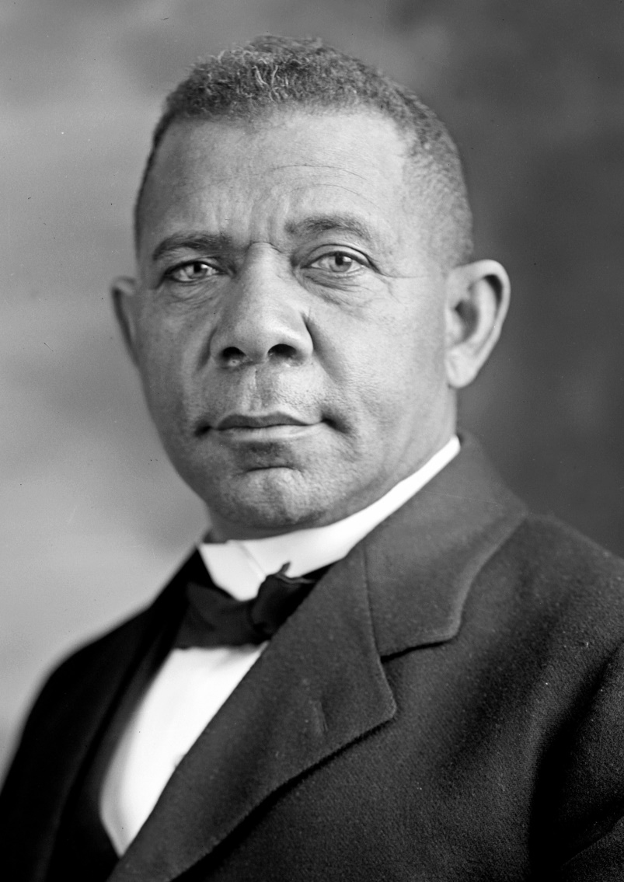
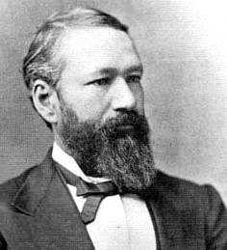
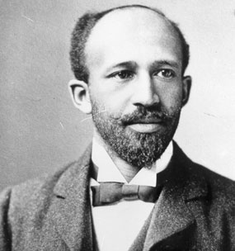
What race are these men?

Slide 3
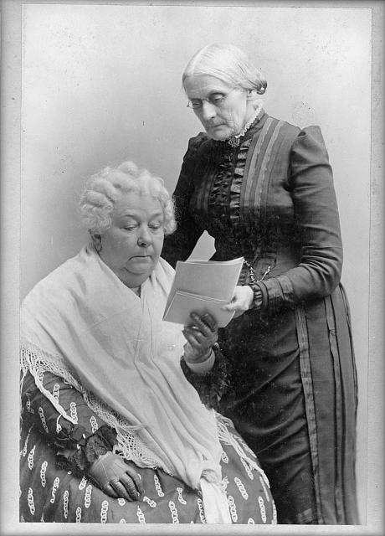
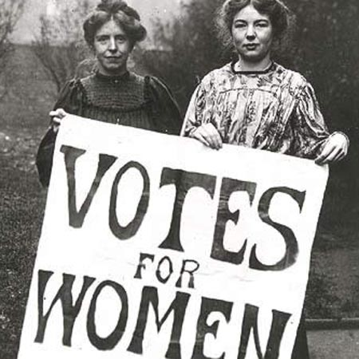
AFRICAN AMERICANS AND WOMEN IN EARLY 1900S

Slide 4
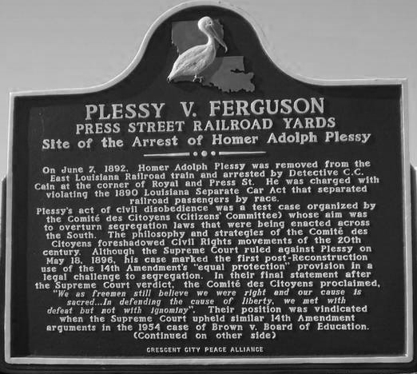

Slide 5
Translate amendments into your own words
13th Amendment (1865) : Neither slavery nor involuntary servitude, except as a punishment for crime whereof the party shall have been duly convicted, shall exist within the United States, or any place subject to their jurisdiction.
14th Amendment (1868): All persons born or naturalized in the United States, and subject to the jurisdiction thereof, are citizens any person within its jurisdiction the equal protection of the laws. of the United States and of the State wherein they reside. No State shall make or enforce any law which shall abridge the privileges or immunities of citizens of the United States; nor shall any State deprive any person of life, liberty, or property, without due process of law; nor deny to
15th Amendment (1870): The right of citizens of the United States to vote shall not be denied or abridged by the United States or by any State on account of race, color, or previous condition of servitude.

Slide 6
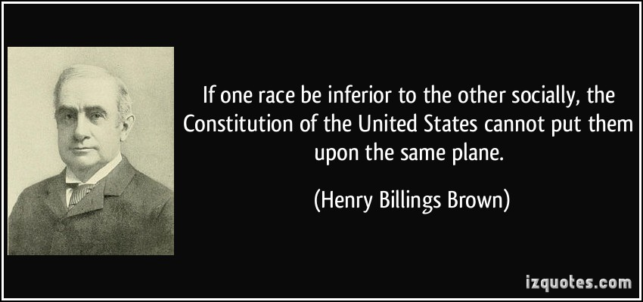
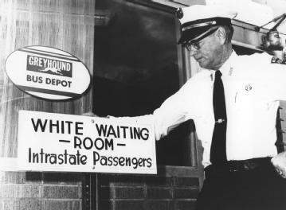
AFRICAN AMERICAS: Post Civil War
South:
Plessy VS. Ferguson: Supreme court case
Legalize segregation “separate but equal”
Separate was not equal
Jim Crow Laws/ Black codes: segregation laws in the U.S., upheld by Plessy vs. Ferguson
Legal “De Jure” Segregation
Violence: Intimidation and Lynching

Slide 7
AFRICAN AMERICANS: Post Civil War
Jim Crow Laws: Alabama
Nurses: No person or corporation shall require any white female nurse to nurse in wards or rooms in hospitals, either public or private, in which negro men are placed.
Buses: All passenger stations in this state operated by any motor transportation company shall have separate waiting rooms or space and separate ticket windows for the white and colored races.
Railroads: The conductor of each passenger train is authorized and required to assign each passenger to the car or the division of the car, when it is divided by a partition, designated for the race to which such passenger belongs.
Restaurants: It shall be unlawful to conduct a restaurant or other place for the serving of food in the city, at which white and colored people are served in the same room, unless such white and colored persons are effectually separated by a solid partition extending from the floor upward to a distance of seven feet or higher, and unless a separate entrance from the street is provided for each compartment.
Pool and Billiard Rooms: It shall be unlawful for a negro and white person to play together or in company with each other at any game of pool or billiards.
Toilet Facilities, Male: Every employer of white or negro males shall provide for such white or negro males reasonably accessible and separate toilet facilities. Alabama

Slide 8
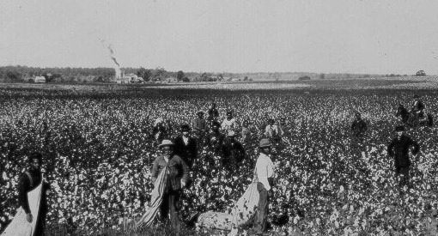
African Americans: Post Civil War
Sharecropping: black families would rent plots of land to work and pay landowners in crops
Resulted in constant debt
Better than slavery?

Slide 9
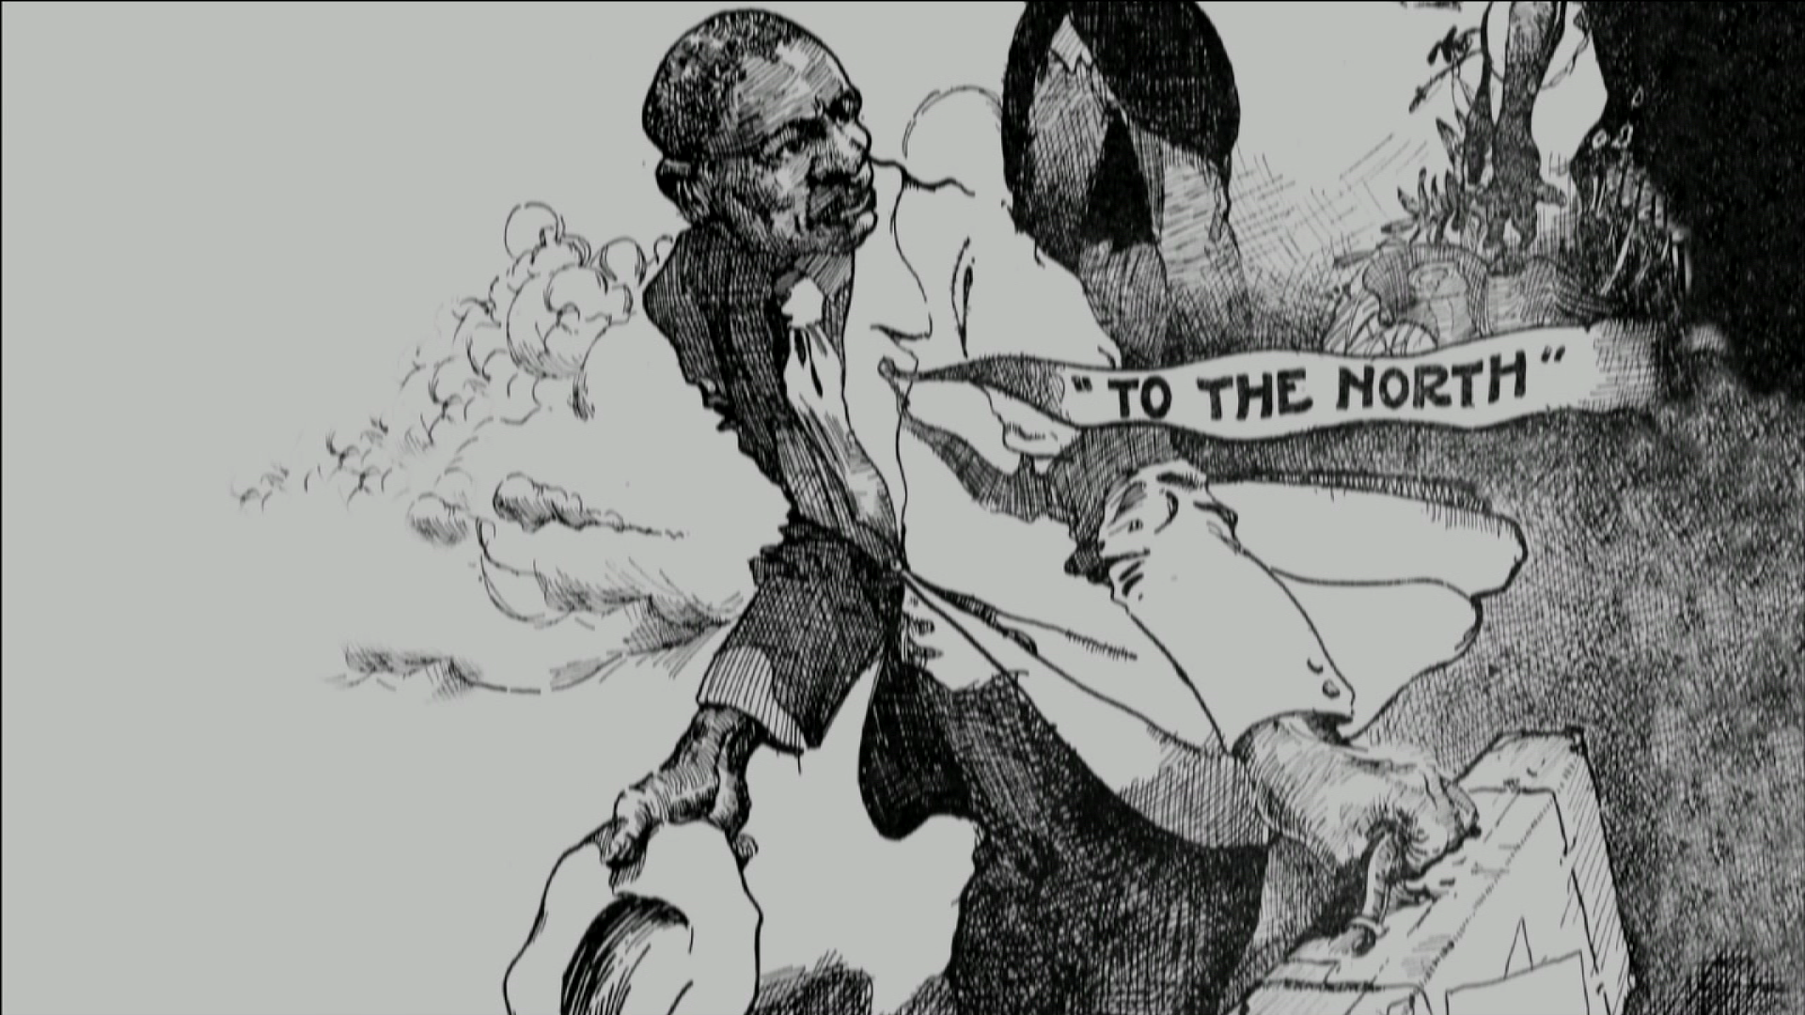
“GREAT MIGRATION” (1890-1960)
African Americans leave the South and settle in Northern Cities
HOW MANY……
A lot- 6 million total

Slide 10
“GREAT MIGRATION” (1890-1960)
WHY?
Push Factors: Why did African Americans leave the South? (at least 2)
Pull Factors: Why did African Americans settle in Northern Cities (at least 2)
North: De Facto (in fact) segregation
Example?____________________ ___________.

Slide 11
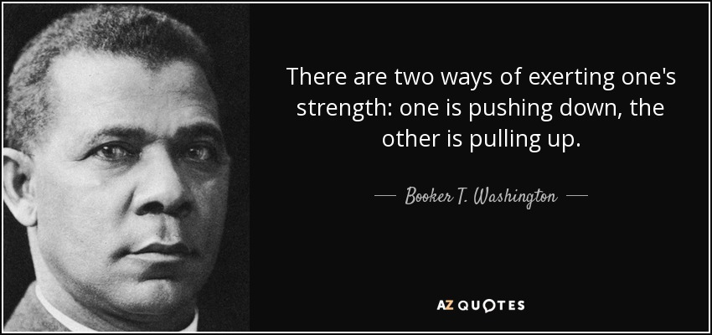
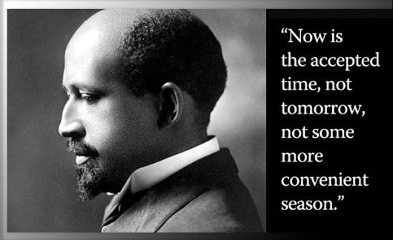
AFRICAN AMERICAN LEADERS
BOOKER T. WASHINGTON:
Institution: Tuskegee Institute
Theory of Progress: Gradual, earn equality and respect
W.E.B. Du Bois:
Institution: NAACP
Theory of Progress: Immediate equality

Slide 12
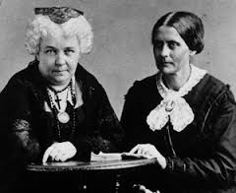
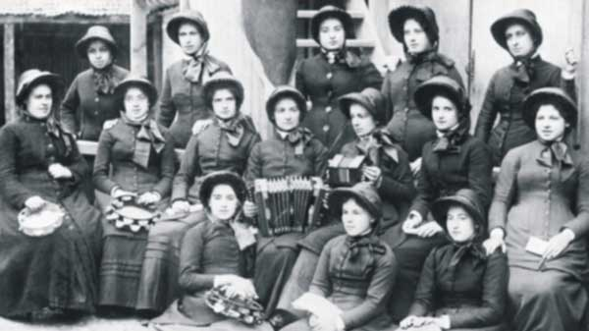
Women’s Rights Movement: (1848-1920)
Feminism: women’s rights, equality of the sexes
First Wave of Feminism: late 1800’s, early 1900s.
“Suffrage movement”- gaining the right to vote.

Slide 13
Women’s Rights Movement: (1848-1920)
“Resistance to tyranny is obedience to God.”
Anthony
Women’s Rights Convention: Seneca Falls, New York (1848)
Susan B. Anthony and Elizabeth Cady Stanton
Grievances of Women- Second class citizens
The key to addressing problems: “The Vote”
Anthony arrested for voting.
Backlash: “Not lady like” or “Not proper”

Slide 14
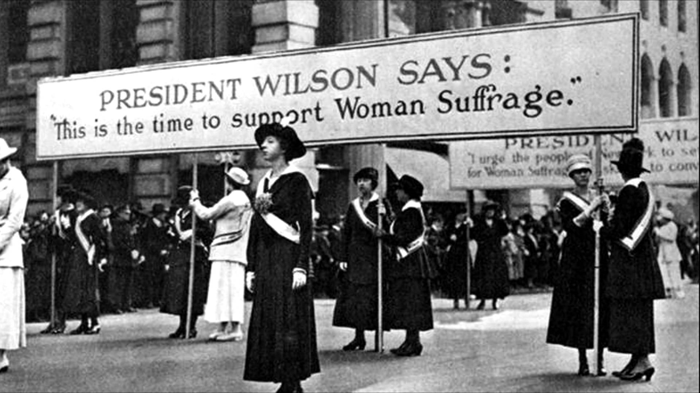
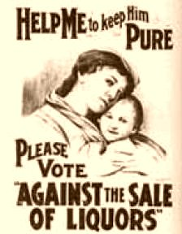
Women’s Rights Movement: (1848-1920)
SUFFRAGE MOVEMENT: 1900
Women in the progressive era
2nd Great Awakening- Active religious women
Temperance-prohibition “evils of alcohol”
Child labor, workplace safety
Club membership
Fight for the Vote:
Western States set trend (WY, UT)
Backlash: Insecure men, liquor companies, “traditional values”

Slide 15
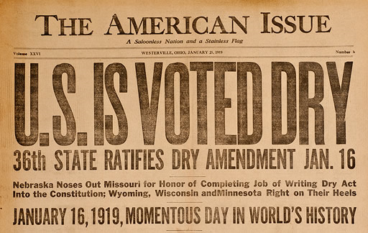
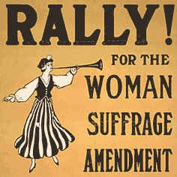
Women’s Rights Movement: (1848-1920)
Women’s Rights Movement: Success!
18th Amendment: Prohibition- bans the manufacture, sale and transportation of alcoholic beverages
“Noble” experiment- failure
Repealed (21st amendment)
19th Amendment: WOMEN GET THE VOTE!
WW1 effect; women enter workforce, earn respect
Susan B. Anthony Amendment

Slide 16
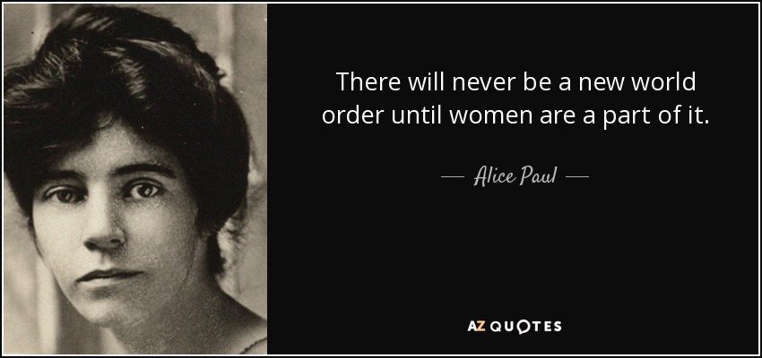
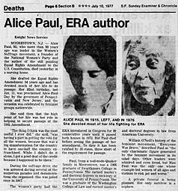
Women’s Rights Movement: (1848-1920)
The Battle for Equality- 1920-Today
Women still fighting for equal opportunity:
Education
Employment- Pay and Opportunity
ERA- Equal Rights Amendment:
Alice Paul- American Feminist used militant tactics (picketing, protests, hunger strikes) to achieve equality
1923, 1972-1982- fails to be ratified
Opposed by conservative women

