Slide 1
Bell Quiz
Define one of the three terms and describe how it was displayed by an Axis power; nationalism, militarism, totalitarianism.
What was the goal of appeasement? Did appeasement achieve it’s goal?
After the Allies official declared war against Germany, which countries did Germany defeat? (list 2)

Slide 2
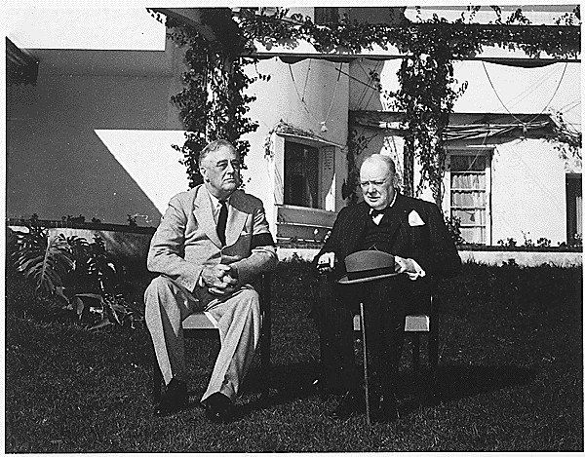
American Neutrality

Slide 3
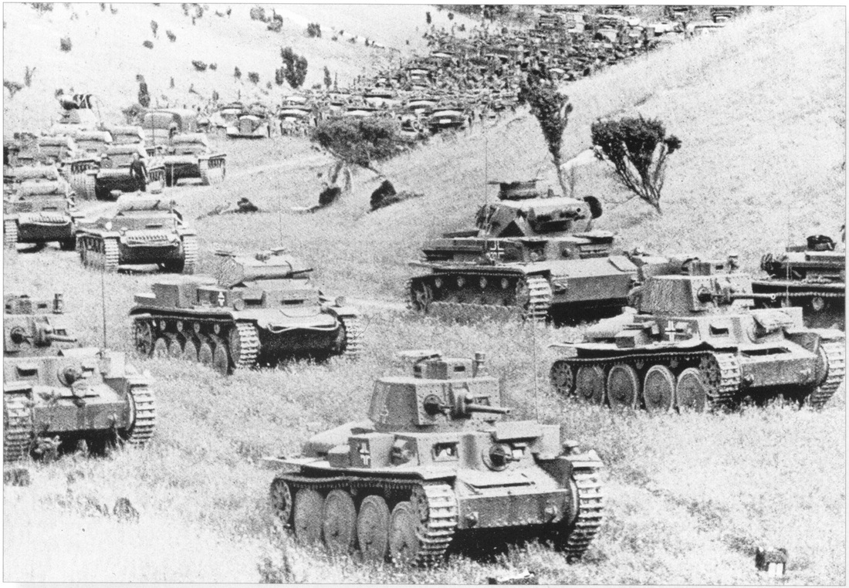
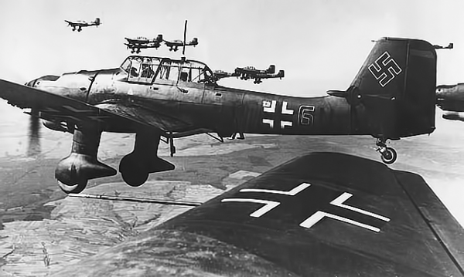
German Blitzkrieg
Blitzkrieg “Lightning War”
Mechanized Warfare- Tanks, artillery, vehicles rapidly strike and push forward
Offensive War (Break stalemate)

Slide 4
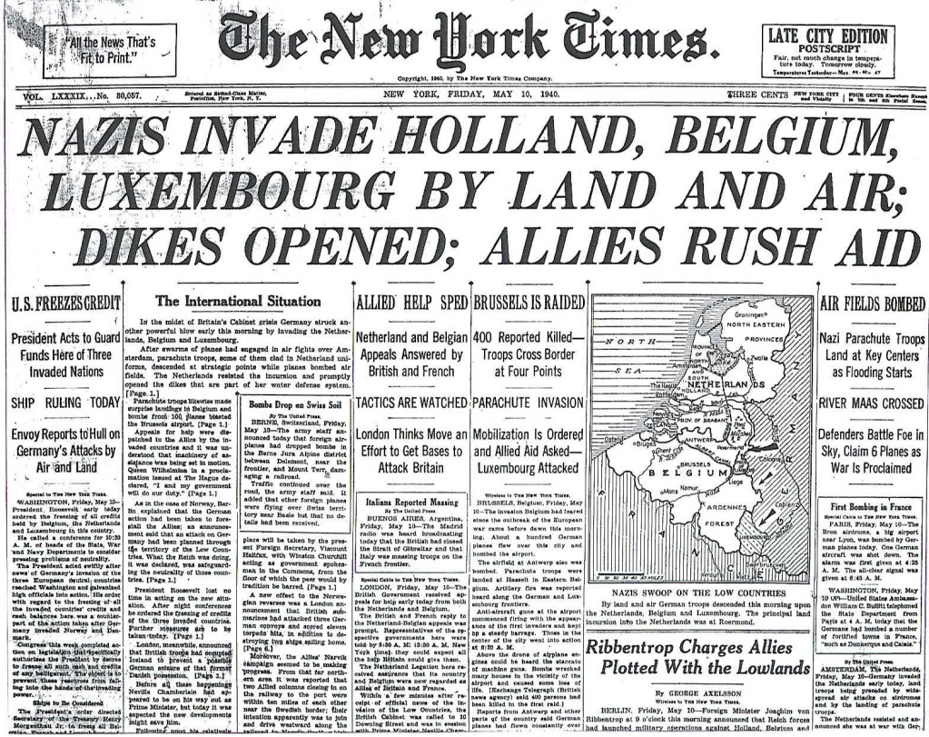
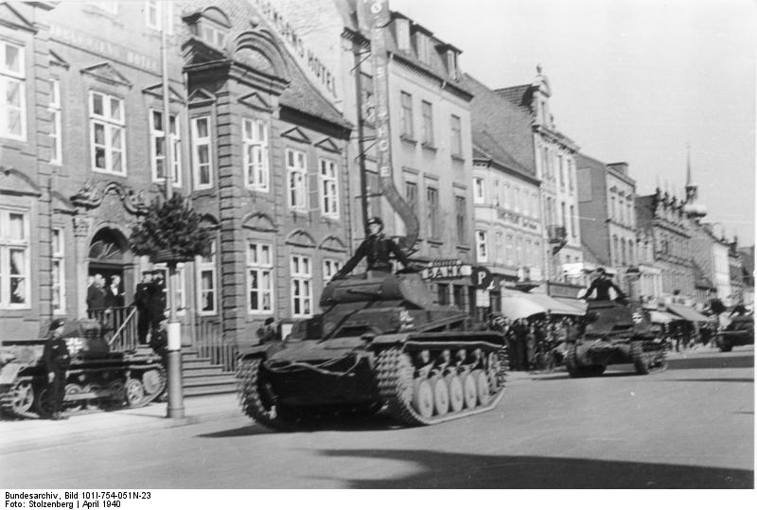
German Blitzkrieg
German troops took Poland in less than a month.
1940- Germany takes Denmark, Norway, Belgium, and the Netherlands.

Slide 5
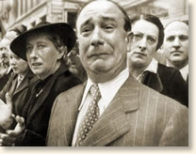
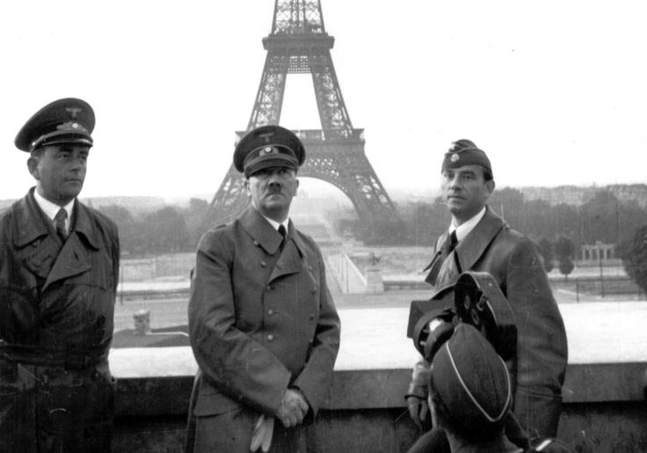
Fall of France
Germans came through Belgium to attack France
British and French troops barely escape
Italy joins on the side of Germany and invades France from the South
France was quickly overtaken

Slide 6
What happened to France?
Nazi Germany occupied Northern France
Germany established a puppet government in southern France, in a town called Vichy
The French Resistance led by Charles de Gaulle continued to oppose Germany. It operated in exile in London.

Slide 7
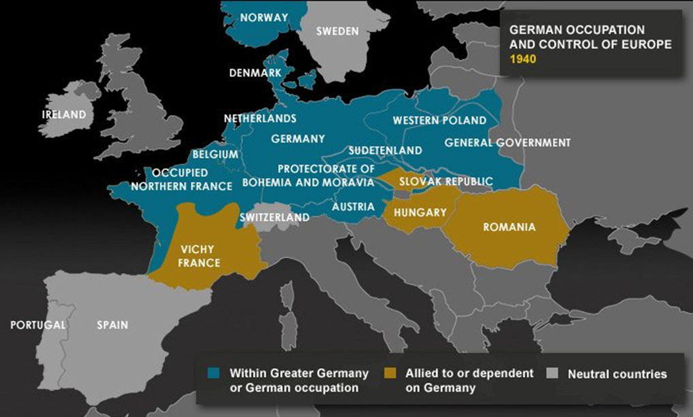
German Expansion 1940

Slide 8
Battle of Britain: August 1940
German Luftwaffe v. British Royal Air Force
Dropping bombs on human populations
Hitler tried to use the Luftwaffe (Air Force) to destroy Britain’s ability to resist.
1,000 planes a day bombed Britain.
RAF pilots flew as many as six and seven missions a day.
Winston Churchill said, “Never in the field of human conflict was so much owed by so many to so few.”

Slide 9
WWII IN EUROPE 1939-1941
Hitler’s War Aims
Goal: | Status:
Rebuild and Rearm Germany (overthrow Treaty of Versailles) | X
Unite the German People (Austria, Czeck) | X
Secure the West (Take Denmark, Norway, Belgium, France) | X
Living Space in the East | 0
Exterminate the Jew | 0
Onwards to Russia

Slide 10
WWII IN ASIA
Japan’s War Aims
Goal: | Status:
Obtain Raw Materials (Manchuria, China, Indochina, etc)
Increase Territory (Manchuria, China, Indochina, etc.)
Aggressively pursuing both goals

Slide 11
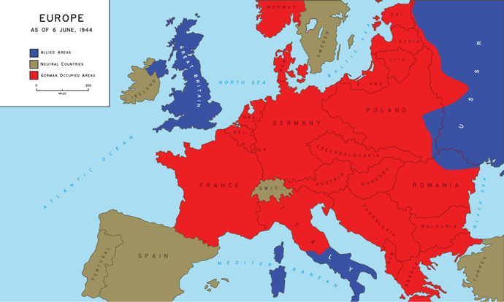
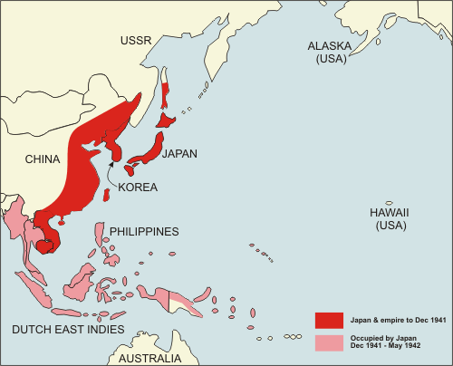
WWII 1941
Air war with Great Britain
Invasion of Russia
Controlling China and Indochina
Advance into Dutch East Indies and Malaya

Slide 12
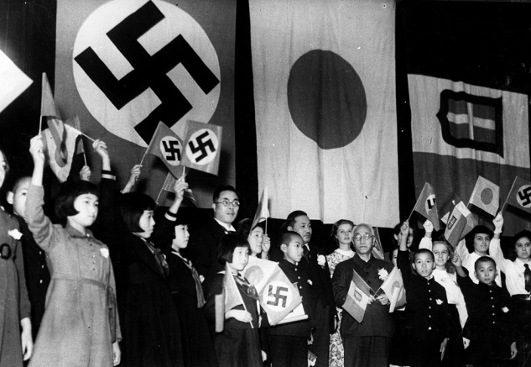
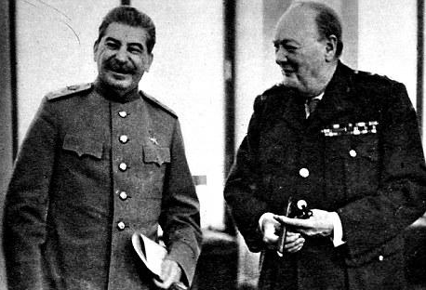
WWII IN 1941
AMERICAN
NEUTRALITY
AXIS
ALLIES
Germany
Italy
Japan
Great Britain
French
Russia
“This nation will remain a neutral nation.” FDR

Slide 13
American Neutrality
Isolationism: policy emphasizing the avoidance of foreign affairs (alliances, commerce, etc.)
American tradition
Neutrality: America wont take sides during the war.
Goal: Stay out of the War!!

Slide 14
American Neutrality
Isolated
1935: Neutrality Act: Will not sell arms to warring nations.
1937: Panay: Japanese sink American gunboat in China. Japanese claim event was accidental. U.S. takes no action.
1939: Cash and Carry: Allows warring nations to buy arms from the U.S. with cash, but they must provide their own transport.
1940: Draft: First peacetime draft in U.S. History.
1940: Lend-Lease: sell and lend weapons and arms to Great Britain.
Neutral
Allies
Involved

Slide 15
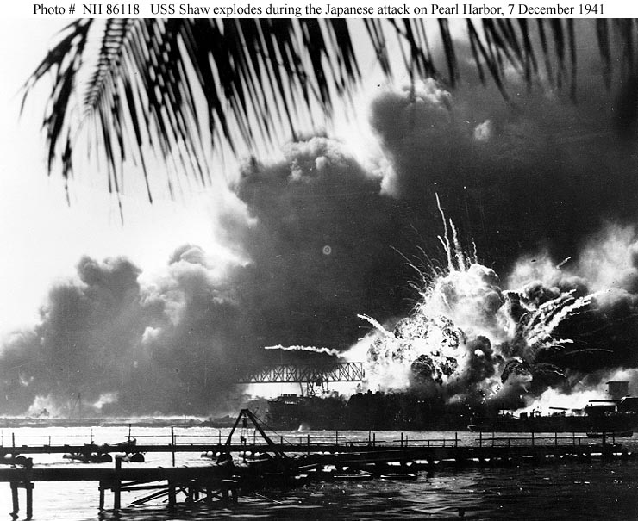
December 7th 1941: Pearl Harbor

