Slide 1
Starter: Why was this play in the Super bowl successful? List at least five reasons.

Slide 2
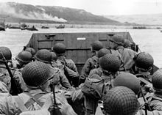
Operation overlord
D-Day June 6th 1944

Slide 3
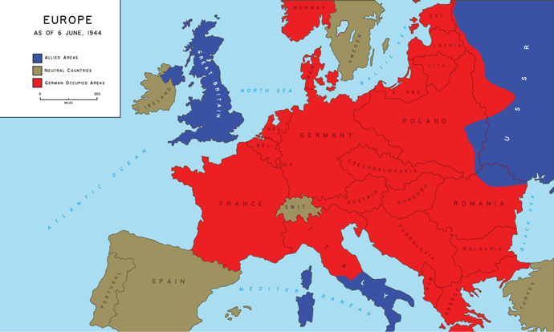
WWII Europe 1944: Conditions
Neutralized German U boats in the Atlantic
Secured the soft underbelly (North Africa, Italy)
Russians stalled the German advances in the east (Stalingrad)

Slide 4
D-Day Purpose:
Secure a landing zone (beach) in N. France to launch major offensive in Europe.
This operation will be the primary United States and British ground and air effort against the Axis of Europe. Following the establishment of strong Allied forces in France, operations designed to strike at the heart of Germany and to destroy her military forces will be undertaken. We have approved the outline plan for Operation Overlord.
—Report by Allied Combined Chiefs of Staff, Quebec Conference, August 1943

Slide 5
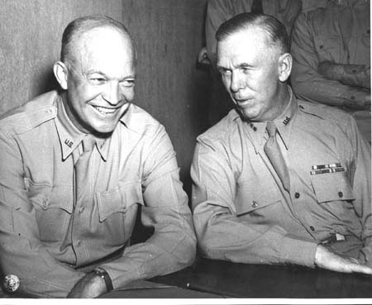
D Day Leadership
The D-Day invasion was planned by:
George C Marshall
The Supreme Commander for Allied Forces during D Day:
Dwight D. Eisenhower

Slide 6
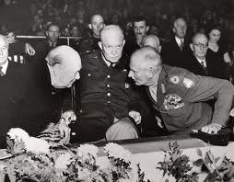
D-Day: The Plan:
1. Planning; locate suitable beaches, identify German defenses
2. Paratroopers will isolate the battlefield (beach area)
3. Amphibious invasion; control beaches

Slide 7
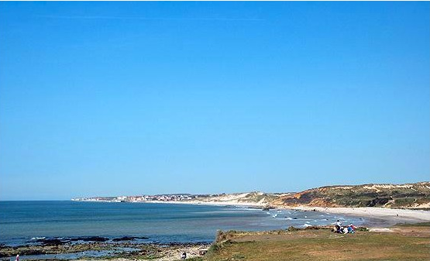
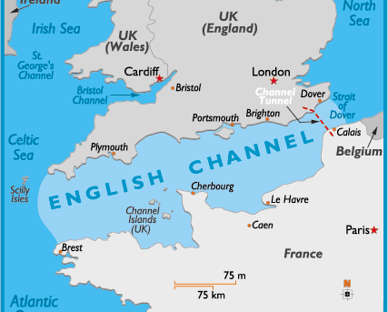
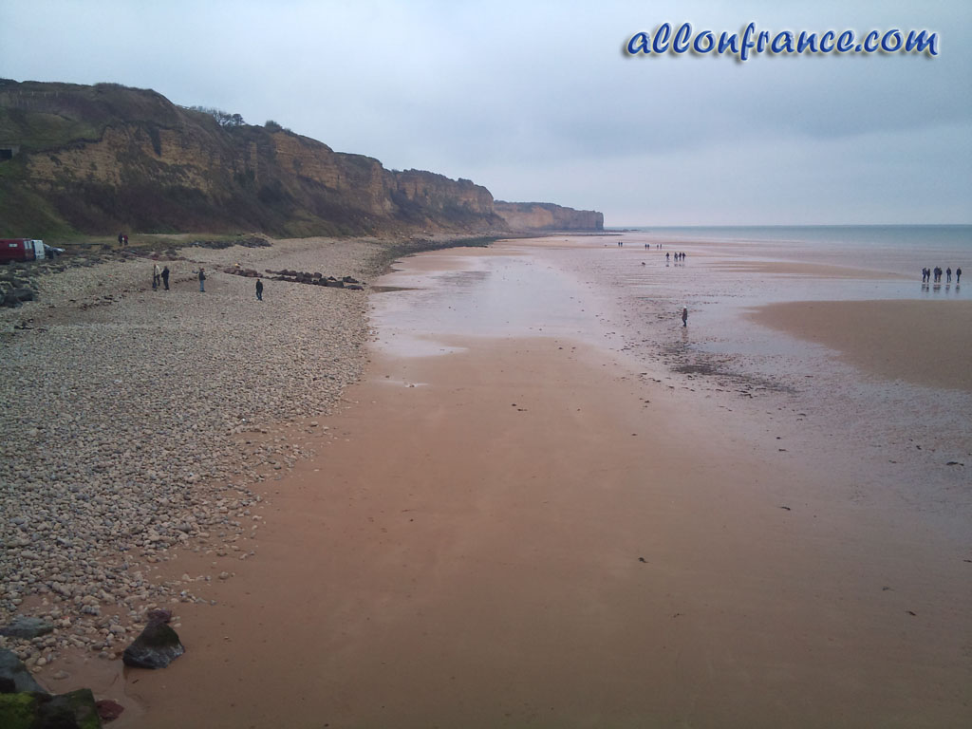
Objective 1: Landing Site

Slide 8
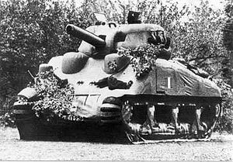
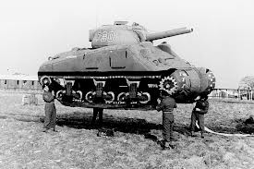
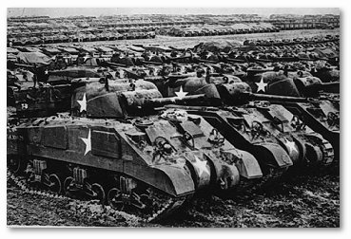
Operation Fortitude:

Slide 9
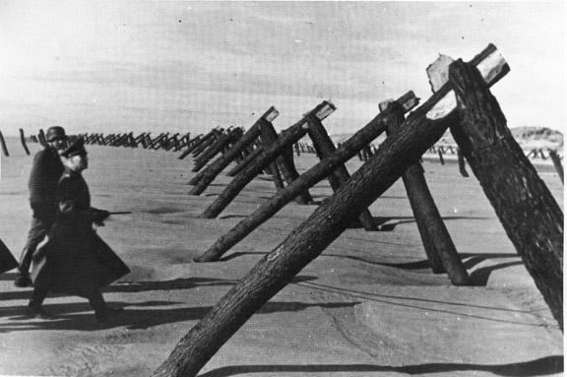
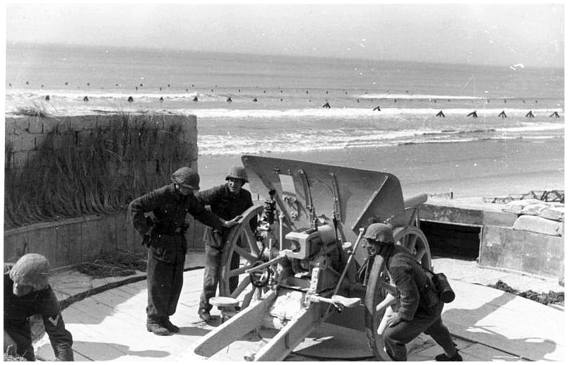
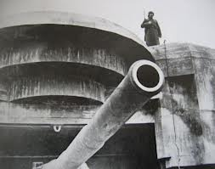
Atlantic Wall

Slide 10
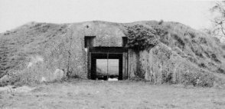
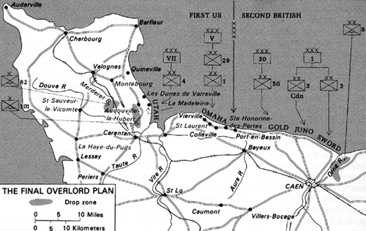
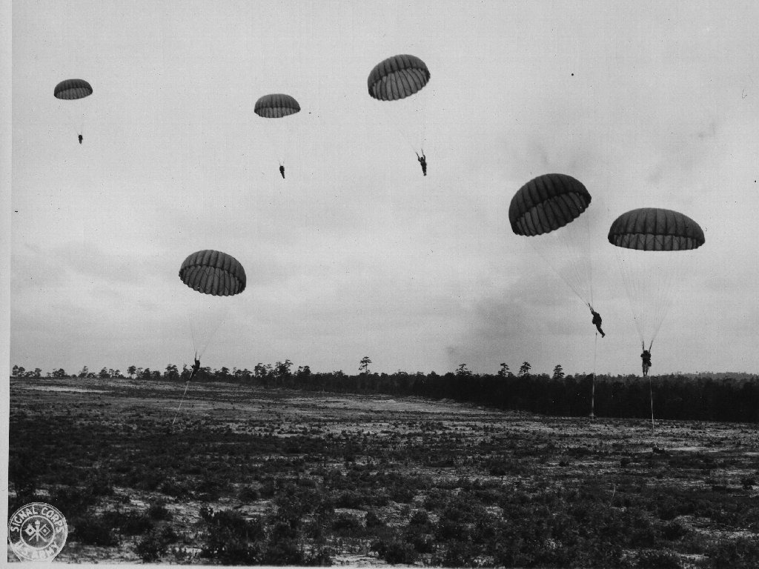
Objective 2: Isolate landing site

Slide 11
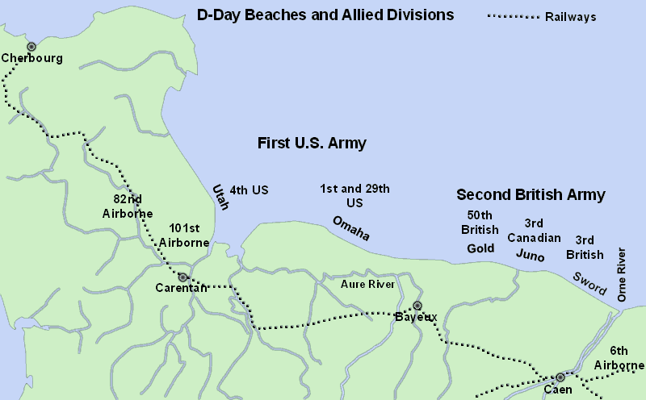
Objective 3: Land the Troops

Slide 12
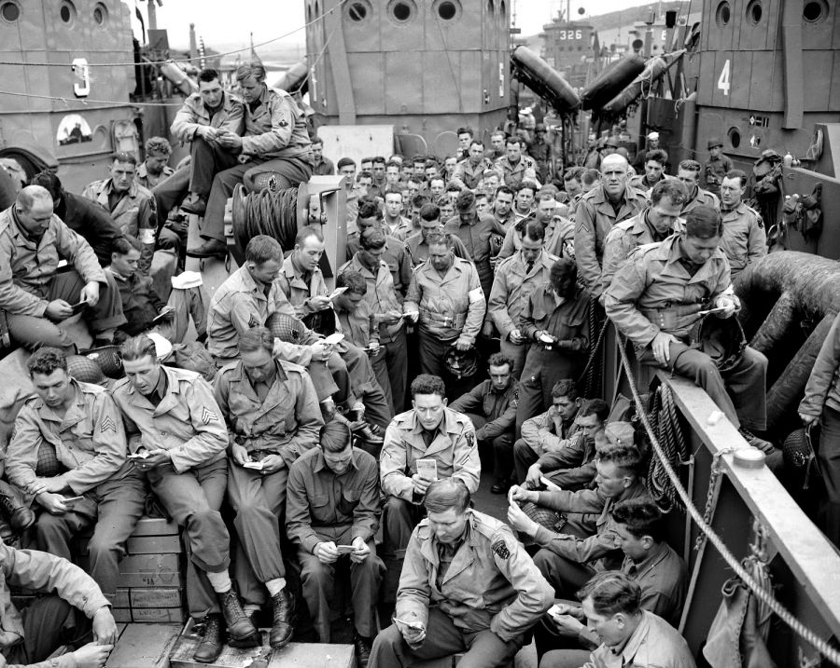
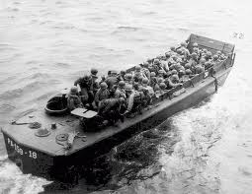
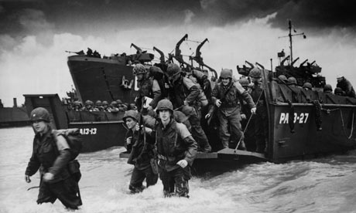
Allied Equipment

Slide 13
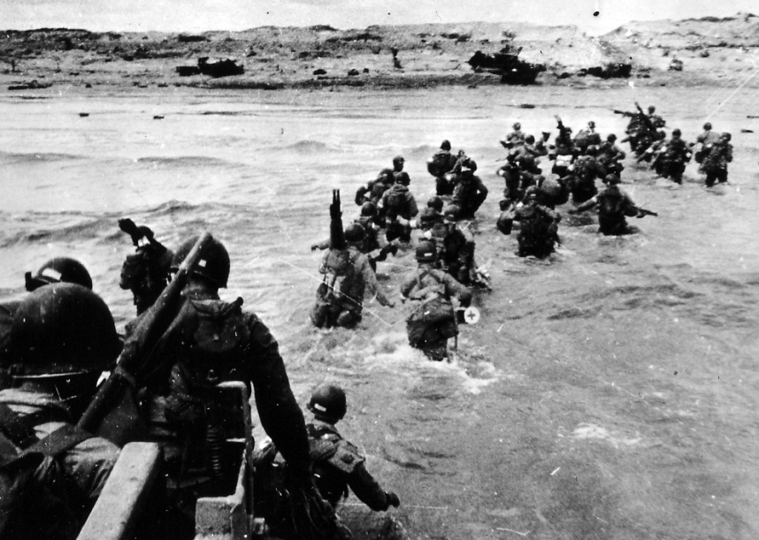
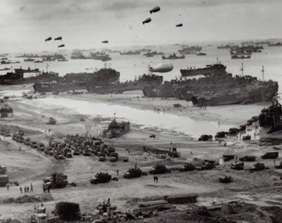
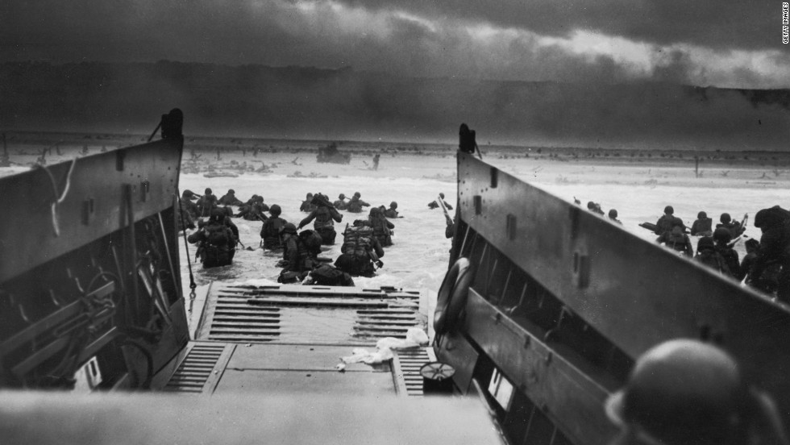
The Beaches

