Slide 1
Starter: Match the inventor to his invention
Henry Bessemer
Alexander Graham Bell
Thomas Edison
Frederick Taylor
Karl Benz
A. Process that converts iron to steel
B. Scientific Management
C. Telephone
D. Automobile
E. Light Bulb

Slide 2
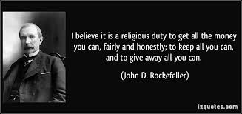
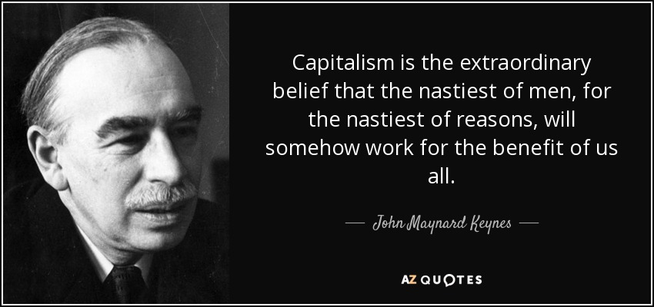
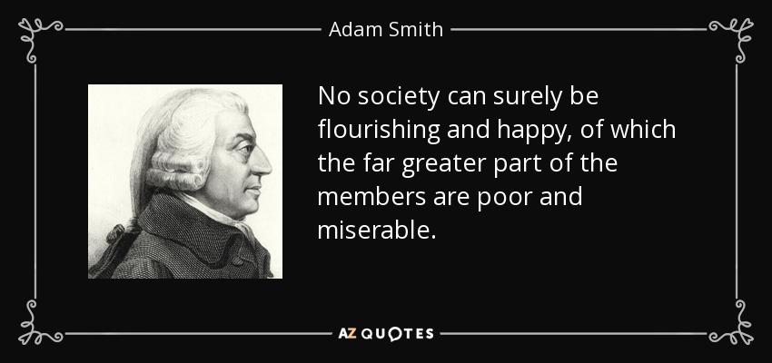
Starter: Which quote do you agree with the most? Why? Which quote do you agree with the least? Why?

Slide 3
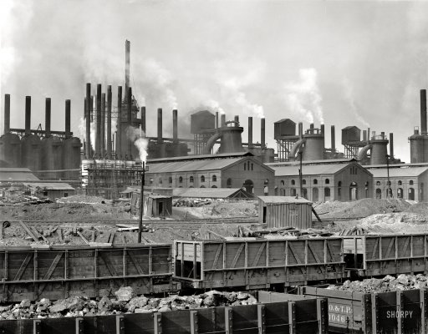
THE GILDED AGE

Slide 4
Economics Vocab: define the terms in language that you understand
Capitalism:
Laisse faire:
Monopoly:
Trust:
Vertical Integration:
Horizontal Integration:

Slide 5
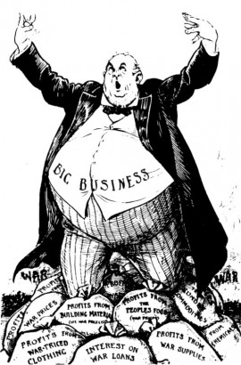
CAPITALISM: Economic System
Ownership:
Private Ownership
Driving Forces:
Supply (make) and Demand (buy)
Competition
Incentive:
Profit and self interest

Slide 6
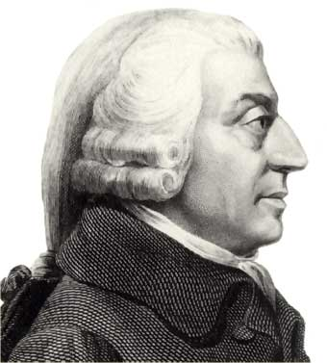
CAPITALISM: Origins
History suggests that capitalism is a necessary condition for political freedom
Adam Smith’s Wealth of Nations (1776)
Laissez Faire: hands off,
Remove government control (tariffs, restrictions) from economy
Invisible hand; Market forces create wealth

Slide 7
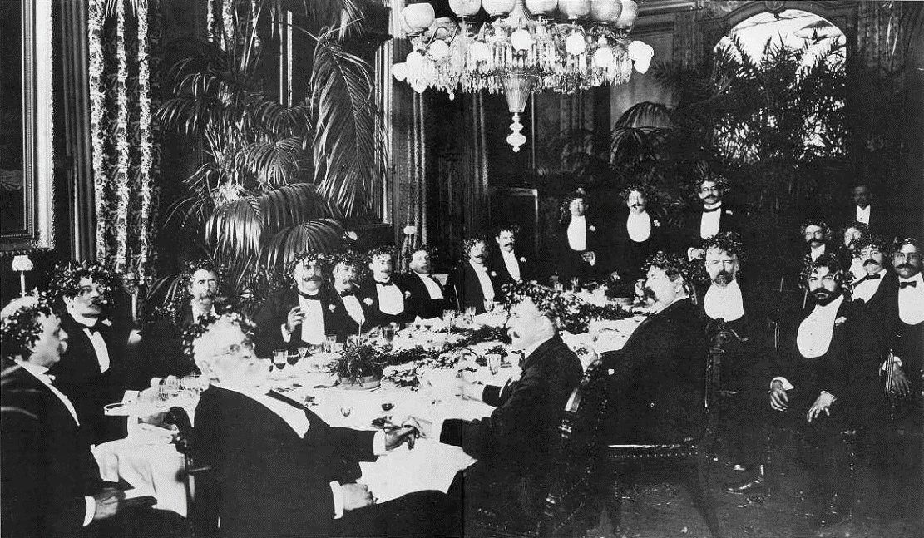
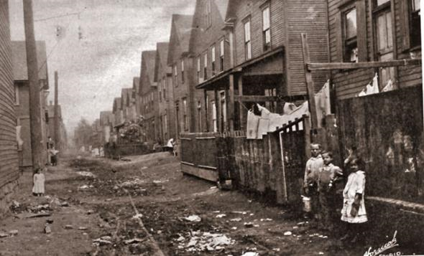
“GILDED AGE” (1865-1900)
Named by MARK TWAIN
Corruption, Greed, and Social problems hidden by Extreme Growth and Wealth
Massive difference between the Few (Wealthy) and the Many (Poor)
History suggests that capitalism is a necessary condition for political freedom

Slide 8
Are we still in a Gilded Age:
“Corruption, Greed, and Social problems hidden by Extreme Growth and Wealth”
“Massive difference between the Few (Wealthy) and the Many (Poor)”
Does this describe America today?

Slide 9
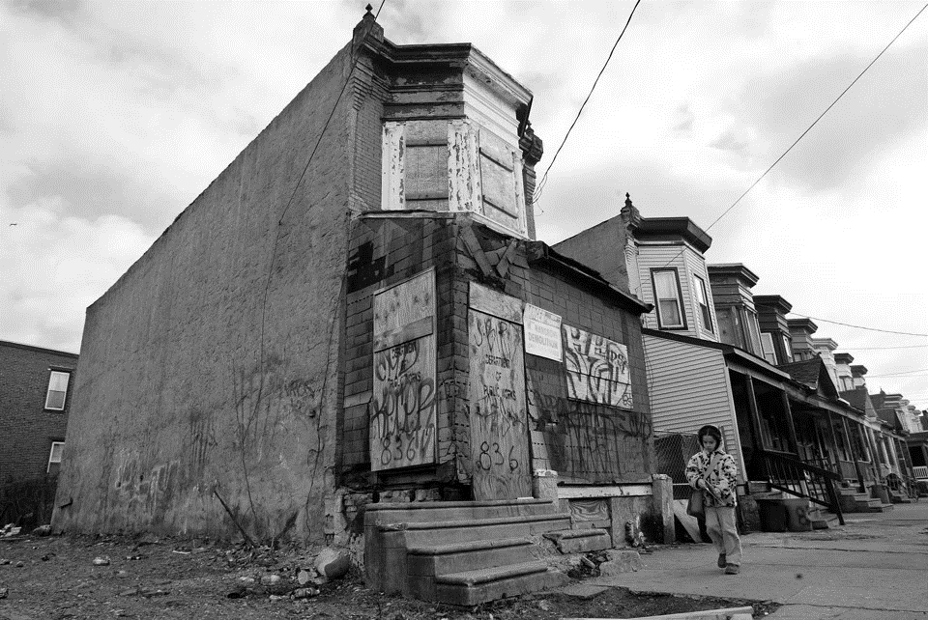
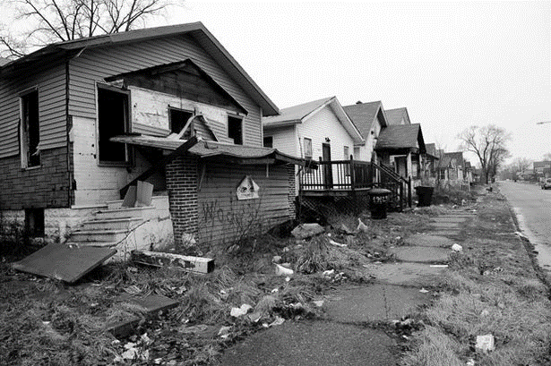

Slide 10
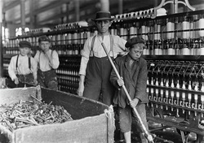
“GILDED AGE” (1865-1900)
Dark side of the Gilded Age:
Exploited workers
Extreme poverty in cities
Corruption

Slide 11
Starter: Match the term to the definition
Monopoly
Capitalism
Vertical Integration
Horizontal Integration
complete ownership or control of the entire supply of goods or services in a certain market.
one company owns two or more steps on the production path or supply chain
Economic system with private ownership in the free market.
Ownership of several companies that make the same product.

Slide 12
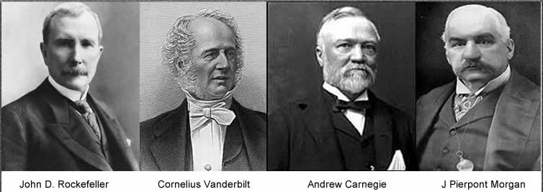
Captains of Industry or Robber Barons?

Slide 13
Important Economic Terms
Monopoly/Trust: complete ownership or control of the entire supply of goods or services in a certain market.
Vertical Integration: one company owns two or more steps on the production path or supply chain
Horizontal Integration: Ownership of several companies that make the same product.

Slide 14
Captains of Industry:

Slide 15
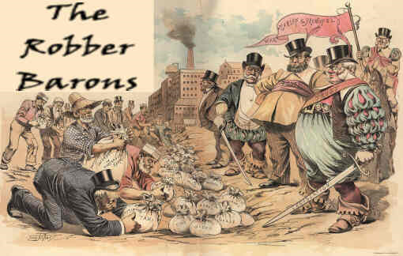
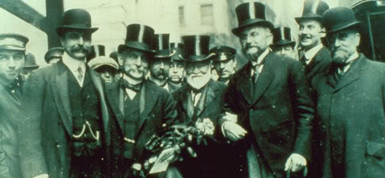
ERA OF BIG BUSINESS:
OR
CAPTAINS OF INDUSTRY:
ROBBER BARONS:
Positive view of business leaders
Revolutionized business
Innovated industry
Built the American economy
Assisted Society
Negative view of business leaders
Cutthroat, corrupt, greedy
Immoral tactics, (bribes, tricks)
Exploited workers
Ignored rules and government

Slide 16
Vanderbilt:

Slide 17
Captains of Industry:
Who are the “Captains of Industry” in our era. What industries are they involved in. Could these men/women be considered “Robber Barons.” Why or why not?

Slide 18
Agree or disagree, Why?
Strong people, races, and cultures grow in power and cultural influence at the expense of the weak, it is natural and necessary.

Slide 19
Agree or disagree. Why?
There can be no wealthy few without a poor many. Social classes and income levels are natural in all societies.

Slide 20
Agree or disagree. Why?
Wealth comes to moral and virtuous people

Slide 21
Agree or disagree. Why?
The wealthy have a moral responsibility to assist the less fortunate.

Slide 22
What is your reaction to this quote?
“Philanthropy (charity) is the marketing (advertising) of the future.”
Biz Stone (founder of Twitter) at a conference at Oxford University in 2014

Slide 23
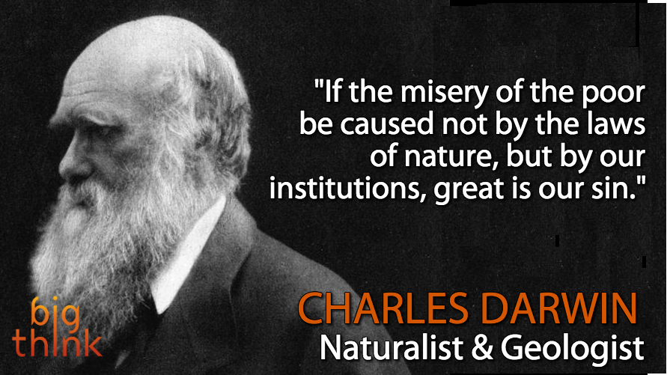
ERA OF BIG BUSINESS: Beliefs
Social Darwinism: “survival of the fittest”
Herbert Spencer
Humans are subject to the same natural selection as other species
strong people, races, and cultures grow in power and cultural influence at the expense of the weak, it is natural and necessary
justification for unchecked capitalism
AGREE OR DISAGREE

Slide 24
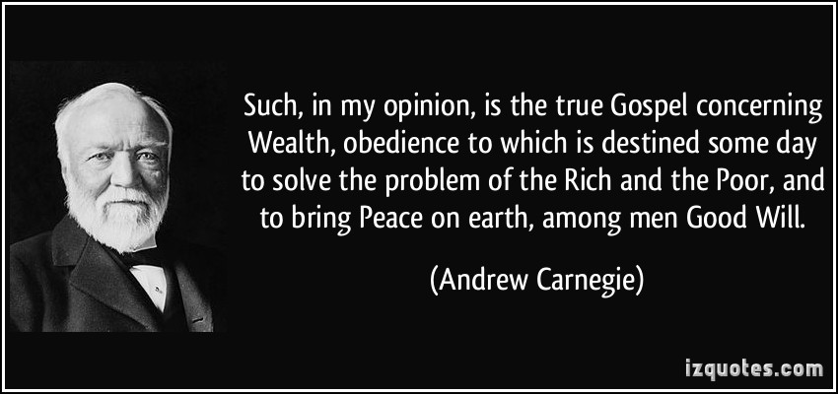
ERA OF BIG BUSINESS: Beliefs
Gospel of Wealth – philanthropy (charity)
Article written by Andrew Carnegie
Wealth comes to moral and virtuous people
Upper classes have a moral responsibility to assist the less fortunate
Don’t waste money on extravagant excessive spending.
AGREE OR DISAGREE

