Slide 1
Starter:
Where did your ancestors come from? What is your ethnic heritage?
Why did your ancestors decide to move to the United States?
What brought your family to Utah?
What are some challenges your ancestors faced when they arrived in America? What are some challenges your family faced when they arrived in Utah?

Slide 2
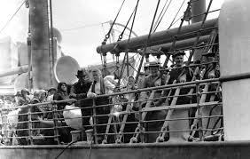
IMMIGRATION

Slide 3
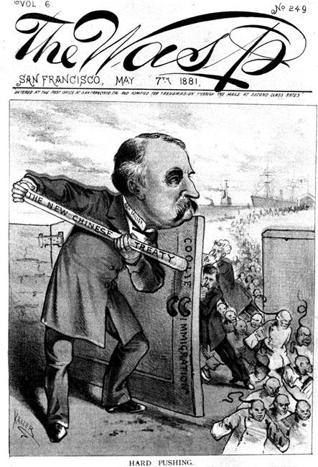
IMMIGRATION: An American Tradition
OLD IMMIGRATION: (1815-1890)
From: Northwest Europe (Britain/ Germany)
Ethnicity: Common language, common religion
Treatment: welcomed in America
W.A.S.P.
White
Anglo-Saxon
Protestant

Slide 4
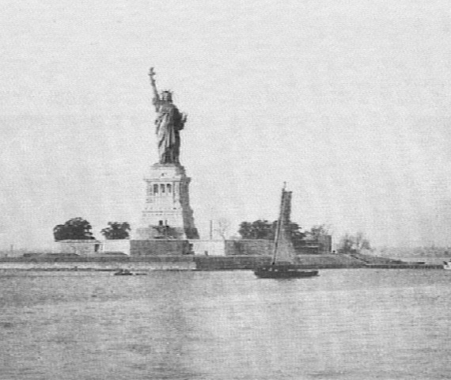
IMMIGRATION: An American Tradition
'Give me your tired, your poor, your huddled masses yearning to be free”.'
NEW IMMIGRATION: (1890-1914)
From: Eastern Europe/ Asia (Poland, Italy, Russia, China)
Ethnicity: Diverse language, religion, culture
Treatment: Met with discrimination

Slide 5
PUSH AND PULL FACTORS:
PUSH (why they left):
PULL (why they came here):
What causes people to leave their home countries?
When people leave their home country, why do they come to America?

Slide 6
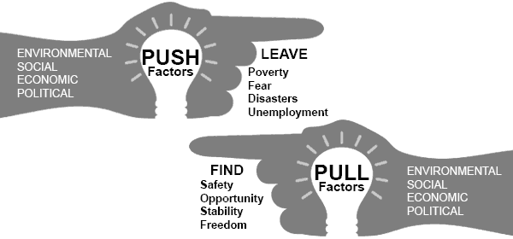
PUSH AND PULL FACTORS:
PUSH (why they left):
PULL (why they came here):

Slide 7
Immigration:
Free Write:
How does America benefit from immigration?
What are the drawbacks of immigration?

Slide 8
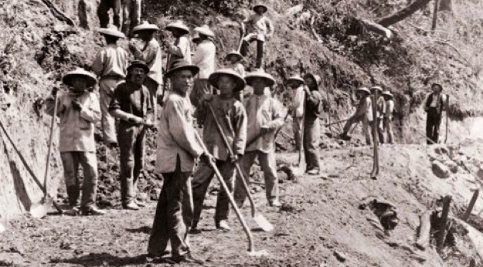
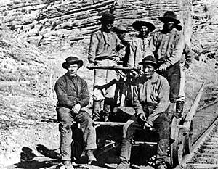
AMERICAN REACTION:
BENEFITS OF IMMIGRATION:
Economic Growth
Cheap labor, hard work
Cultural diversity

Slide 9
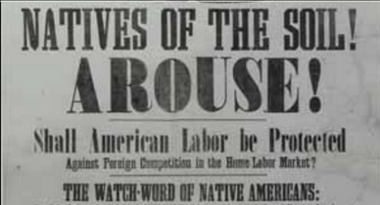
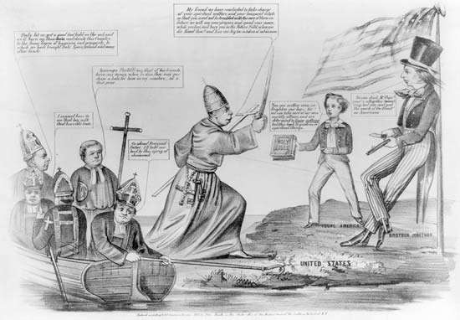
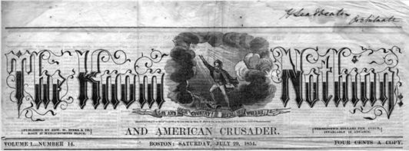
AMERICAN REACTION:
AMERICAN REACTION:
Xenophobia: hatred and fear of foreigners
Nativism: policy of keeping society homogenous (same)
Chinese Exclusion Act of 1882: ban Chinese immigration

Slide 10
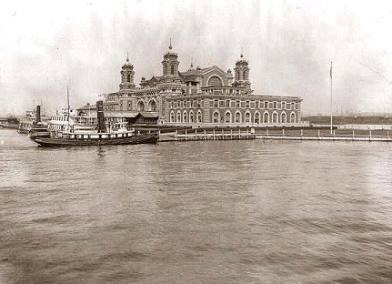
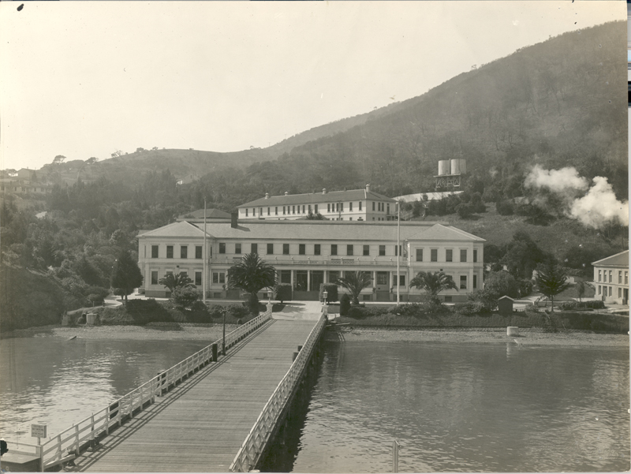
COMING TO AMERICA:
The Journey…..
6-14 day trip on a crowded ship
ELLIS ISLAND and ANGEL ISLAND (the arrival)…..

Slide 11
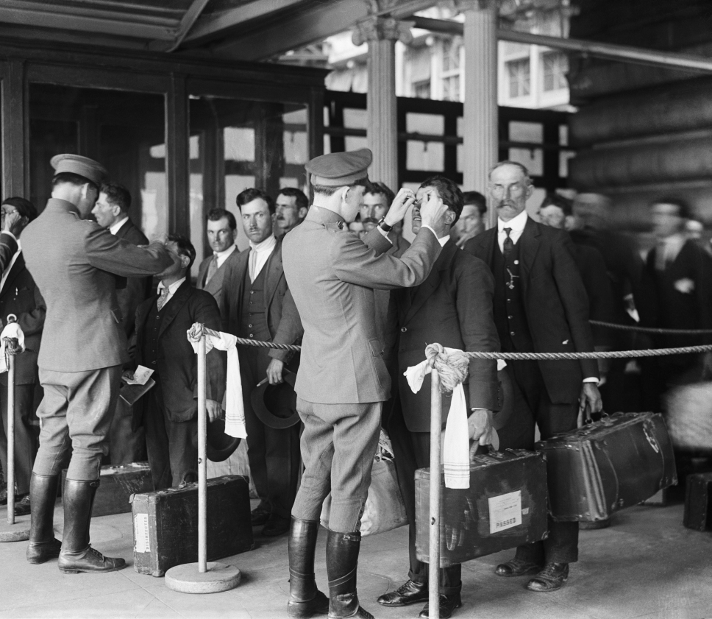
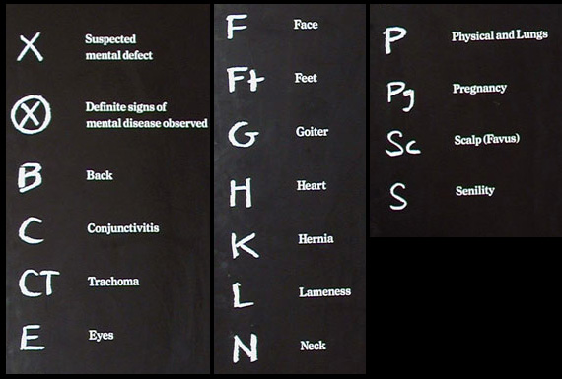
COMING TO AMERICA:
ELLIS ISLAND and ANGEL ISLAND (the arrival)…..
Examined and questioned (interrogated)
Eyes, ears, body, mental ability, criminal records
Sick, disabled, or the crippled- sent back
Preference to “Old Immigrants”

Slide 12
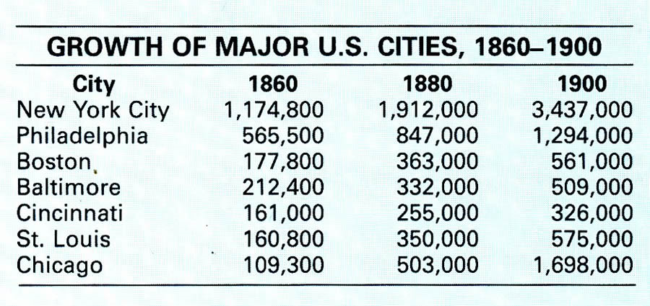

Slide 14
This phrase describes how America welcomes and treats immigrants, 'Give me your tired, your poor, your huddled masses yearning to be free”.'

Slide 15
America is a “melting pot” of different cultures. We value and celebrate cultural difference in America.

Slide 16
America is still plagued by Xenophobia and Nativism

Slide 17
Immigrants threaten national security and domestic tranquility.

