Slide 1
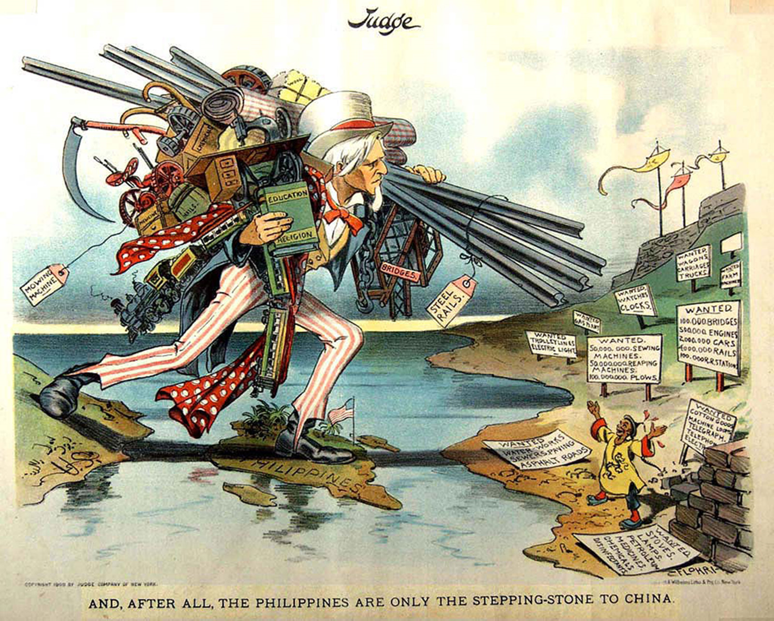
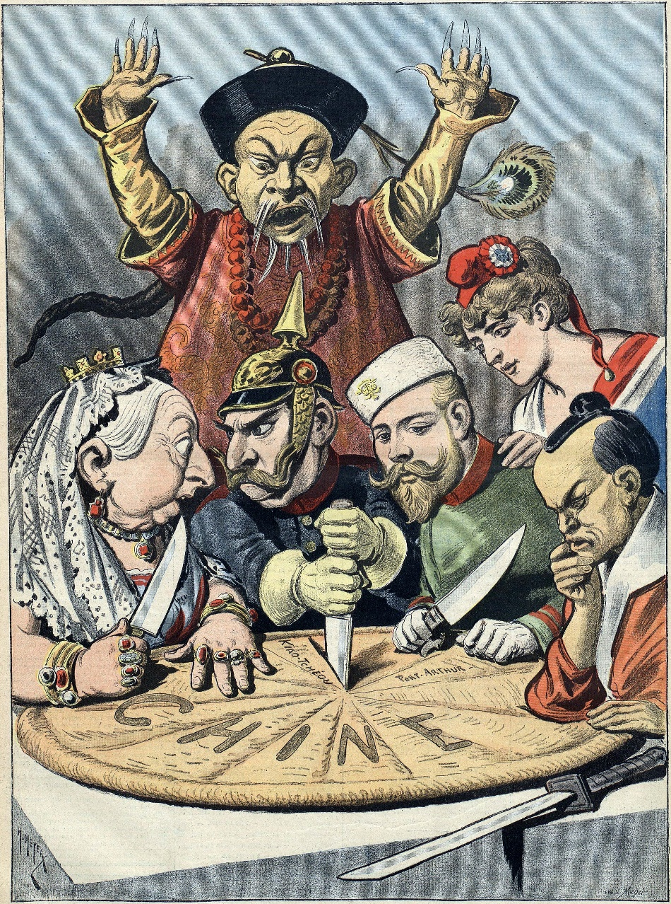
Starter: Review

Slide 2
Starter: Grade check up
If you have a phone available, log onto your skyward.
What is your score on last week’s test?
Are you going to retake the test? If so, when?
Do you have any missing assignments from the last unit? If so, list your missing assignments and collect the work you are missing from the files in the back of the classroom.
What is your current grade in this class? Are you satisfied with this grade.

Slide 3
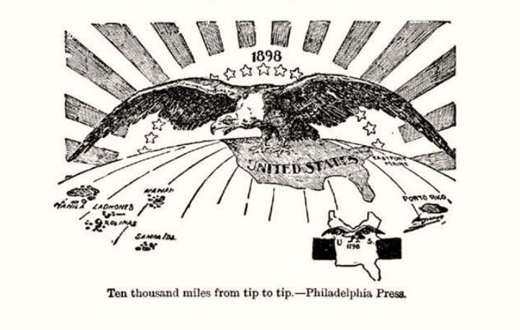
American Imperialism

Slide 4
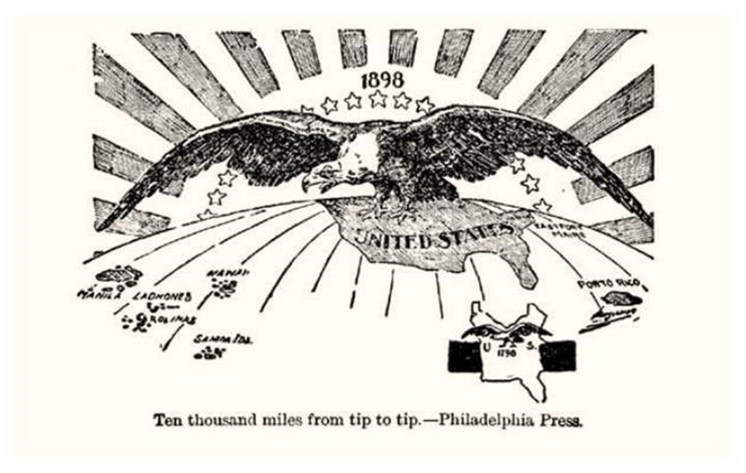
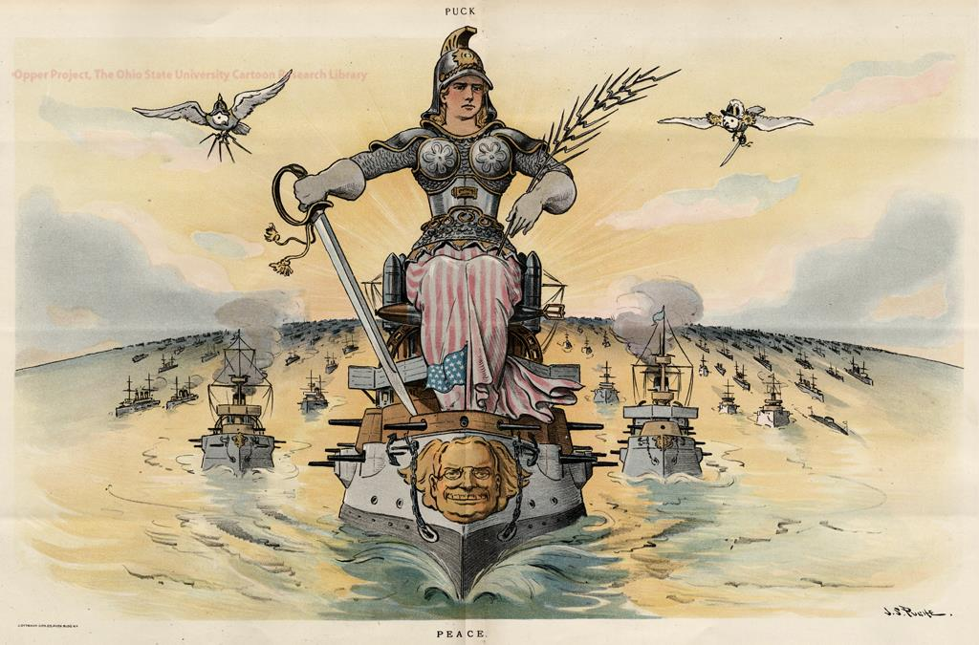
IMPERIALISM:
Strong nation gains control over and dominates foreign weaker nation.
“We can run your country better than you can.”
Economic, political, and cultural effects.

Slide 5
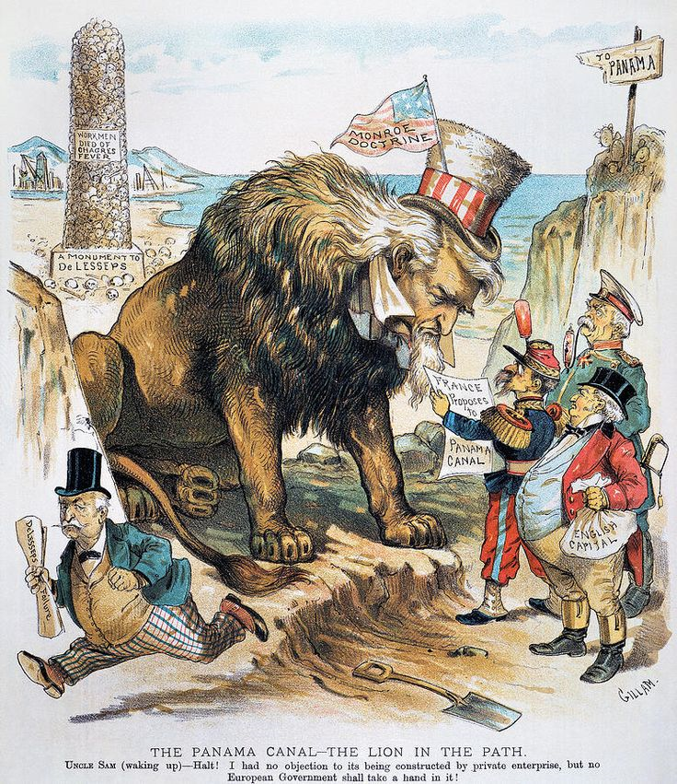
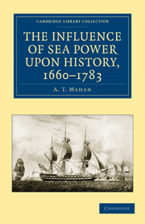
AMERICAN IMPERIALISM: God, Glory, and Gold
WHY?
Expansion Mentality (manifest destiny)
National Pride
Alfred Mahan's Influence of Sea Power Upon History-
Powerful navy and overseas colonies create powerful nation, very influential

Slide 6
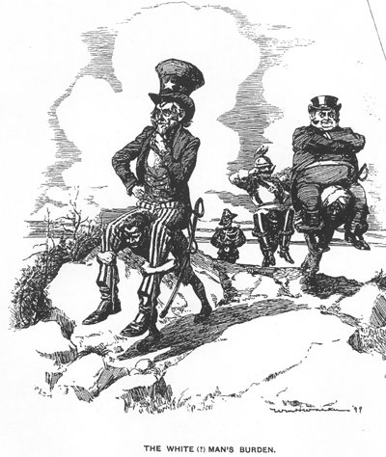
AMERICAN IMPERIALISM: God, Glory, and Gold
WHY?
Social Darwinism:
White people (Americans) are innately superior
‘White Man’s Burden”- to spread Christianity and culture
It is our right and duty to dominate and spread our culture. “Survival of the fittest”
Economic benefits
Open markets (Pacific), places to sell our products
Raw materials

Slide 7
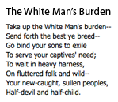
AMERICAN IMPERIALISM: God, Glory, and Gold
According to this poem, what is the White Man’s Burden?

Slide 8
AMERICAN IMPERIALISM: God, Glory, and Gold
What is the message of the “White man’s Burden” cartoon?

Slide 9
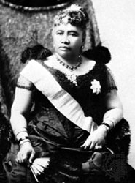
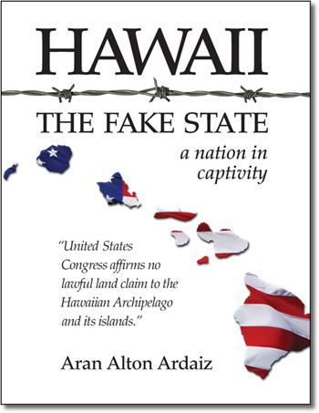
HAWAII: early Imperialism
WHY HAWAII?
Sugar Trade: American planters cashing in
Want to annex Hawaii to avoid Tariffs
American Rebellion:
Queen Liliuokalani Opposes Foreigners
American planters ( with Marine support) rebel and overthrow Queen Liliuokalani
President Cleveland ashamed of actions
Official annexation delayed until Spanish-American War (1898) Naval base and coaling station to fight in the Philippines

Slide 10
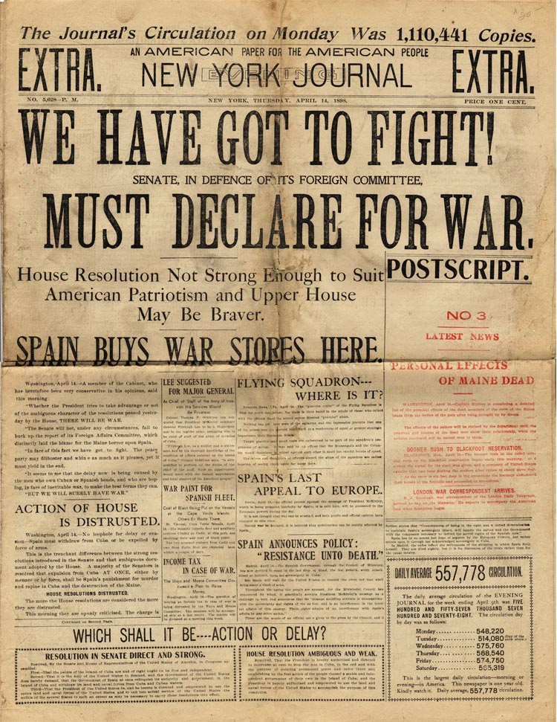
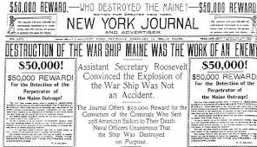
YELLOW JOURNALISM:
embellish and stretch stories to influence public opinion and sell newspapers
William Randolph Hearst New York Journal
Joseph Pulitzer New York World
“YOU FURNISH THE PICTURES AND I WILL FURNISH THE WAR.”
HEARST

Slide 11
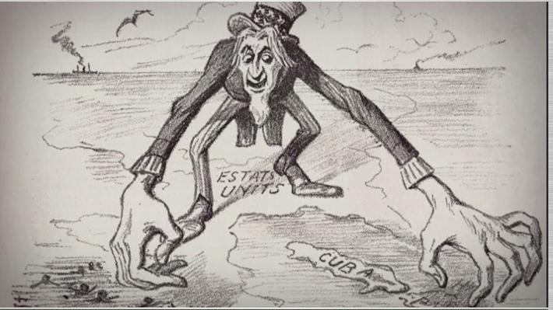
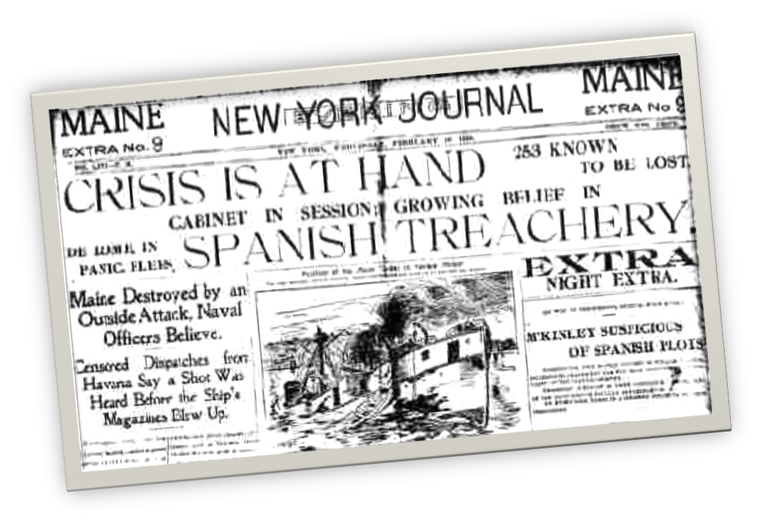
SPANISH AMERICA WAR- “Splendid Little War”
When? 1898
Where? Cuba and Philippines
Why? Imperialism
U.S. supports the Cuban people in rebellion
U.S. economic interest (sugar)
The sinking of the U.S.S. Maine in Havana Harbor
“REMEMBER THE MAINE….”
Was Spain responsible? 1976 report says no
Yellow Journalism

Slide 12
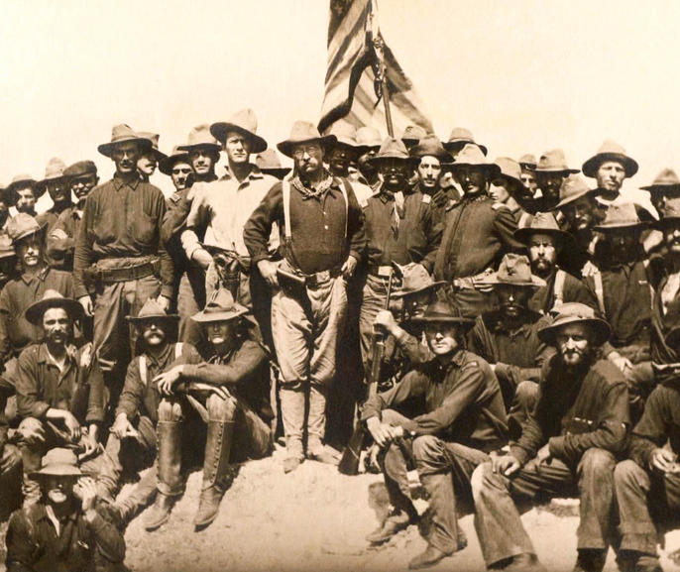
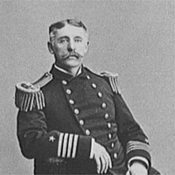
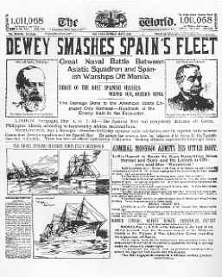
SPANISH AMERICA WAR- “Splendid Little War”
The War:
Cuba: land and sea victory (Rough Riders)
Philippines: Commodore Dewey in Manila Bay
Americans and Filipinos defeat Spanish
Spain gives up Guam and Puerto Rico
Platt Amendment (1902);
Cuban independence, sort of….
Cant make own treaties
Allow U.S. intervention
US control of Cuban market
Land for Naval bases (Guantanamo Bay)

