Slide 1
Starter:
“If a Western Rip Van Winkle had fallen asleep in 1869 and awakened in 1896, he would not have recognized the lands that the railroads had touched. Bison had yielded to cattle; mountains had been blasted and bored. Great swaths of land that had once whispered grass now screamed corn and wheat. Nation-states had conquered Indian peoples, slaughtering some of them and confining and controlling most of them. Population had increased across much of this vast region, and there were growing cities along its edges. A land that had once run largely north-south now ran east-west. Each change could have been traced back to the railroads.” – Richard White,
The author describes how the railroad altered society in a drastic manner. Is there any technology/inventions in your lifetime that have had a similar effect? Identify and describe forms of technology that have altered your life.

Slide 2
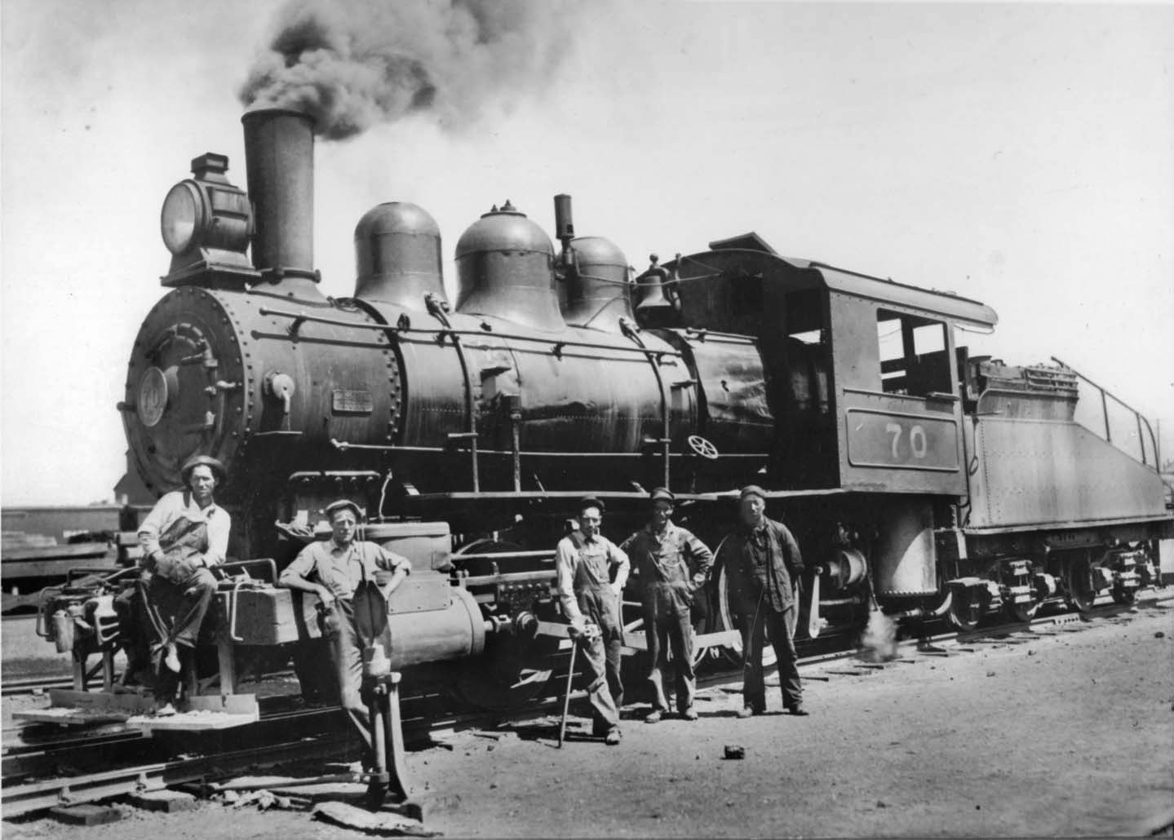
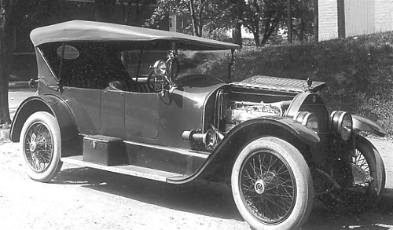
INDUSTRIAL REVOLUTION

Slide 3
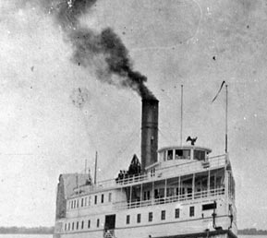
INDUSTRIAL REVOLUTION:
Technology and invention change America
First Industrial Revolution: early and mid 1800’s
Methods: Factory (textile factory)
Materials: Iron
Power: Steam (transportation)
Robert Fulton invents the Steamboat
Railroad

Slide 4
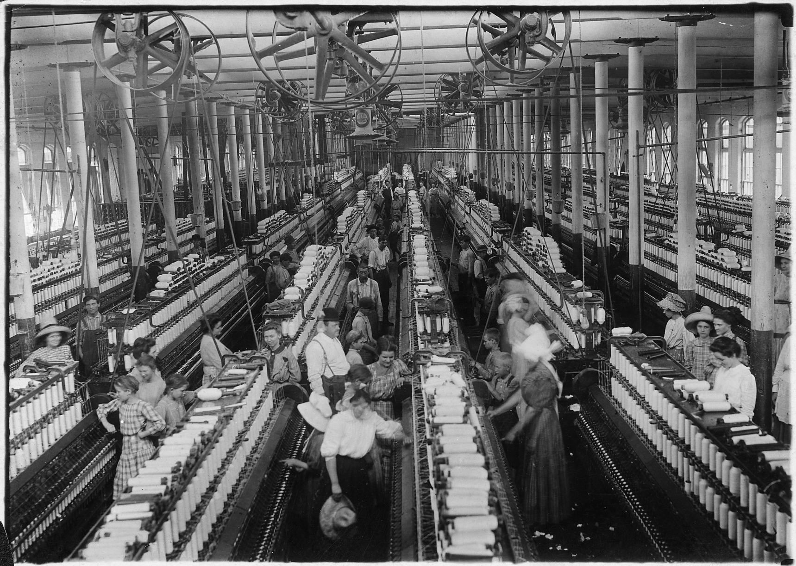
What is the benefit of producing a product in a factory?

Slide 5
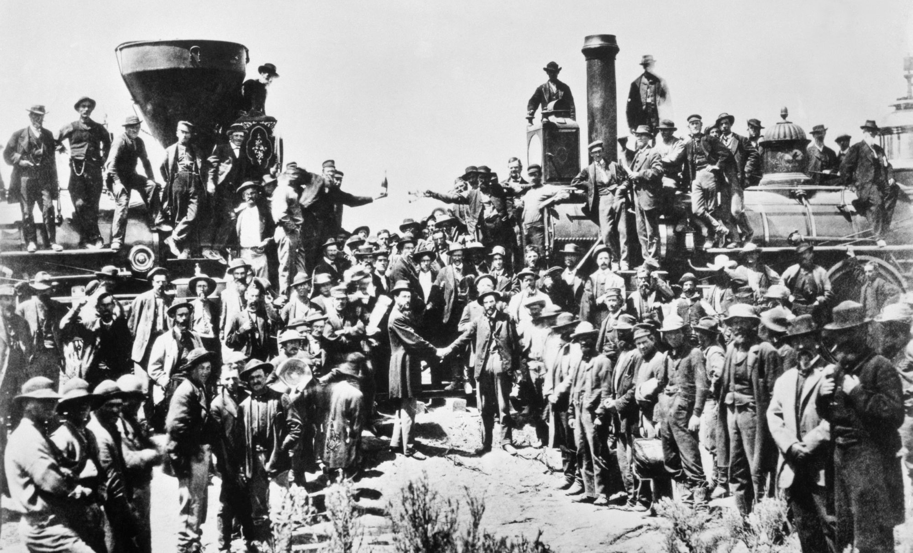
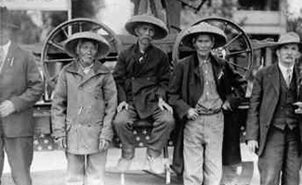
Railroad: Transportation Revolution
Transcontinental Railroad:
Union Pacific (Omaha)
Chinese and Irish immigrants
Central Pacific (Sacramento)
Chinese
Promontory Summit May 10th 1869
Connect America- people, tech, trade

Slide 6
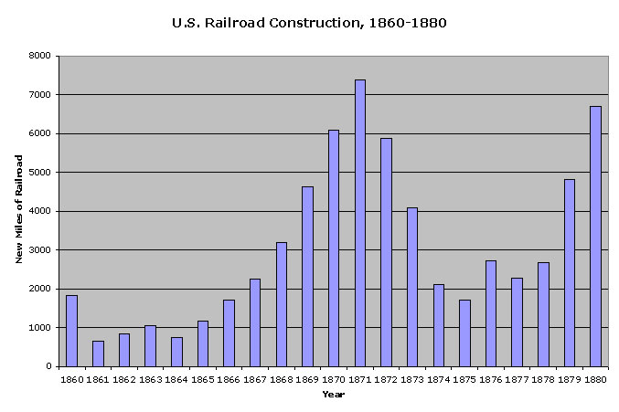
Why was their decrease in railroad construction between 1860 and 1865?

Slide 8
Free Write: Pen to paper for 90 seconds
American ingenuity (creativity in design and invention) is a quality we celebrate in this country. Why are Americans more creative and inventive than other cultures?

Slide 9
List as many examples of American ingenuity (inventions) as you can think of?

Slide 10
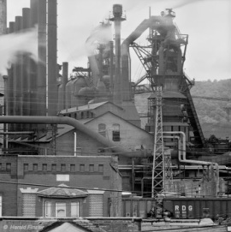
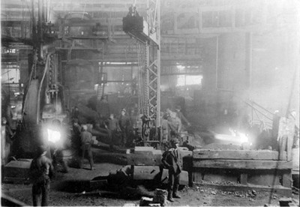
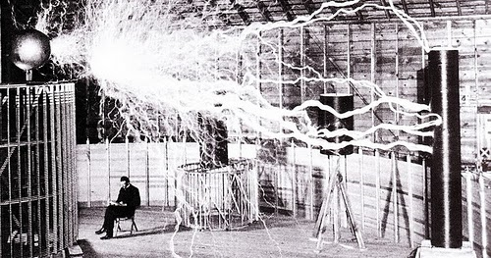
INDUSTRIAL REVOLUTION:
Technology and invention change America
Second Industrial Revolution (1870-1917)- 4 Major Industries:
R- RAILROADS
O- OIL
S- STEEL
E- ELECTRICITY

Slide 11
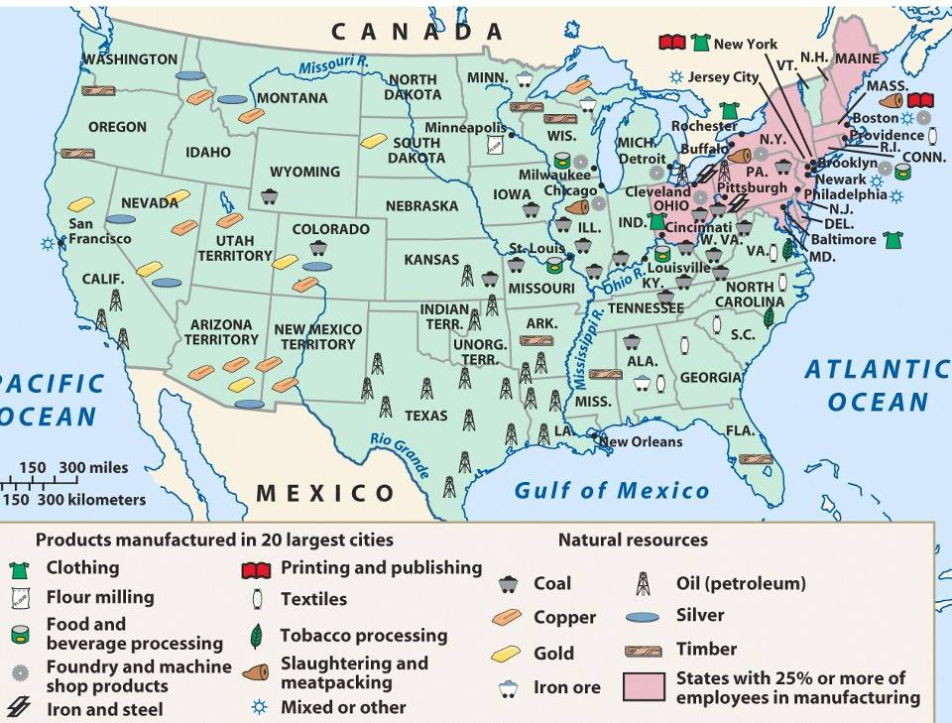

Slide 12
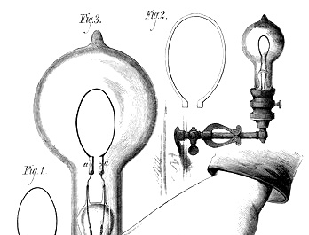
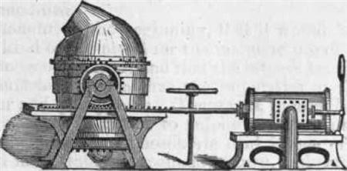
INDUSTRIAL REVOLUTION:
Technology and invention change America
Second Industrial Revolution (1870-1917) Bigger, stronger, faster
Methods: Scientific Management and Assembly Line
Materials: Steel
Bessemer Process: convert iron to steel cheaply and efficiently
Power: Electricity and Internal Combustion Engine

