Slide 1
Starter: Match the term to the definition
Monopoly
Capitalism
Vertical Integration
Horizontal Integration
complete ownership or control of the entire supply of goods or services in a certain market.
one company owns two or more steps on the production path or supply chain
Economic system with private ownership in the free market.
Ownership of several companies that make the same product.

Slide 2
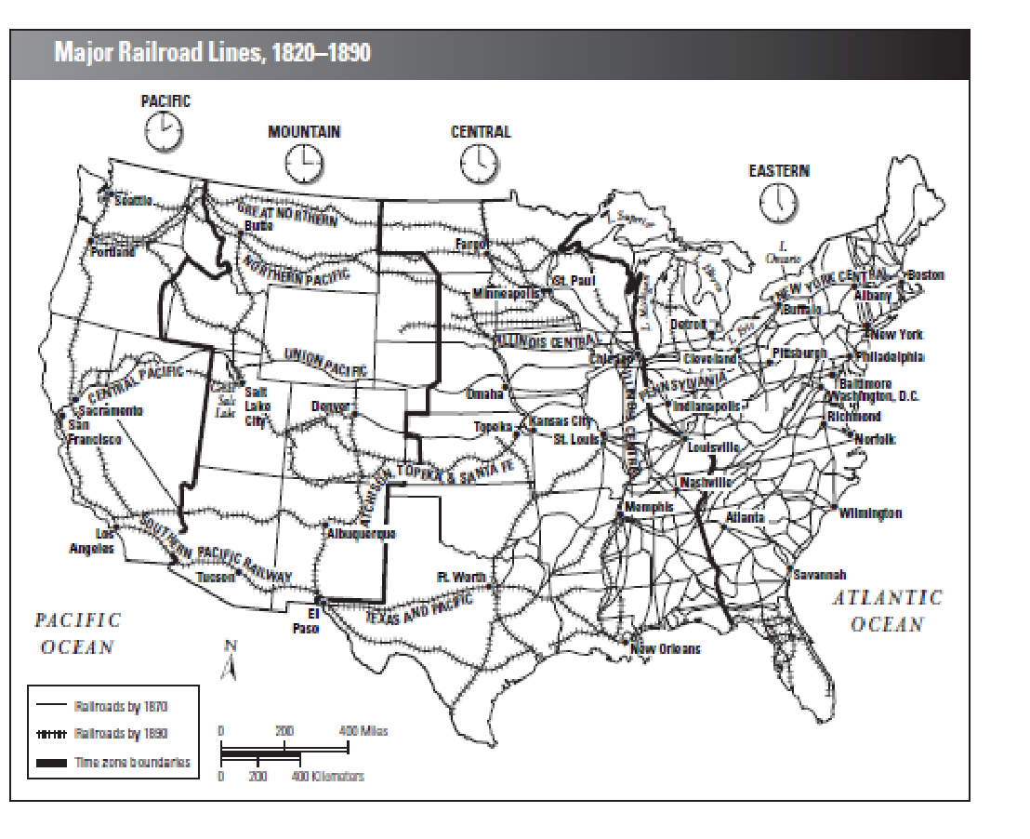
Starter:
Where did most U.S. railroads exist in 1870? Why?
Which two railroads were the first to connect the East Coast and the West Coast?
Time zones were adopted by railroads in 1883. How does the map help explain why this happened when it did?
On which haul would a farmer probably receive the best price, Fort Worth to El Paso, or Fort Worth to Memphis? Why?

Slide 3
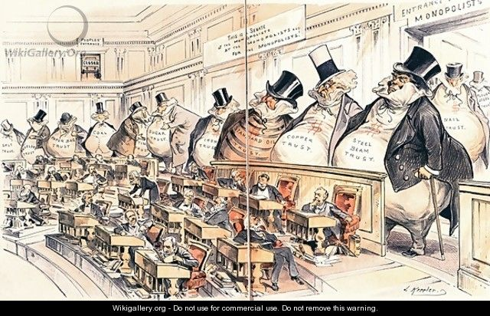
Living and Working Conditions in the Gilded Age

Slide 4
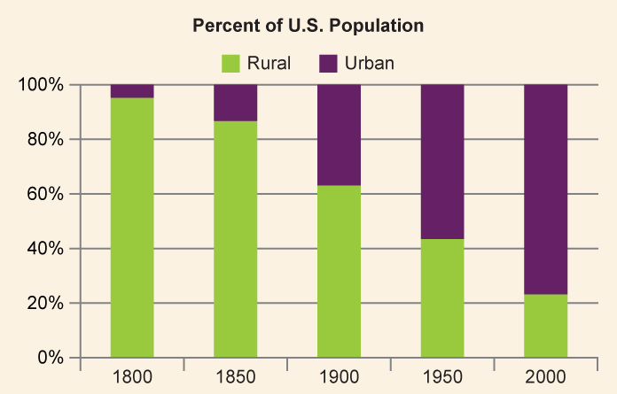
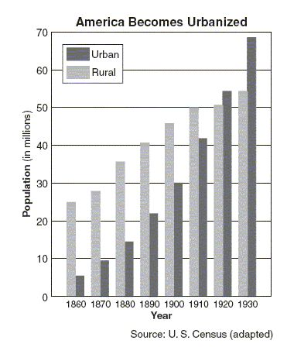
Describe the trend in this graph

Slide 5
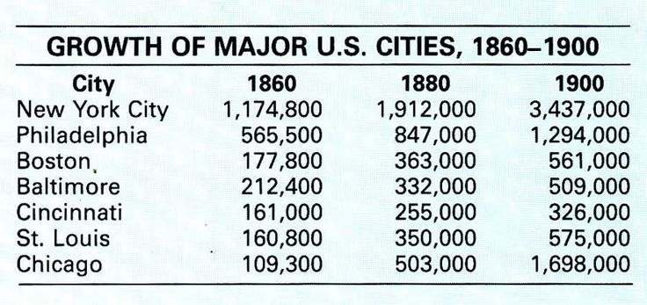
Describe the trend in this graph

Slide 6
URBANIZATION: farms to the factories
“All the fresh air that enters these stairs comes from the hall-door that is forever slamming… . The sinks are in the hallway, that all tenants may have access — and all be poisoned alike by the summer stenches… . Here is a door. Listen! That slow, hacking cough, that tiny helpless wail — what do they mean? The child is dying of measles..”
1900= 10 million farmers, 18 million others
1920=10 million farmers, 30 million others
Overcrowded cities- (immigrants)
3 cities with million + people
NY 2nd biggest city in world
Tenement housing:
Overcrowded
Unsanitary
Run down

Slide 7
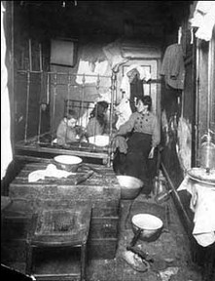
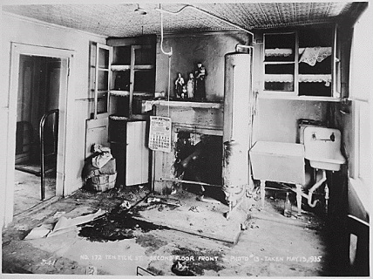
TENEMENT HOUSING:
“All the fresh air that enters these stairs comes from the hall-door that is forever slamming… . The sinks are in the hallway, that all tenants may have access — and all be poisoned alike by the summer stenches… . Here is a door. Listen! That slow, hacking cough, that tiny helpless wail — what do they mean? The child is dying of measles..”

Slide 8
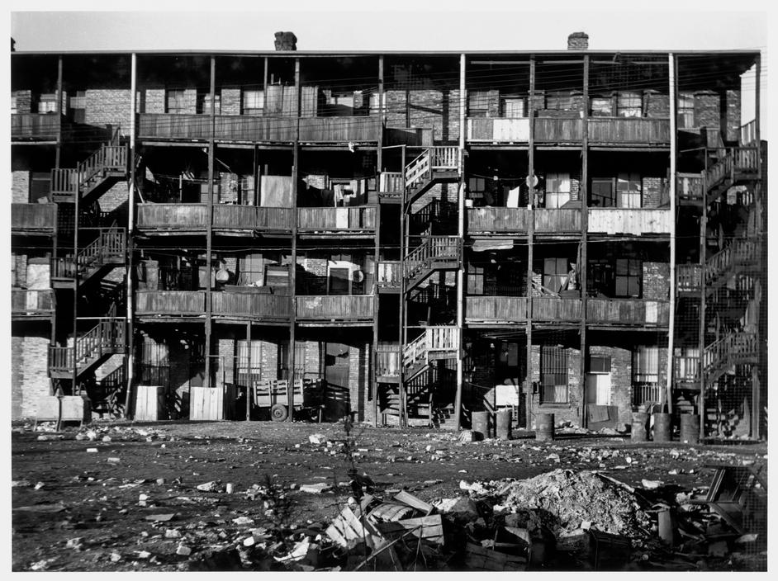
TENEMENT HOUSING:
A message came one day last spring summoning me to a Mott Street tenement in which lay a child dying from some unknown disease. With the 'charity doctor' I found the patient on the top floor stretched upon two chairs in a dreadfully stifling room. She was gasping in the agony of peritonitis that had already written its death-sentence on her wan and pinched face. A glance around the wretched room left no doubt as to the cause of the child's condition. 'Improper nourishment', said the doctor, which, translated to suit the place, meant starvation.

Slide 9
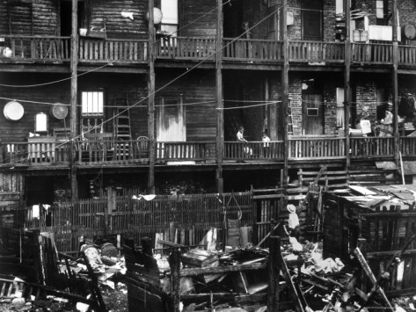
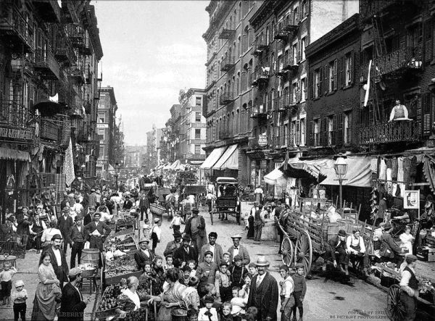
TENEMENT HOUSING:

Slide 10
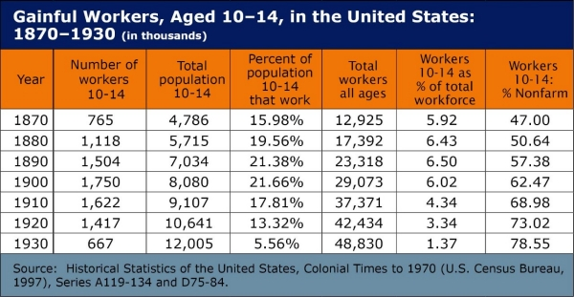
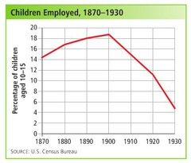
Working Conditions:
What problem of the Gilded Age are revealed in these charts

Slide 11
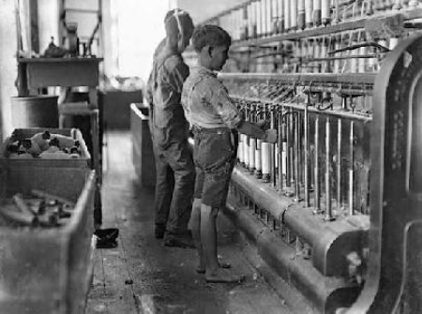
Working Conditions:
Describe the two boys in the picture
Describe conditions of the factory.

Slide 12
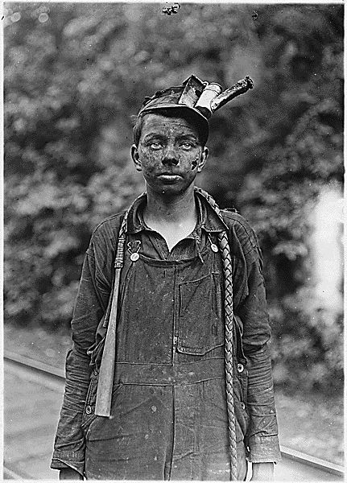
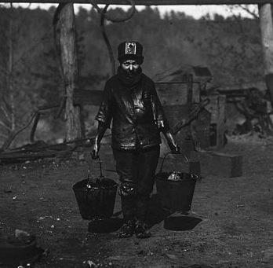
Working Conditions:
Describe conditions in industry?

Slide 13
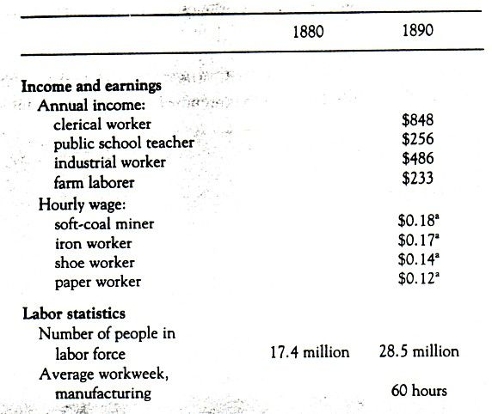
Working Conditions:
What problems of the Gilded Age are revealed in this data set?

Slide 14
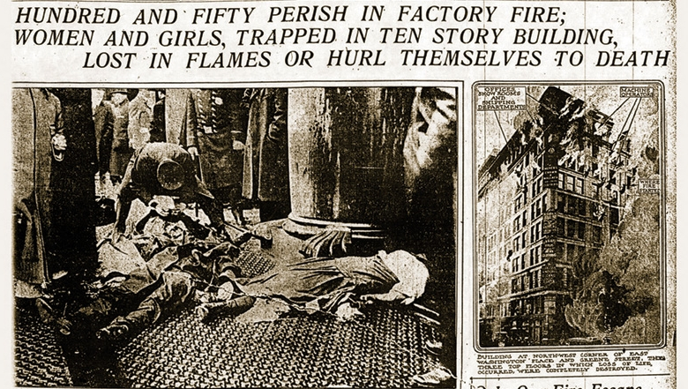
PROBLEMS FOR WORKERS:
WORKER ABUSES: “Wage Slaves”
Underpaid
Over worked
12 hours a day, 6 days a week
Child labor
Unsafe conditions
Pittsburgh 1906-1907: 195 deaths
Example: Triangle Shirtwaist Factory Fire

