Slide 1
Starter 1:
What do you consider to be the top 3 problems that America faces today?
What can be done to confront and fix these problems?
What role do normal citizens play in fixing these problems?
What role does the government have in fixing these problems?

Slide 2
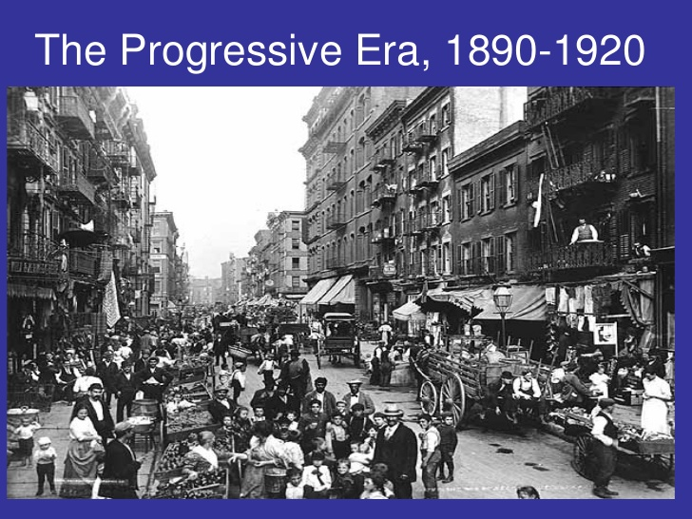
PROGRESSIVE ERA

Slide 3
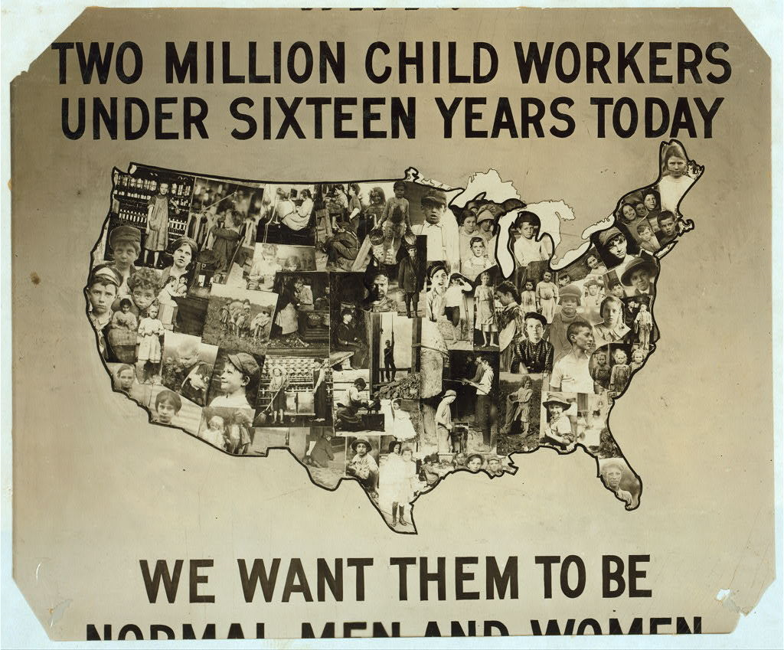
GILDED AGE PROBLEMS- REVIEW!!!!
Business success and massive economic growth at the expense of the working man (and woman)
Population growth and urbanization creates overcrowded and unsanitary living conditions
Political inaction and corruption hurts the American people

Slide 4
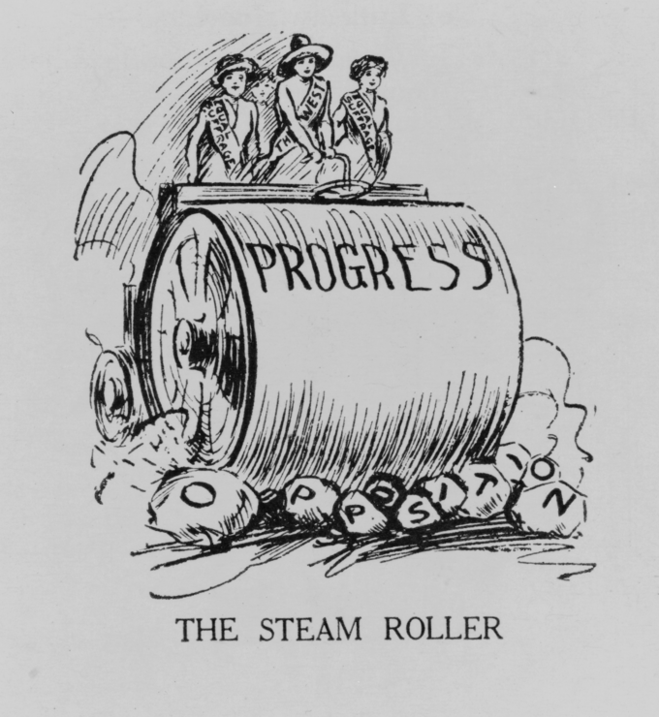
PROGRESSIVISM: Social Movement
Reform America to make it better
“Activism”: action and intervention
Want an active and responsive government
Roots in Christian groups, populists, and women’s clubs.
Various Causes: Social, political, moral vice
Poverty, violence, corruption, greed, etc.

Slide 5
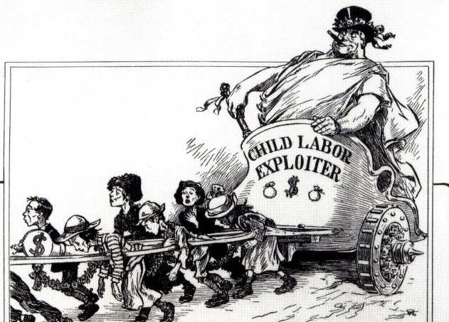
MUCKRAKERS: reveal the MUCK
Expose problems through investigative journalism
Cartoons
Articles
Books
Photographs

Slide 6
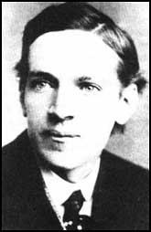
Upton Sinclair
He wrote The Jungle in 1906
He used writing to:
Expose working conditions, the
exploitation of immigrant workers and the unsanitary
conditions in Chicago’s Meat Packing Industry
Meat Inspection Act (1906)
Pure Food & Drug Act (1906

Slide 7
Ida Tarbell
She wrote The History of the Standard Oil Company (1904)
She used writing to:
Expose unfair business practices such as “rebates” used by Rockefeller’s Oil Trust to put small companies out of business
Lead to passage of more Anti-Trust Legislation
Hepburn Act (1906)
Mann-Elkins Act (1910)
Clayton Anti-Trust Act (1914)

Slide 8
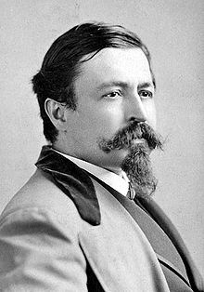
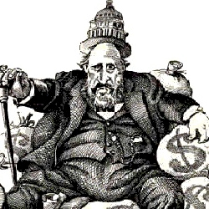
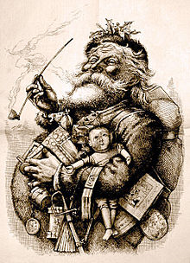
Thomas Nast takes down Boss Tweed
Thomas Nast:
“The Father of the American Cartoon”
Uses cartoons to expose and take down Boss Tweed.

Slide 9
Lincoln Steffens
He wrote The Shame of the Cities (1904)
He used writing to:
Expose the corruption of political machines
Draw attention to the need for electoral reform… many states adopted secret ballots, initiative, referendum, and recall measures

Slide 10
Jacob Riis
He wrote How the Other Half Lives (1890)
He used photography to: expose the horrific, overcrowded living conditions in New York City tenement houses

Slide 11
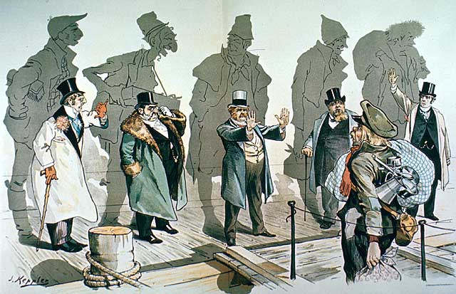
B: Background (Immigration Cartoon printed in the NY Times in the early 1900s.
A: Argument. (What does the author want me to think?)
S: Symbols
I: Indicators and Text
C: Caricature (look for stereotypes and exaggerations)

Slide 12
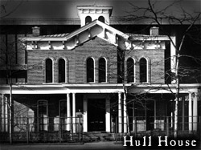
SETTLEMENT HOUSES:
“WHAT AFTER ALL HAS MAINTAINED THE HUMAN RACE ON THIS OLD GLOBE DESPITE ALL THE CALAMITIES OF NATURE AND ALL THE TRAGIC FAILINGS OF MANKIND, IF NOT FAITH IN NEW POSSIBILITIES AND THE COURAGE TO ADVOCATE FOR THEM”
Assistance for Immigrants: variety of services
Child care
Education
Activities
Make transition easier
Jane Addams: Hull House of Chicago
Most famous settlement house
Influenced women across nation to open similar homes.
Social worker, activist, and champion for peace

