Slide 1
Quiz:
Match the individual to their description, work, or contribution
Lincoln Steffens
Jacob Riis
Upton Sinclair
Ida Tarbell
Jane Addams
The Jungle
Hull House
C. How the Other Half Lives
D. History of Standard Oil
E. The Shame of the Cities
6. What was the goal of Progressives?
7. Investigative journalists (writers, photographers, cartoonists) who exposed America’s problems with their works were known as _________________________.
8. When is the next Test?

Slide 2
PROGRESSIVE PRESIDENTS

Slide 3
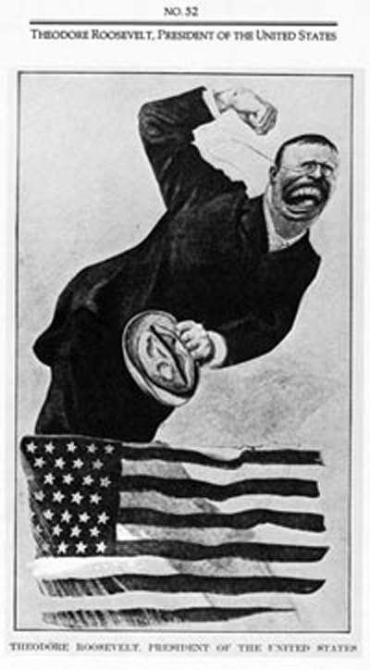
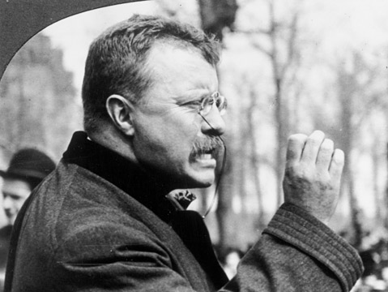
PROGRESSIVE PRESIDENTS:
“….the bride at every wedding and the corpse at every funeral.”
THEODORE ROOSEVELT:
War hero (Rough Riders), Politics (Governor), Navy
Assumes Presidency after assassination of McKinley
Youngest President to ever take office (42), perhaps the most energetic.
“Bully Pulpit”
Active government that protects people from business
President is the center of US government.

Slide 4
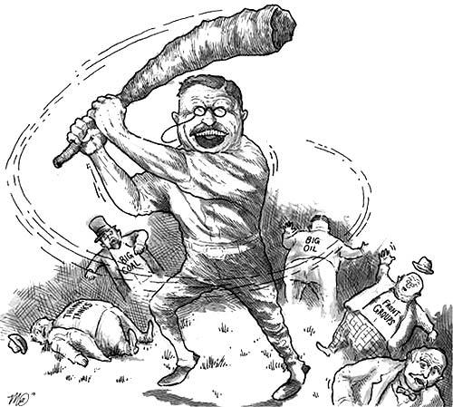
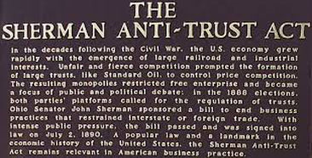
PROGRESSIVE PRESIDENTS:
ROOSEVELT’S SQUARE DEAL
“Trust Buster”- Break apart monopolies
Sherman Anti-Trust Act(1890)- stop trusts “in restraint of trade” (monopolies)
Roosevelt actually enforces and uses the Law
Goes after the “bad” trusts, leaves the “good” trusts alone.

Slide 5
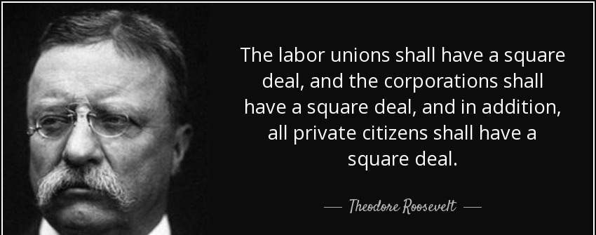
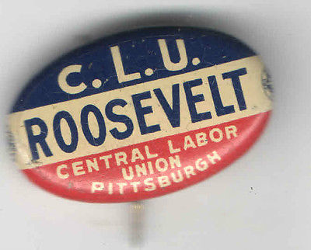
PROGRESSIVE PRESIDENTS:
ROOSEVELT’S SQUARE DEAL
ROOSEVELT FOR LABOR-
Supported labor over business
Arbitrated strike between mine workers and mine owners.
Compromise was reached; Mine workers more money and less hours
A WIN FOR LABOR! HURRAY FOR TEDDY!

Slide 6
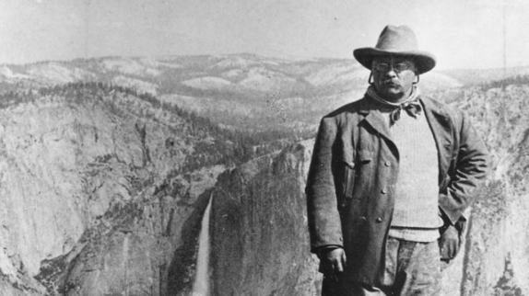
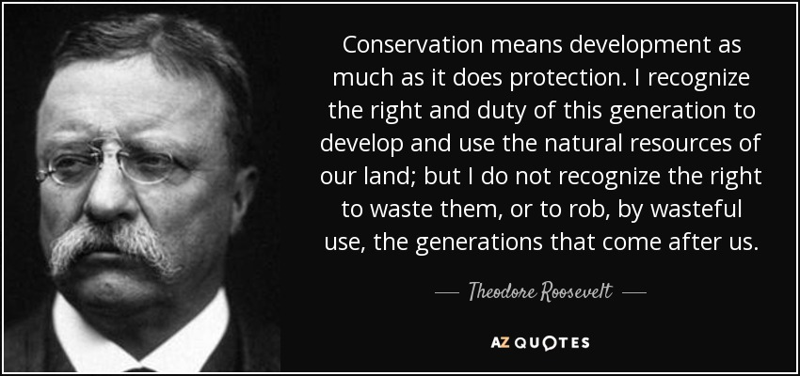
PROGRESSIVE PRESIDENTS:
ROOSEVELT’S SQUARE DEAL
Conservation:
Protect our environment
Conserve natural treasures
National Forests and Wildlife Preserves

Slide 7
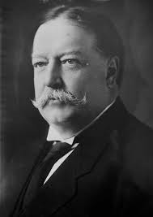
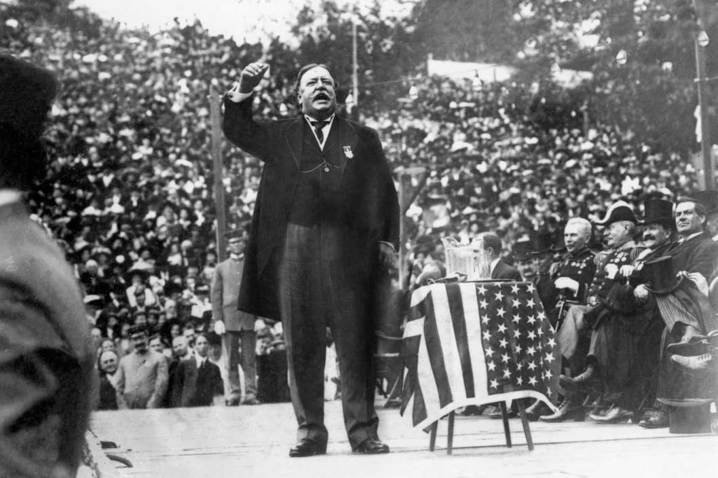
PROGRESSIVE PRESIDENTS:
WILLIAM HOWARD TAFT: (R) 1908
Roosevelt’s chosen successor.
Continues Progressive Agenda
“Trust Buster”
Stands up for labor
Not as popular as Roosevelt

Slide 8
ELECTION OF 1912: Teddy is back
Roosevelt: “Bull Moose” Party
Roosevelt returns, and he want the Republican nomination
Creates his own party
Taft: Republican Party
Taft will not give the Republican nomination up
VS.
Woodrow Wilson: Democrats
Democratic party united behind Wilson

Slide 9
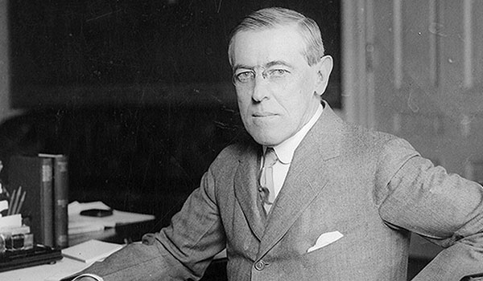
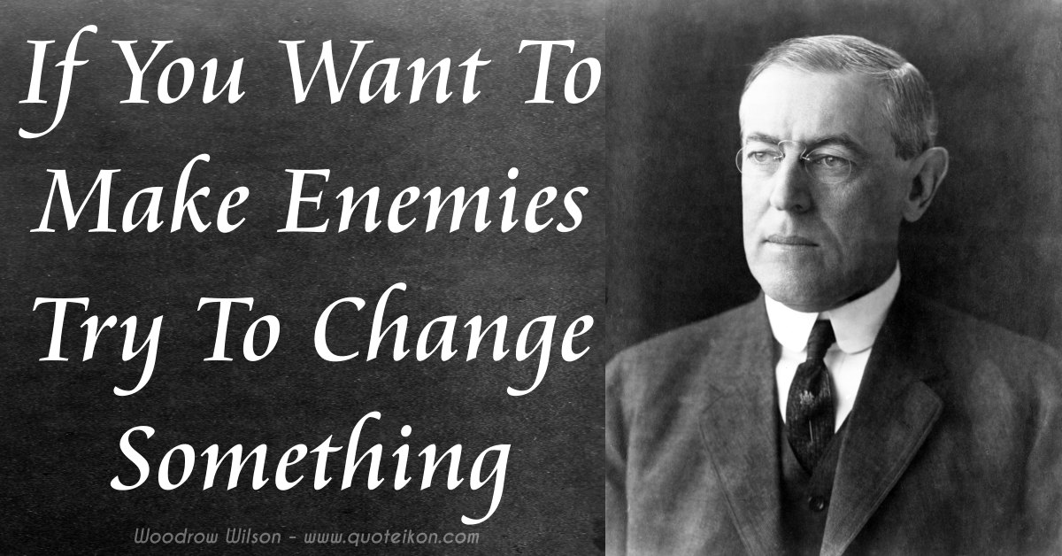
PROGRESSIVE PRESIDENTS:
WOODROW WILSON: Progressive Democrat
“ New Freedom” Regulates business/banks and pushes labor reform
Federal Trade Commission: regulates unfair business practices
Child labor law
8 hour work day for railroad workers.

Slide 10
THANK YOU PROGRESSIVE ERA!
Monopolies forced apart
Northern Securities Company (Morgan) 1907
Standard Oil (Rockefeller) 1911
Beef Monopoly and Bank Monopoly 1907
Food Safety; rules for the preparation and handling of food and medicine
Meat Inspection Act
Pure Food and Drug Act
Wins for labor:
Limited workday for federal employees (8 hours)
Federal Child Labor Law
Support for Families/children:
Children’s Bureau; tackle nation’s social issues for mother and children

Slide 11
THANK YOU PROGRESSIVE ERA!
Political Reform; A Government that Serves the People
Secret Ballot: fair elections, protection from intimidation
16th Amendment: federal income tax
17th Amendment: direct election of senators by the people
Referendum: PEOPLE can vote to overturn law
Recall: PEOPLE can vote to remove official from office
Initiative: PEOPLE can propose legislation
Boss Tweed thrown out of Tammany Hall

