Slide 1
STARTER #2: Answer the question in 3-5 sentences
When is declaring war necessary and appropriate?

Slide 2
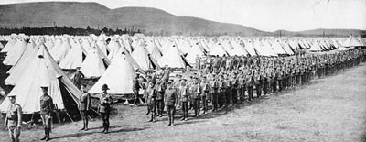
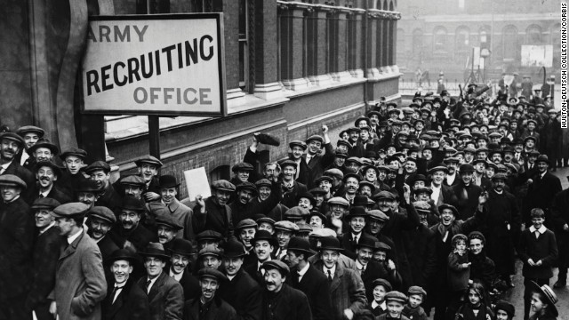
WWI MOBILIZATION

Slide 3
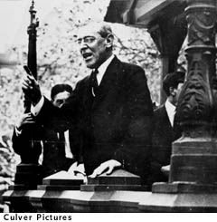
US ENTERS WORLD WAR I
WHY?
Wilson:
“War to end all Wars”
“Make world safe for democracy”
“Freedom of the seas (trade)”
*Still much opposition- “Foreign War” “Over there”

Slide 4
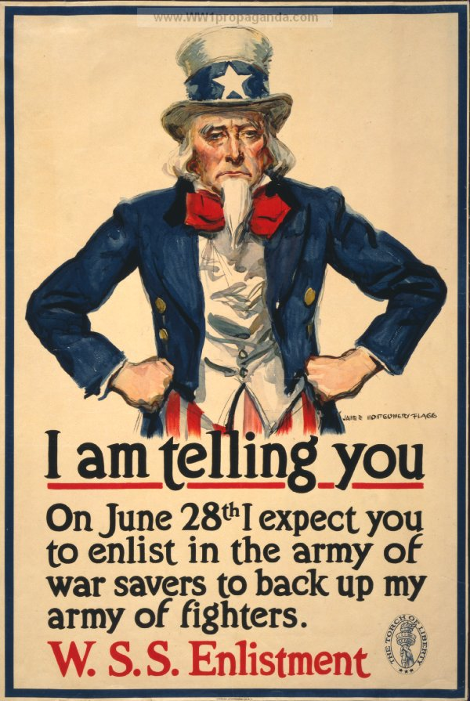
WWI PROPAGANDA: Selling a War to America
Propaganda: spreading ideas and information to influence public opinion.
WHY?
3 Reasons
1. Recruitment: Men for the army (enlistment), people for industry
Donations: raise money (victory bonds) and raise food
Ration: save food and save fuel

Slide 5
WWI PROPAGANDA: Selling a War to America
HOW?
5 THEMES
Dehumanization- the process of making the enemy appear inhuman. Demonization- the process of making the enemy appear evil Masculinity/Femininity- Portrayal of women as frail and needing a man to protect them. Fear- Showing something that caused the target audience to fear the enemies causing the audience to take action. Nationalism: Pride in one's nation and the image of your country being threatened by another cause the target audience to take action.

Slide 6
PROPAGANDA POSTERS:
Easy to duplicate
Put them everywhere

Slide 9
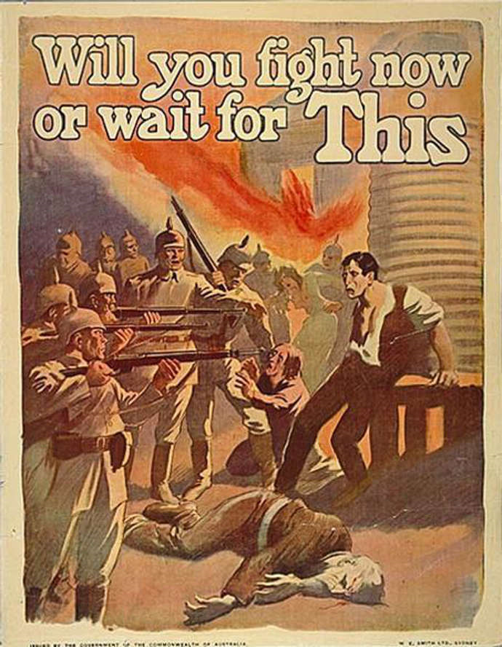

Slide 13
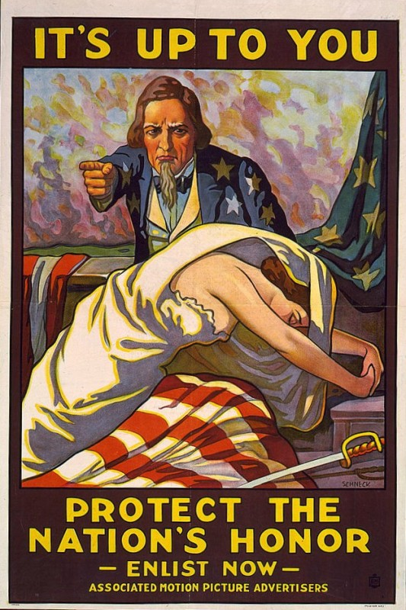

Slide 14
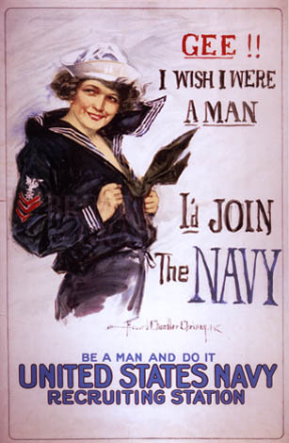

Slide 15
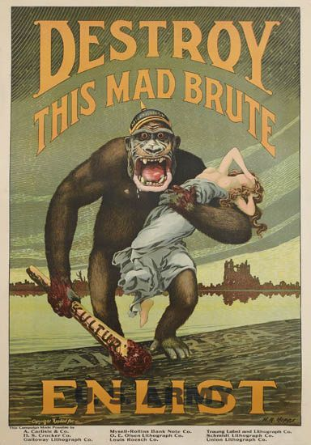

Slide 16
