Slide 1
Battle of the Bulge/Race to Berlin

Slide 2
WWII SUMMER/FALL 1944
West:
Pushing East
Liberate Paris August 25, 1945
East
Pushing West
Conquer Poland

Slide 3
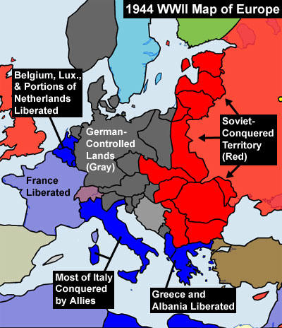
War in 1944

Slide 4
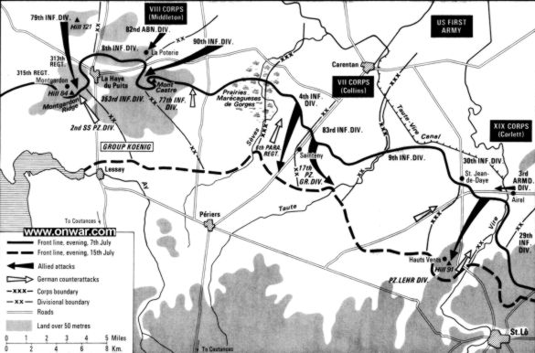
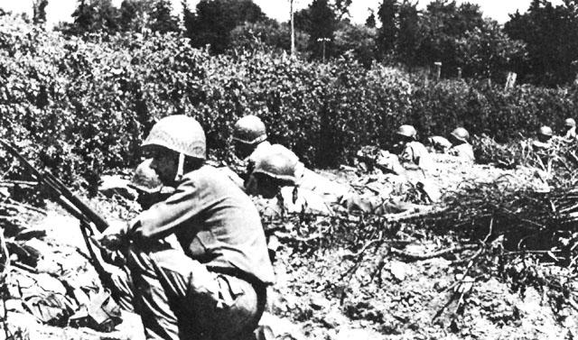
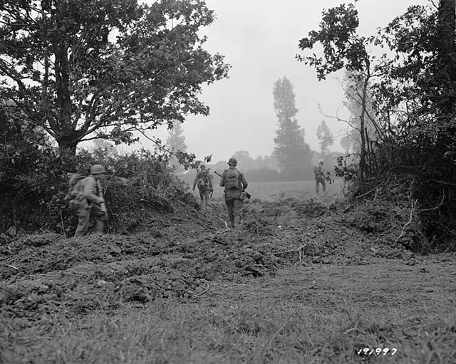
1944: War in the West

Slide 5
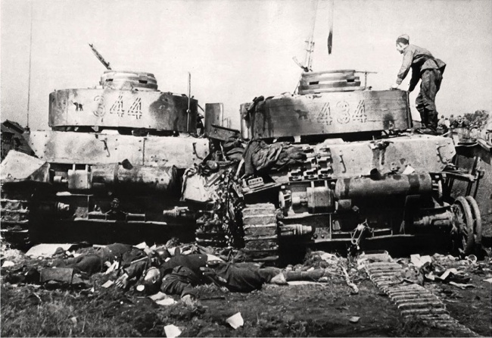
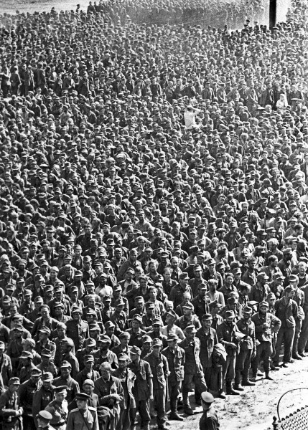
1944: War in the East

Slide 6
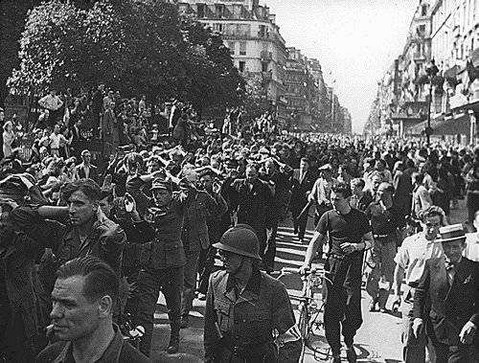
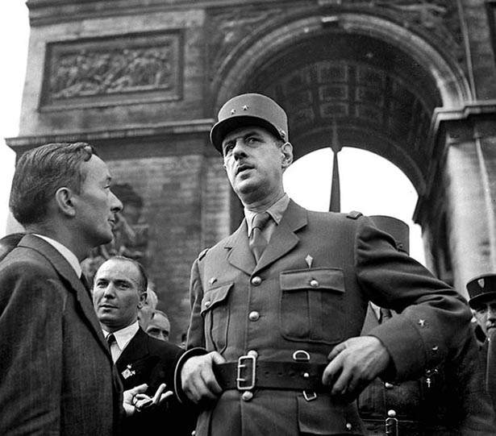
Liberation of Paris
Charles de Gaulle said, “This duty of war, all the men who are here and all those who hear us in France know that it demands national unity. We, who have lived the greatest hours of our History, we have nothing else to wish than to show ourselves, up to the end, worthy of France. Long live France!”

Slide 7
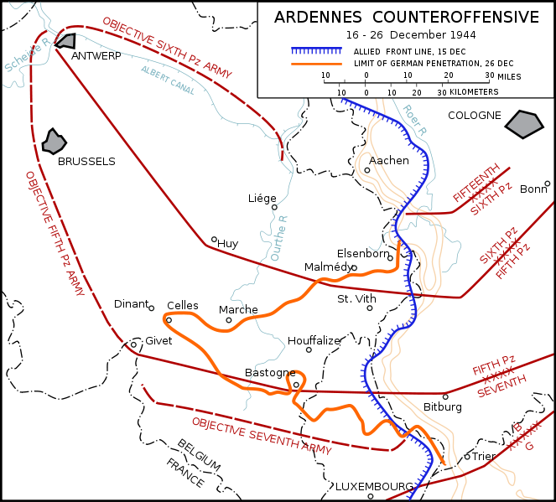
Battle of the Bulge:

Slide 8
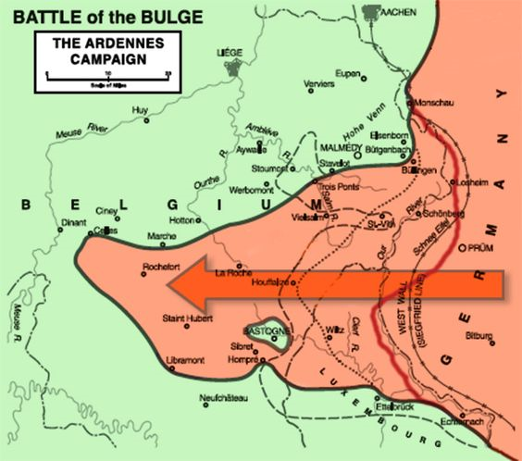
Battle of the Bulge:

Slide 9
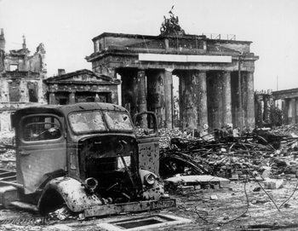
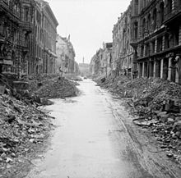
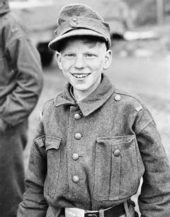
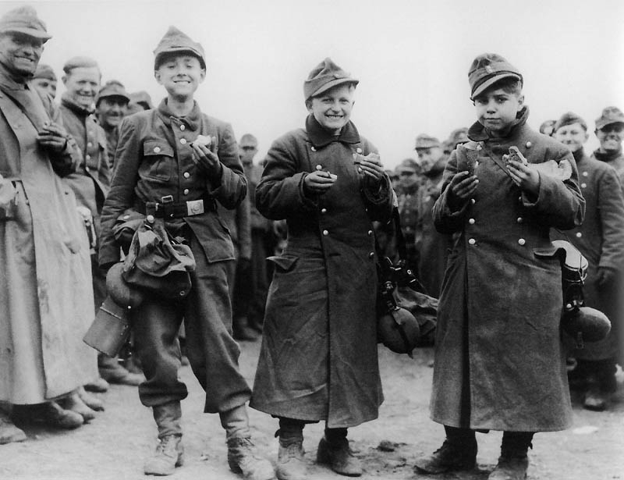
What does these pictures reveal about the state of Germany in 1945?

Slide 10
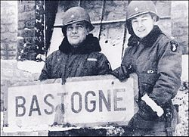
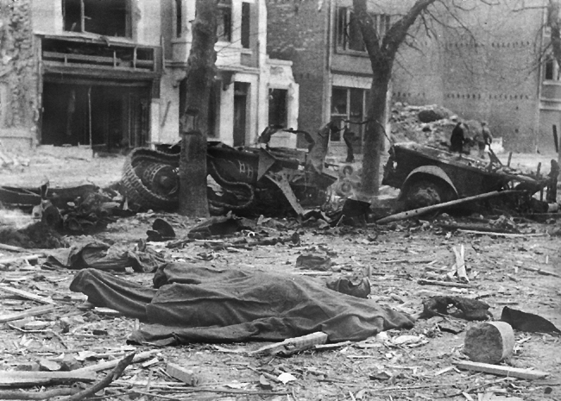
Bastogne, December 20-27th
Brigadier General Anth Brigadier General Anthony McAuliffe. When confronted with a written request from German General Luttwitz for the surrender of Bastogne, his reply was one word: "NUTS!"

Slide 11
Germany 1945
Cities demolished
Industry crippled
Man power running dry

Slide 12
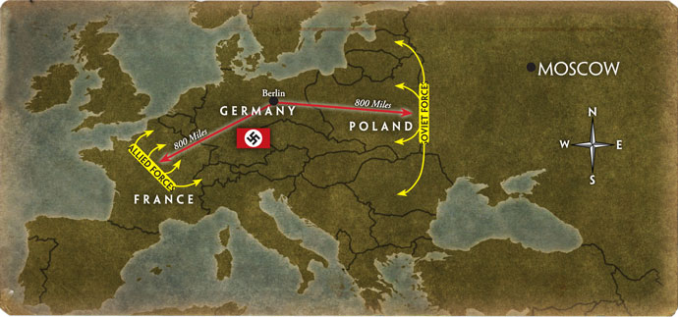
Race to Berlin

Slide 13
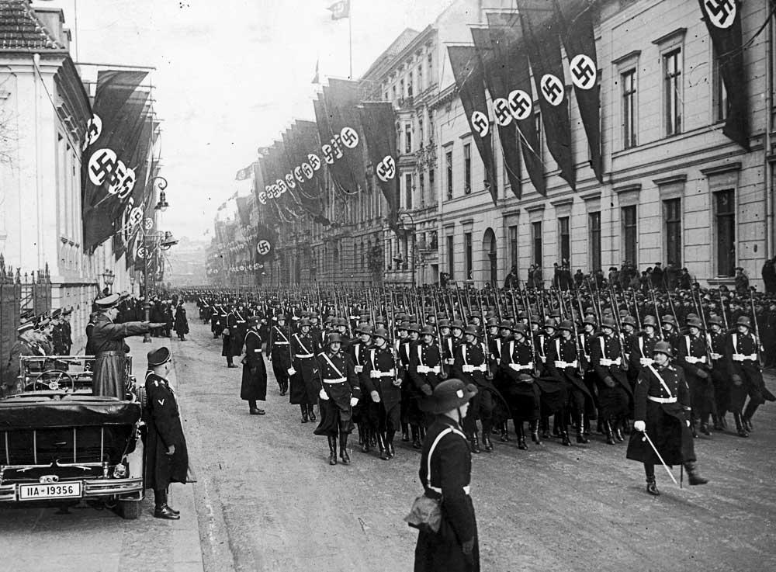
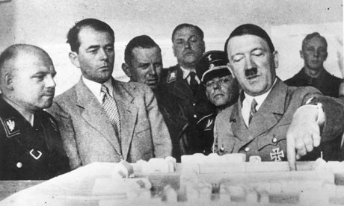
Berlin: key to victory
Capital City

Slide 14
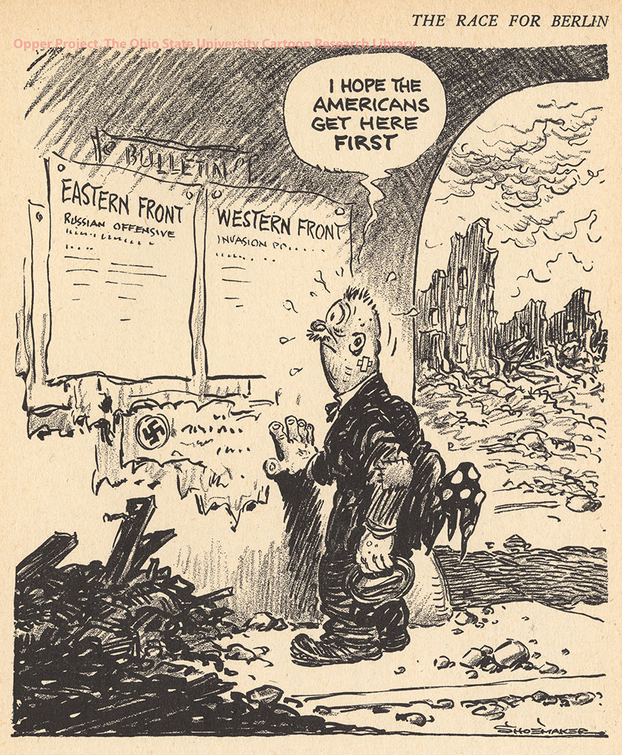
Race to Berlin: According to this cartoon, who did Germany hope would reach Berlin first?

Slide 15
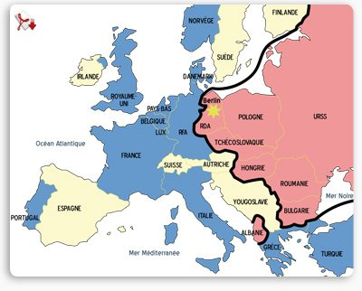
Race to Berlin:
Tension:
Mutual distrust
Occupy Vs. Liberate

Slide 16
Occupy Vs. Liberate

Slide 17
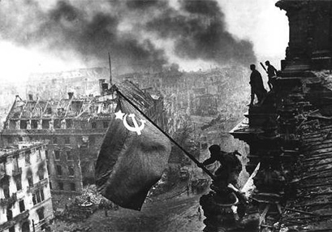
According to this picture, who reached Berlin first.

