Slide 1
STARTER: WWI Review
1. What event started World War I?
2. Who was victorious in the first World War? Who was defeated?
3. List one condition of the Treaty of Versailles in relation to Germany?
4. Do you think WWI was a necessary war? Why or why not?

Slide 2
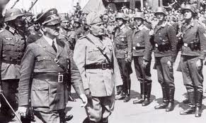
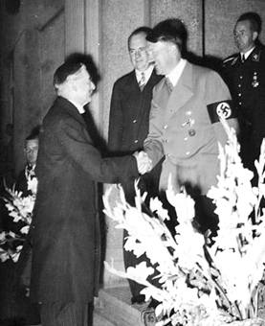
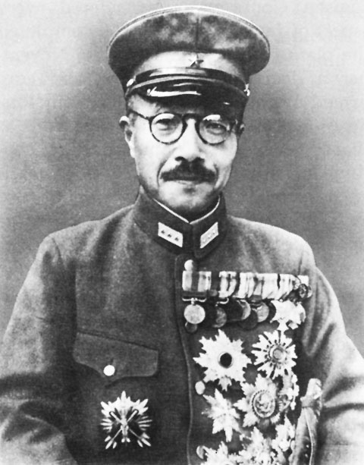
THE START OF THE SECOND WORLD WAR

Slide 3
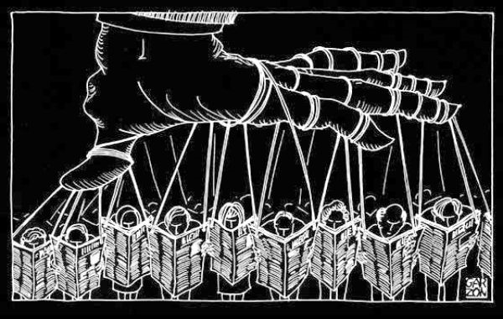
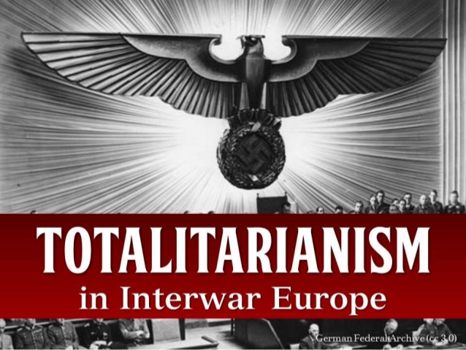
Economics/Government Vocab:
Democracy
Nationalism
Totalitarian
Fascism
Socialism
Communism
Dictatorship

Slide 4
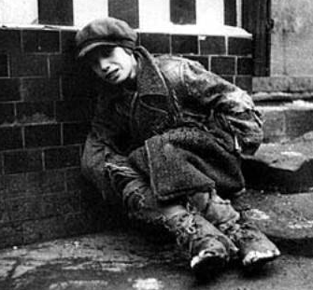
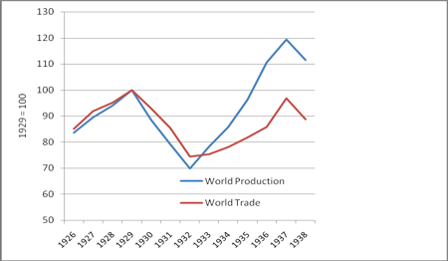
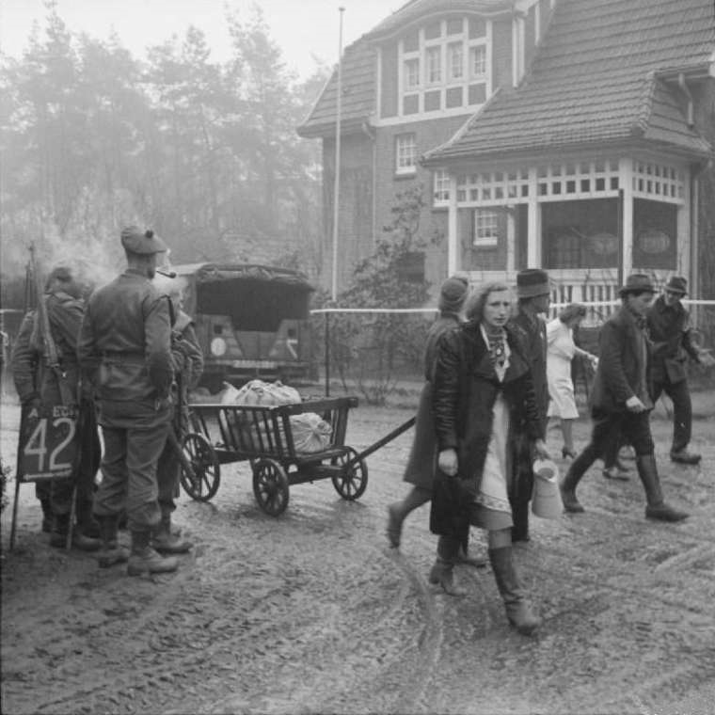
Pre-War World Conditions 1920s-1930s:
World wide economic depression
Intensified national rivalries and hostilities
Instability

Slide 5
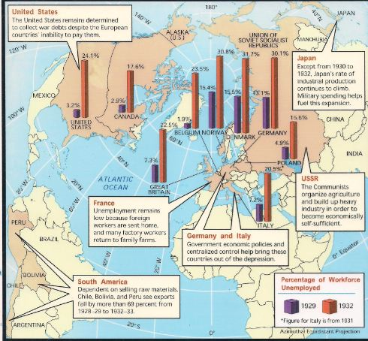

Slide 6
World Conditions- Results
Nationalism: belief in a strong national identity
Language, ancestors, symbols, culture
Militarism: belief in the importance of a strong military to promote national interests
Totalitarianism: Political system where the state holds total and complete control of public and private life.
Trend: Aggressive and violent leaders and armies invading foreign countries and attacking specific races/ethnic groups.

Slide 7
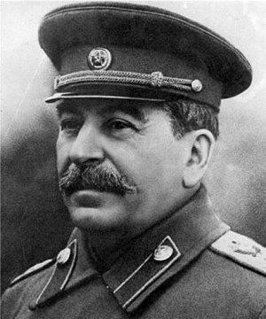
Nationalism/Militarism/ Totalitarianism (examples)
Russia:
Conditions:
Instability after communist revolution.
Results:
1926- Joseph Stalin seizes power
USSR (Union of Soviet Socialist Republics)
Begins massive industrialism in Russia – harsh conditions and lower wages
Tolerated no opposition

Slide 8
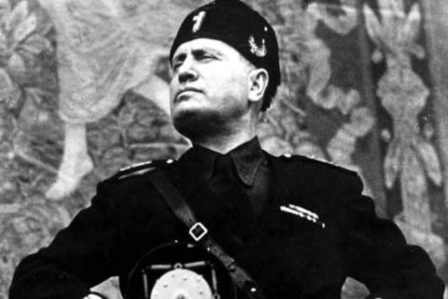
Nationalism/Militarism/ Totalitarianism (examples)
Italy:
Conditions:
Economic depression
National rivalries, felt they were shortchanged at conclusion of WW1
Results:
Benito Mussolini, Fascist Regime (nationalism, totalitarianism).
Fascist Socialism
Expansion into Africa and the Mediterranean

Slide 9
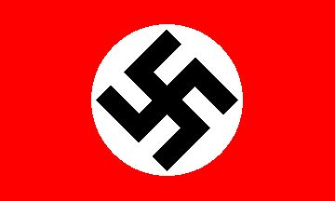
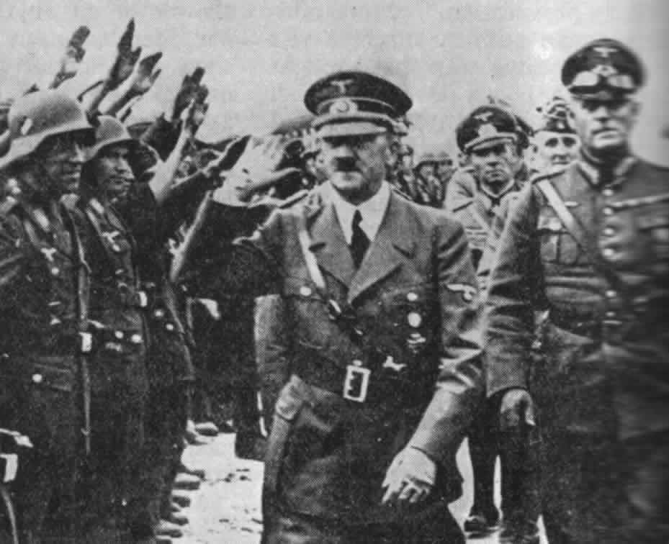
Nationalism/Militarism/ Totalitarianism (examples)
Germany:
Conditions:
Economically crippled (depression and the Treaty of Versailles)
Political chaos
National rivalries, embarrassed and harassed by French and Allies
Results:
Adolf Hitler, National Socialist Party (Nazis)
Belief in superior race (Aryan)
Rearms German military

Slide 11
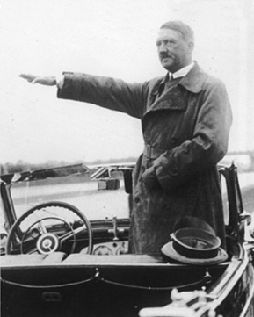
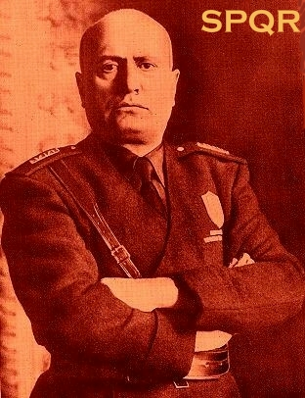
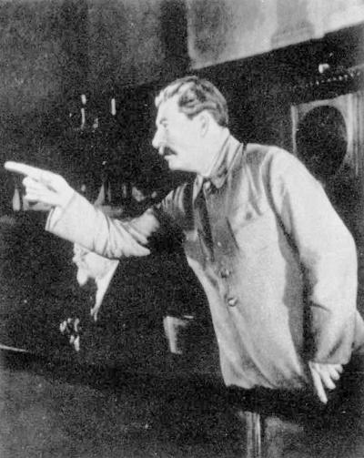
The Faces of Totalitarianism
Fascist Italy
Extreme nationalism
Militaristic expansionism
Charismatic leader
Private property with strong govt controls
Anticommunist
Nazi Germany
Militaristic expansionism
Forceful leader
Private property with strong govt controls
Anticommunist
Communist Soviet Union
Create a sound communist state and wait for world revolution
Revolution by workers
State ownership of property

Slide 12
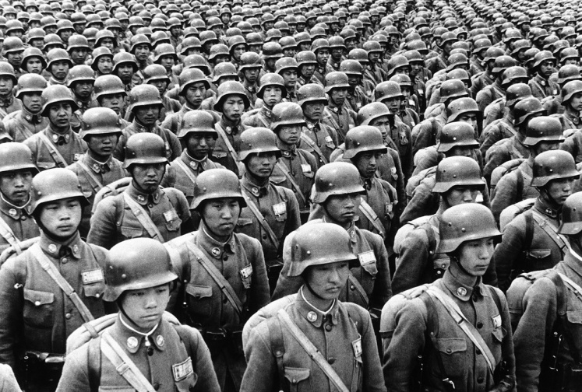
Nationalism/Militarism/ Totalitarianism (examples)
Japan:
Conditions:
Few Natural Recourses
Desire to become imperial power and industrialize.
Results:
TOJO: Military gains influence and control in Japan
Belief in National Superiority
Attack and control Manchuria, invade northern China.
Acquire recourses and become power in the region
Brutal attacks and occupation

Slide 13
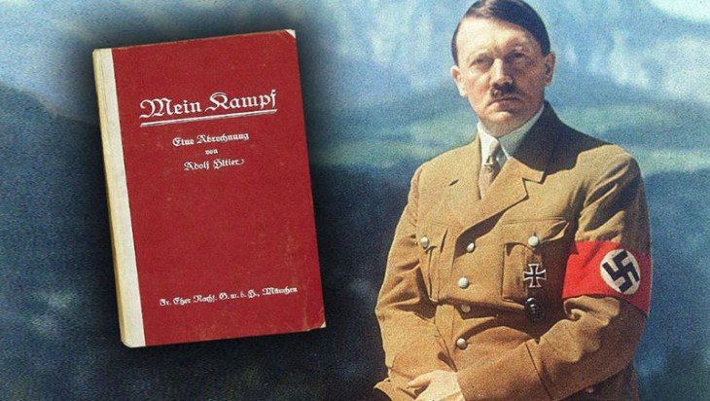
Adolf Hitler’s Beliefs and War Aims:
Mein Kampf (My Struggle)-
What does Hitler believe about Race?
What are Hitler’s goals?
Lebensraum ('living space')

Slide 14
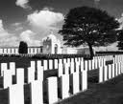
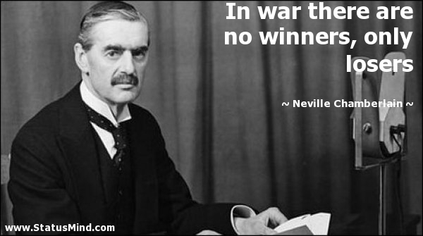
Pre War European Mindset
Memory of WWI: War Weary
Over 4 years of intense combat
70 millions soldiers involved, 9 million dead
Was it necessary?
Economic depression
Global depression and domestic uncertainty
AVOID WAR! APPEASEMENT

Slide 15
Appeasement Activity:
Examine the event
What happened?
How did the Allies react?
Describe why the Allies reacted the way they did
Propose alternative reactions
Decide the best reaction
Predict the results of your decision

Slide 16
Appeasement Event #1
The Event: Rearmament and violation of the Treaty of Versailles
In the mid 1930’s, with blatant disregard for the sanctions imposed by the Treaty of Versailles, Hitler started an aggressive policy to rearm Germany. This rearmament involved pumping a large sum of state money to expand and modernize the Germany war machine. In 1936, in further opposition to the Treaty, Hitler remilitarized the Rhineland (western German lands bordering Belgium).
The Response:
The French and British did nothing to stop Germany.
Why did the French and British take no action towards Hitler after this event? (Consider the Allies mindset)
What were some alternative actions the French and British could have taken?
What do you believe was the appropriate action to take?
What could have been the results of these actions?

Slide 17
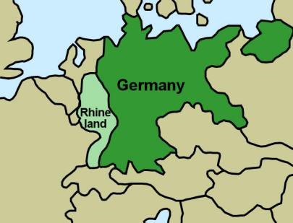
Road to WWII
1936- Germany reoccupied Rhineland

Slide 18
Road to WWII
1938- Germany annexes Austria “Austrian Anschluss”

Slide 19
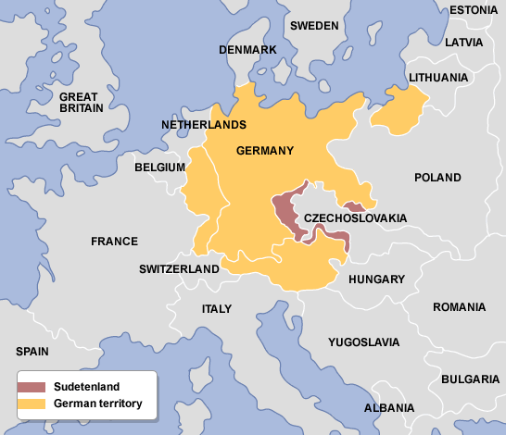
Road to WWII
1938-Germany takes Sudetenland in Czechoslovakia

Slide 20
STOP ! Munich Conference
Representatives of Britain, France, Italy, and Germany agreed to meet in Munich to decide Czechoslovakia’s fate (the Munich Conference)
Appeasement: agreed to Hitler’s demands- Germany gifted Sudetenland- NO MORE!
Hitler has few demands – give him what he wants and we can avoid war
Goal: Avoid war!

Slide 21
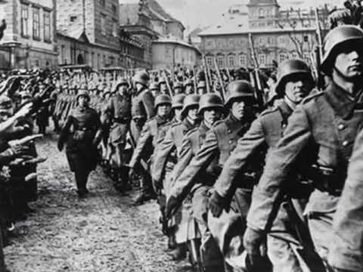
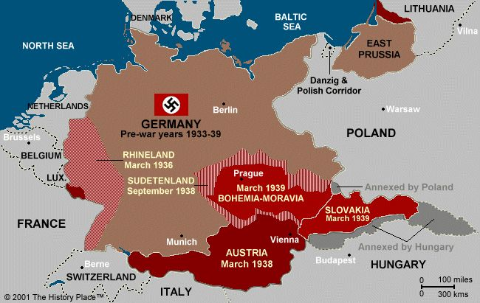
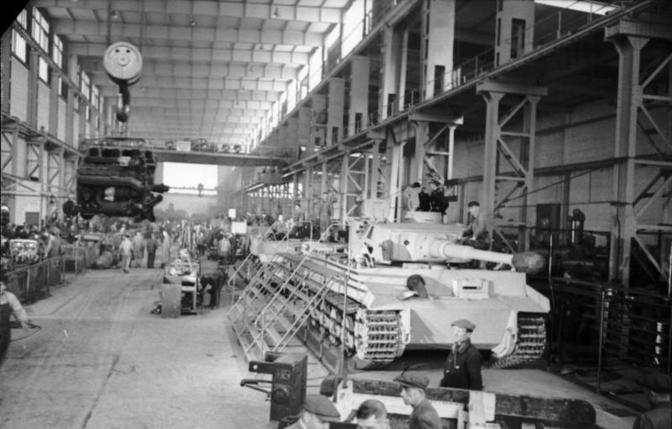
The Result of Appeasement
While Allies avoid war….
Germany builds war machine
Germany strengthens industry
Germany increases territory

Slide 22
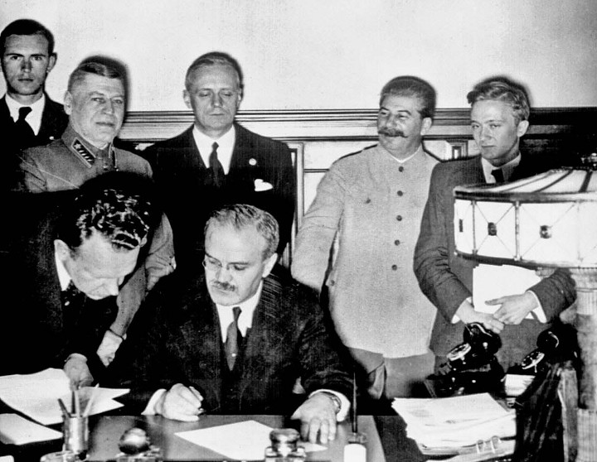
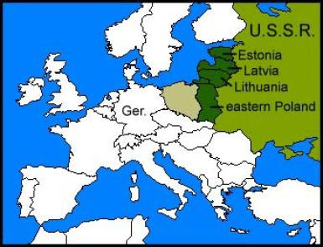
Nazi-Soviet Non Aggression Pact
Nazi Soviet Non Aggression Pact:
Germany and Russia promise not to fight
(Secret) Decide to divide Poland.

Slide 23
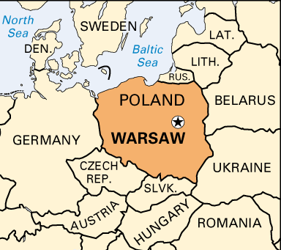
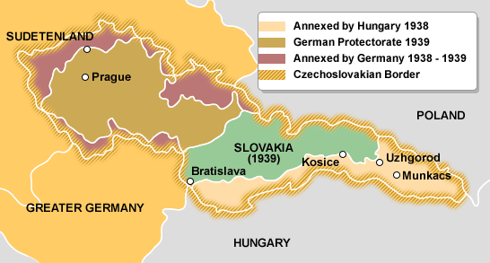
Germany Invades Poland- WWII begins
March of 1939- Germany takes rest of Czechoslovakia
September 1st 1939- Germany invades Poland
September 3rd 1939, Britain and France declare war

