Slide 1
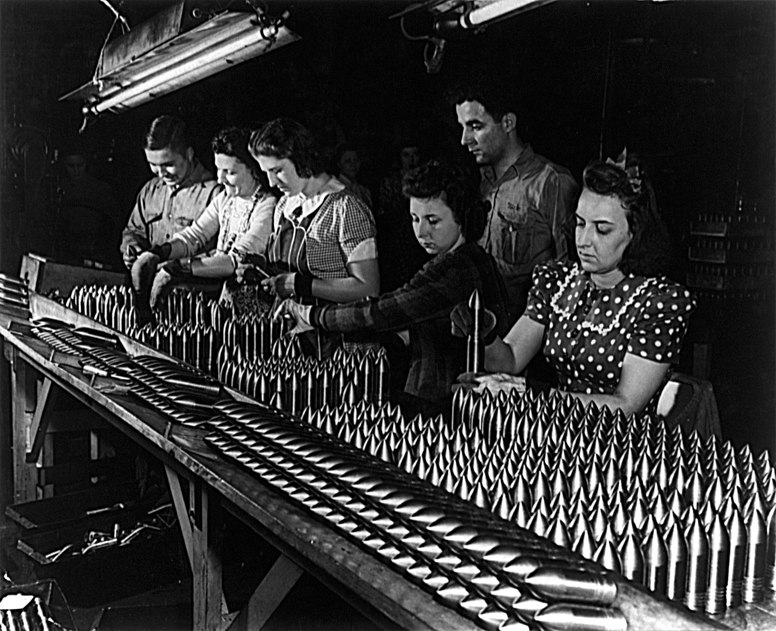
American Homefront

Slide 2
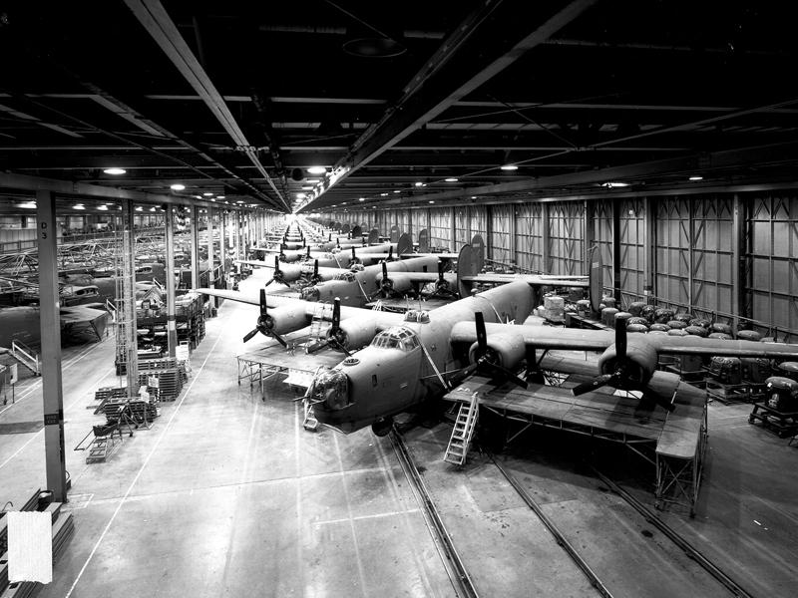
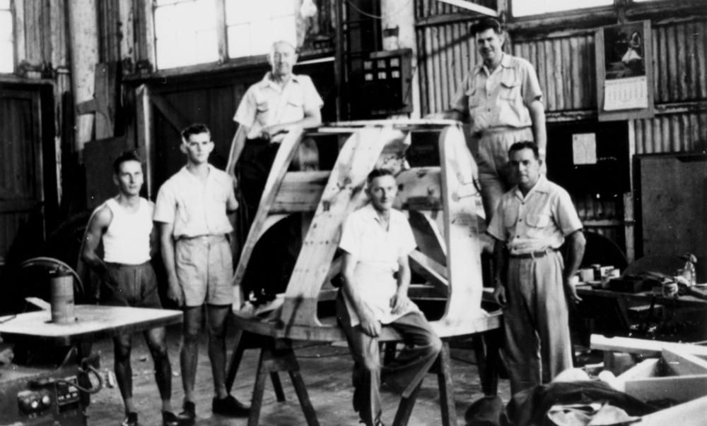
Mobilizing the War Effort
People
War
Government
Industry

Slide 3
People: Man power (and woman power) for the war
Serve in the military
Support:
Victory Gardens
War bonds
Rationing
Supply:
Labor force for War machine

Slide 4
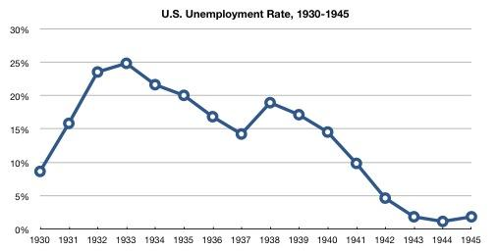
How did WWII affect the unemployment rate?

Slide 5
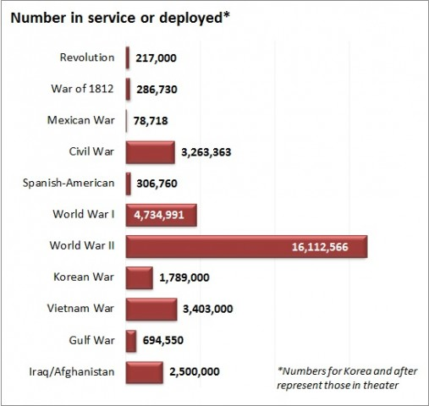
How many men served during WWII? How does this compare to other wars America has participated in?

Slide 6
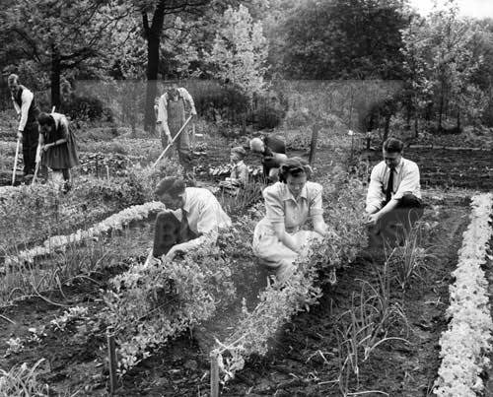
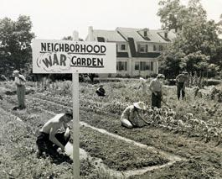
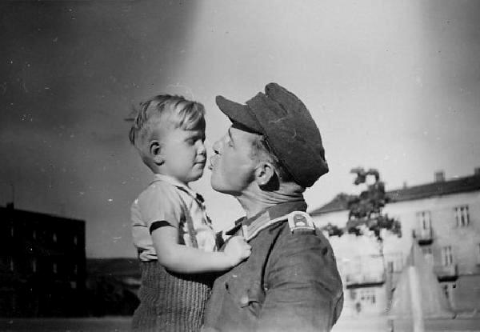
People: Unite to support War

Slide 7
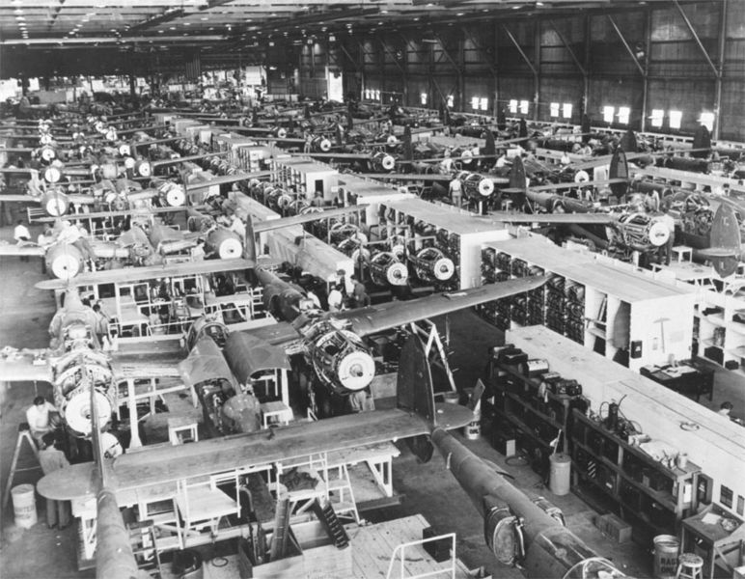
Industry: Resources for the War
Factories: convert factories to produce war materials.
Technology and Efficiency: out-produce the enemy

Slide 8
Government: Money and leadership to direct war.
War Production Board (WPB) and Office of War Mobilization (OWM): Direct military spending.
Federal Government: Funds the war

Slide 9
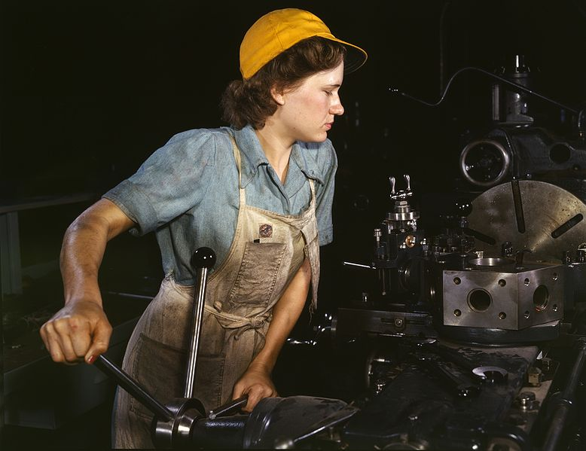
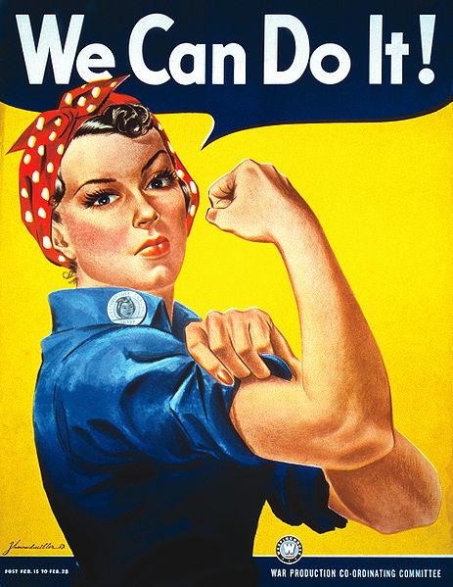
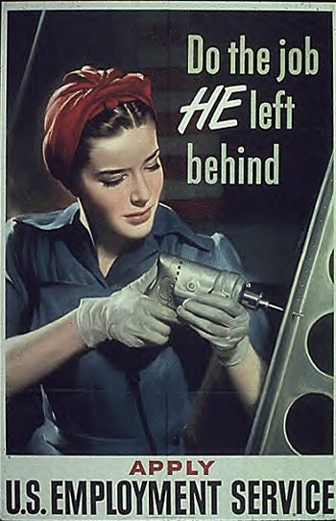
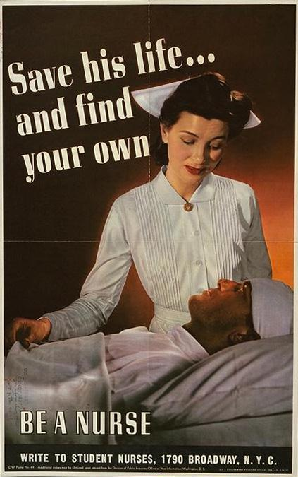
Women

Slide 10
Rosie The Riveter:
Opportunities:
Women enter the workforce to fulfill war needs.
More money, more independence.
Challenges:
Less pay for equal work
Workforce discrimination

Slide 11
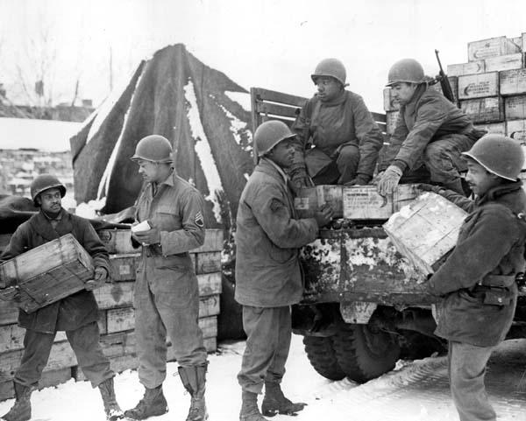
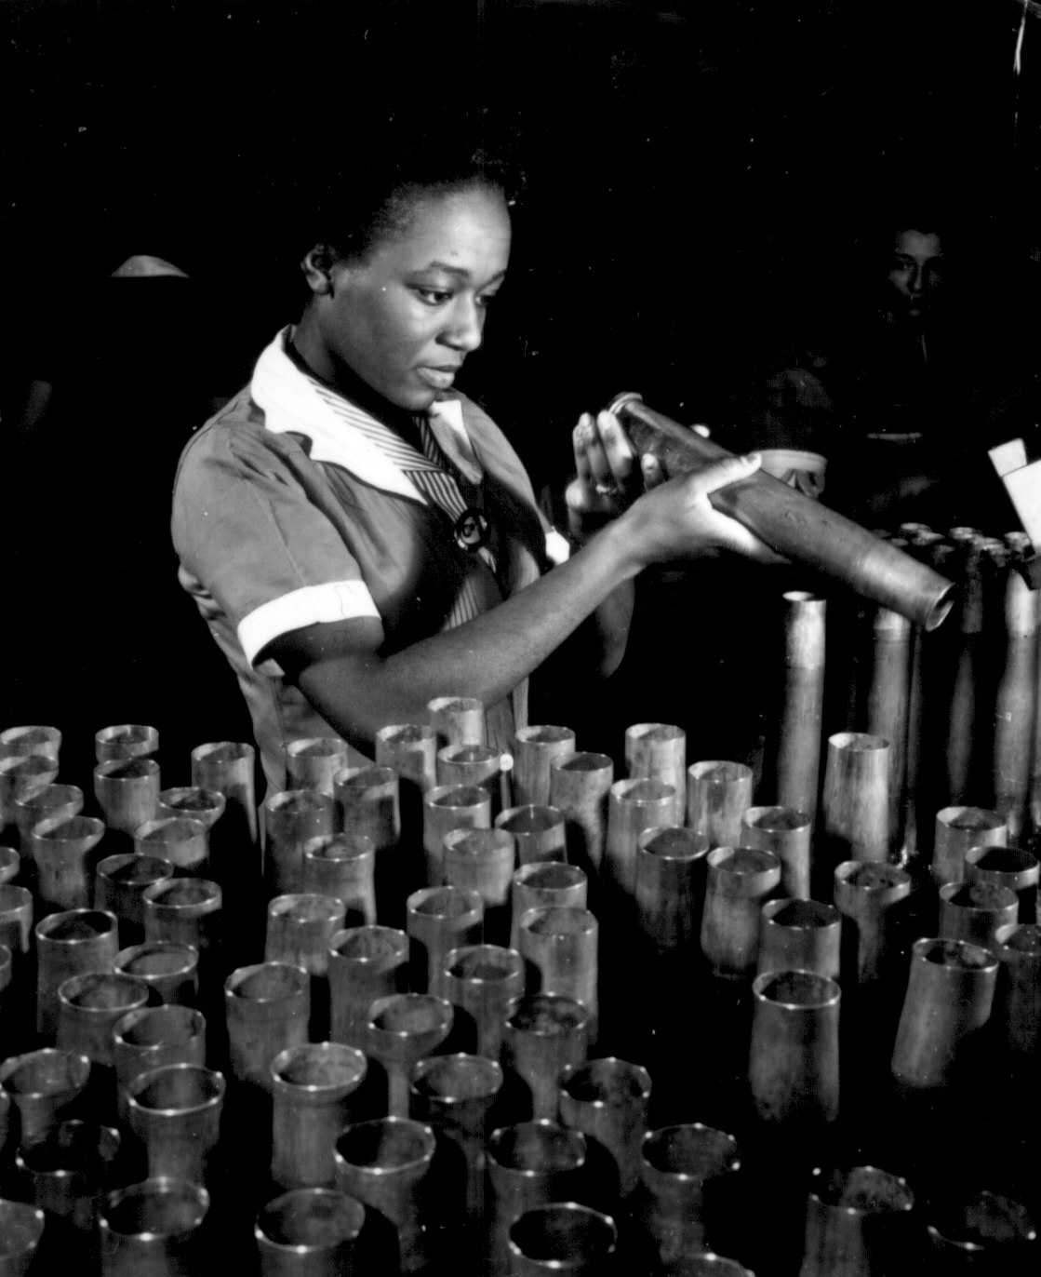
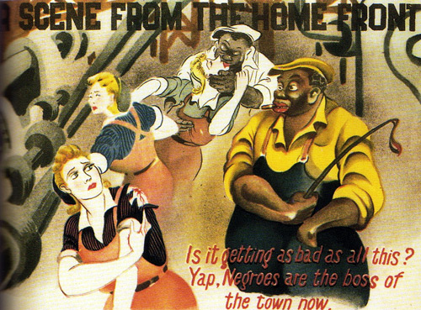
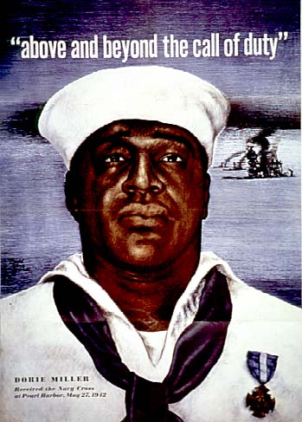
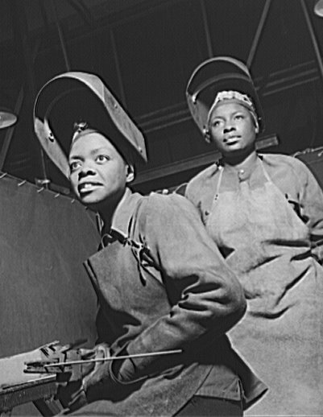
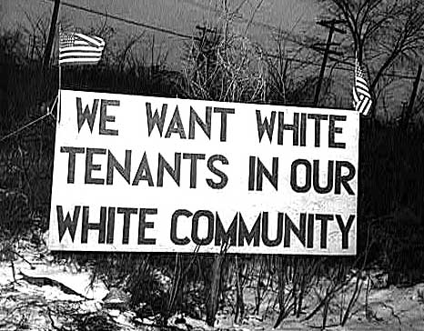
AFRICAN-AMERICANS

Slide 12
African Americans:
Opportunities:
Migrate from the South to industrial cities in the North and Pacific Coast
700,000 out of the South by 1943
Many serve in Military
Challenges:
Discrimination in the workforce.
Racial violence in the cities (Detroit)
Some persistent segregation in the Military

Slide 13
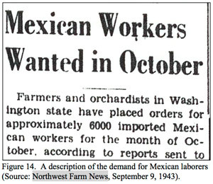
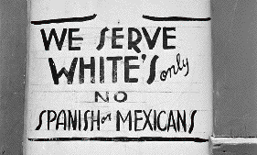
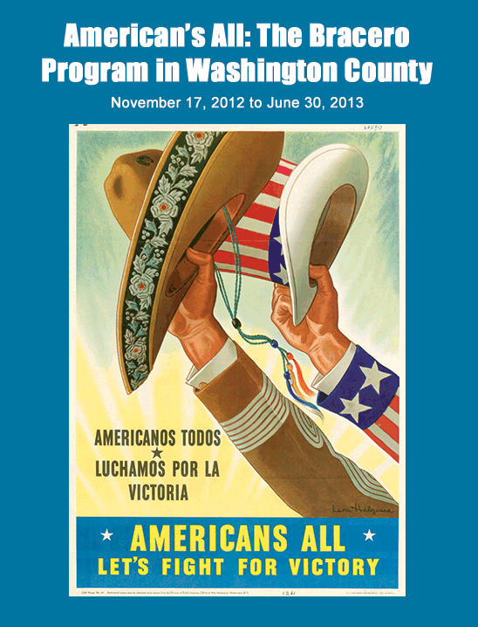
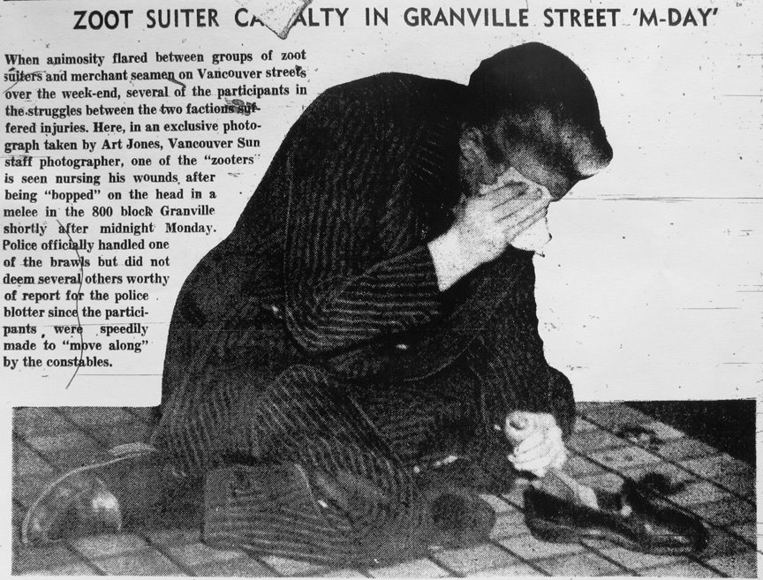
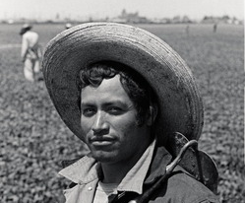
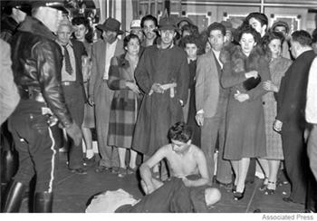
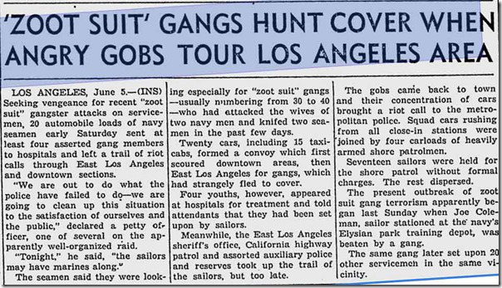
MEXICAN AMERICANS

Slide 14
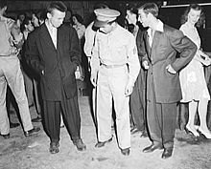
Mexican-Americans:
Opportunities:
Bracero Program: U.S. recruits 290,000 Mexican workers to work on the farms in Texas and California.
Migration to California to work in factories
Challenges:
Segregated housing, low wages,
Racial Violence: Zoot Suit Riots

Slide 15
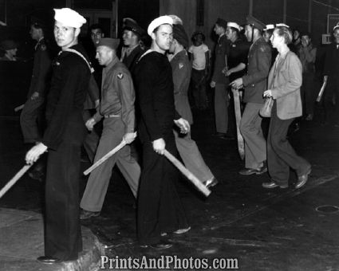
Mexican-Americans:
Zoot Suit Riots (1943): Rising tensions between service men and Mexican Americans in Los Angeles. It escalates into 4 days of violence.
Service men take to the streets, bars, etc. and beat up Mexican young men.
Product of paranoia, anxiety, and racism.

Slide 16
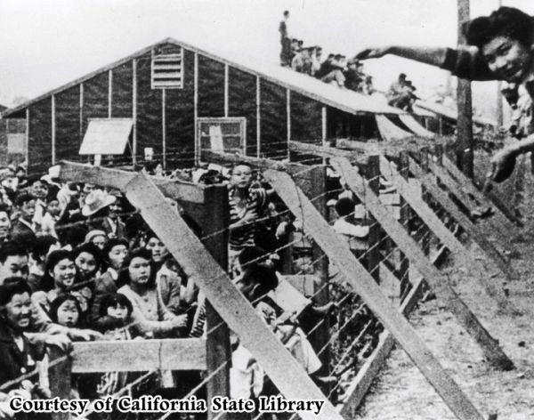
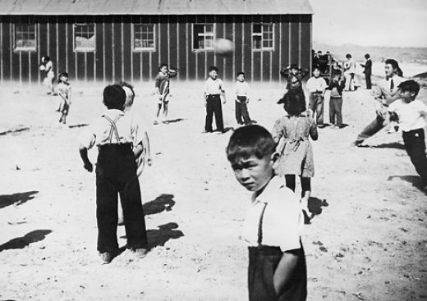
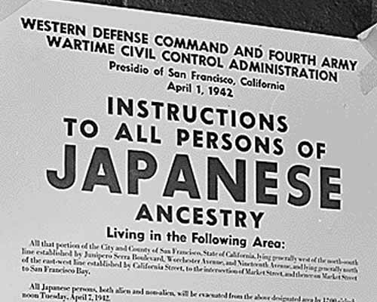
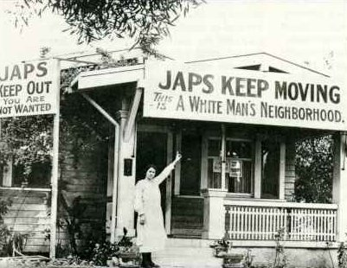
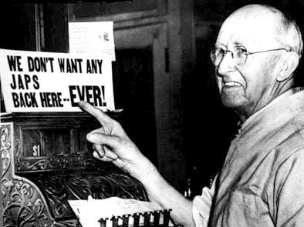
JAPANESE AMERICAS

Slide 17
Japanese Americans:
Internment Camps:
Executive order 9066-
120,000 Japanese-Americans detained in camps for 4 years.
Fueled by anger (Pearl Harbor), paranoia (spies and espionage) and racism.

