Slide 1
Total War
Total War:
Wage war against everything/everyone
Target industry-ability to fight
Target people- break will to fight
Strategic Bombing: “Terror Bombing”
Bomb cities and civilian populations
Target industrial and manufacturing centers

Slide 2
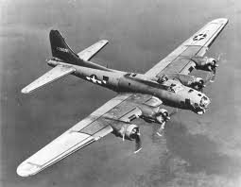
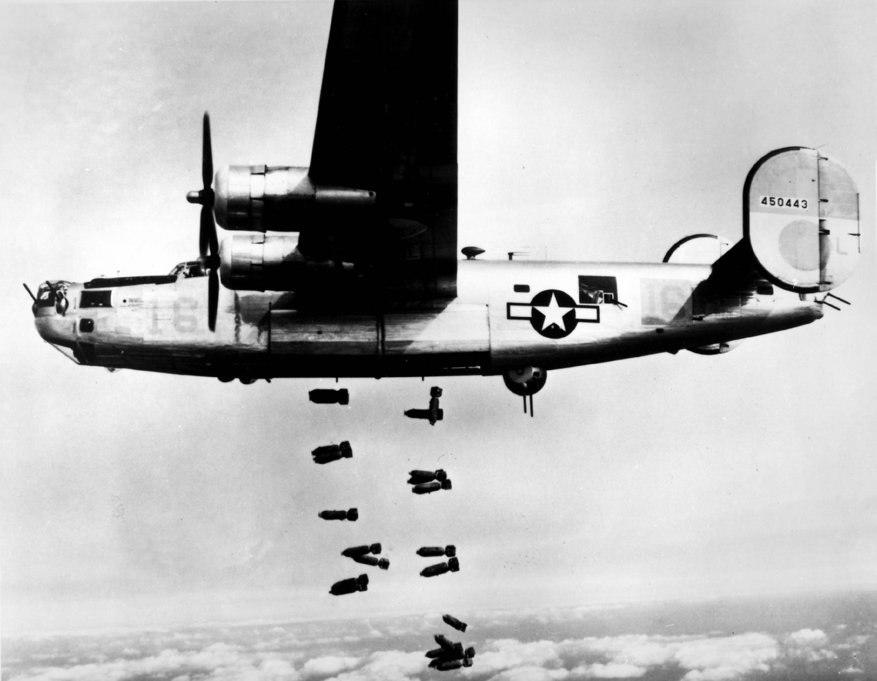
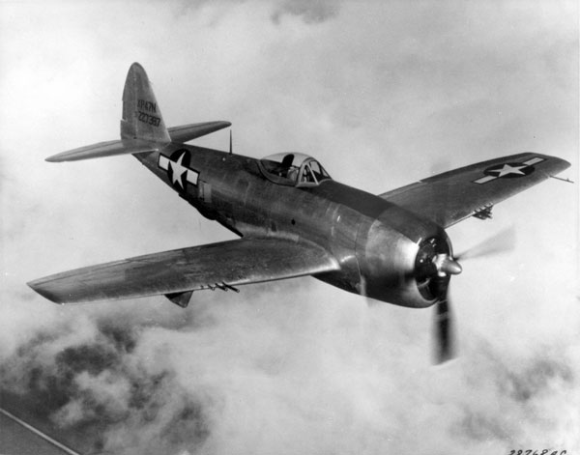
Aircraft

Slide 3
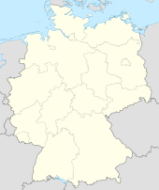
Target: Cologne, Germany
1940-1945
Located in the Rhine River valley
Military Area Command Headquarters
Major Industrial City
Large civilian population
Appropriate Military Target? Does this help us win the war? Should we bomb this city?

Slide 4
Cologne
20,000 civilians dead
Wounded Nazi War Machine
City completely destroyed

Slide 5
Target: Kassel, Germany
1942-1945
Located in central Germany
Military Area Command Headquarters
Aircraft, tank, engine, production plant.
Moderate civilian population
Appropriate Military Target? Does this help us win the war? Should we bomb this city?

Slide 6
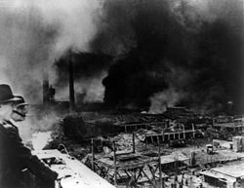
Kassel
10,000 dead
City completely destroyed

Slide 7
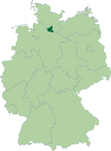
Target: Hamburg
Major bombing: July 1943
N. Germany city
Major transport hub (port, railroad)
Largest industrial city (armaments factories, oil)
One of the most populous cities in Germany.
Appropriate Military Target? Does this help us win the war? Should we bomb this city.

Slide 8
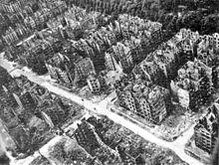
Hamburg
42,000 civilians dead
Huge hit on Germany’s war effort

Slide 9
Target: Dresden
February of 1945
Located on the Elbe River near Czech border
Some industry
A cultural center known for Porcelain production
7th largest city in Germany
Filled with civilian refugees after the collapse of the Eastern front
Appropriate Military Target? Does this help to win the war? Should we bomb this city?

Slide 10
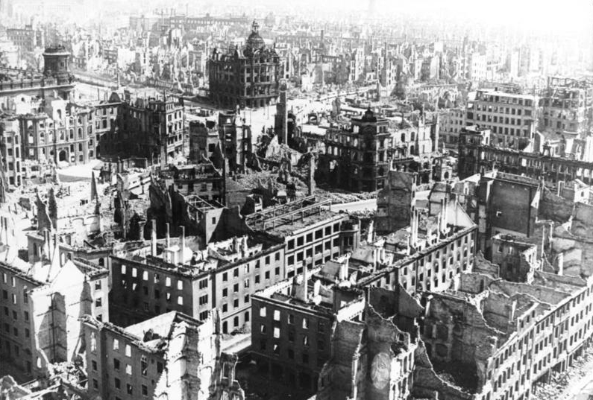
Dresden
25,000 German civilians dead
Many more thousand refugees dead
90 percent of the city destroyed.

Slide 11
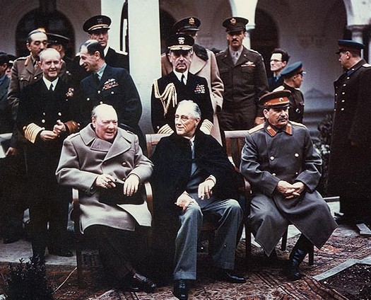
Yalta Conference
Meet to discuss post peace Europe (February 1945)
The Big Three:
Franklin Roosevelt; United States
Winston Churchill; Great Britain
Joseph Stalin; USSR

Slide 12
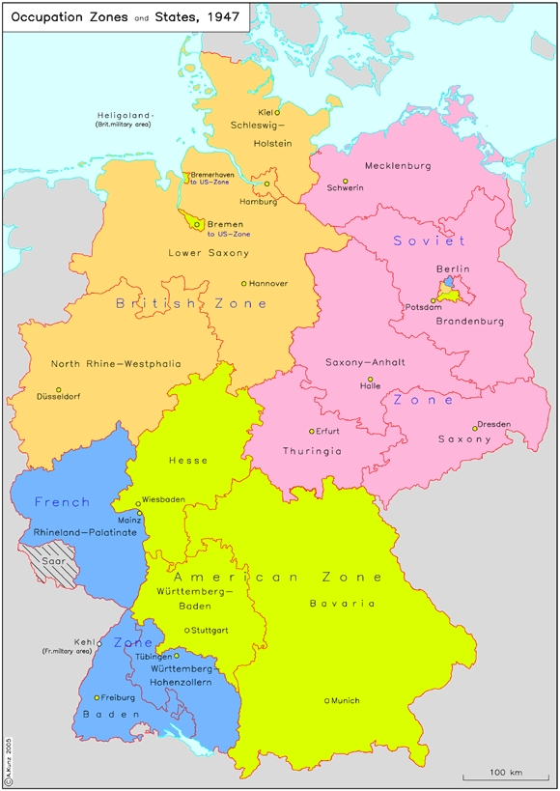
Yalta Accords
Germany:
Only accept unconditional surrender, demilitarize
Divided into four zones of occupation
US, UK, France, and USSR
Frances zone created at expense of US and UK territory
Divide Berlin
Germany pays for war, reparations and forced labor (Soviet Union)

Slide 13
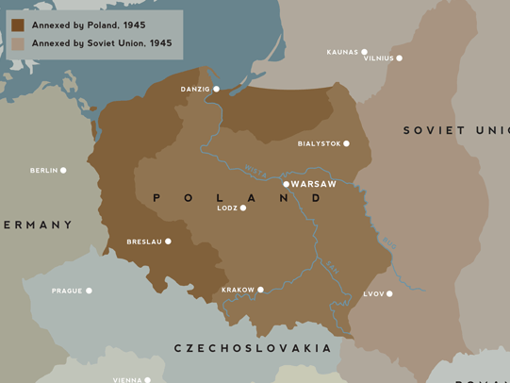
Yalta Accords
Europe:
Conditions for eventual free elections in occupied countries
No date, no specifics
Pro communist Poles retain control
Soviets keep annexed territory from Poland in the east
Poles get a piece of Germany

Slide 14
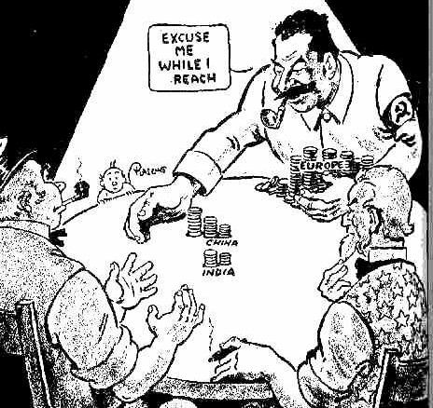
Yalta Accords
Asia:
Soviet Union agrees to enter War in the Pacific
Soviets will get territory from Japan and interests in China in return

Slide 15
Yalta Accords
United Nations:
Stalin agrees to enter United Nations
US, UK, France, and Soviet Union given permanent membership in Security Council
Veto power.

Slide 16
Yalta Accords
Vague language
No specific
No deadlines
Free Poles betrayed
Too much faith in Stalin

Slide 17
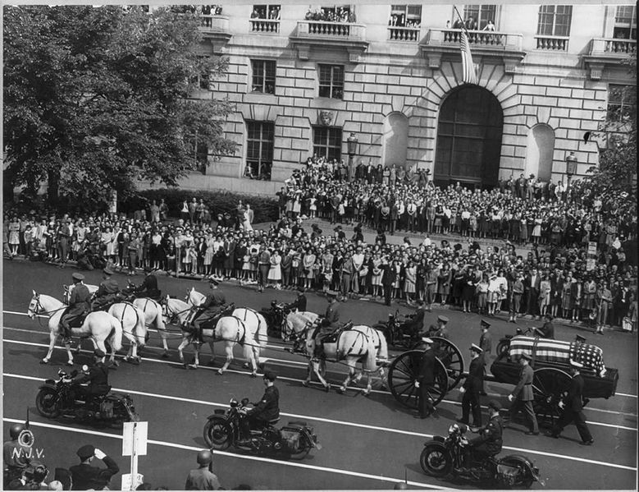
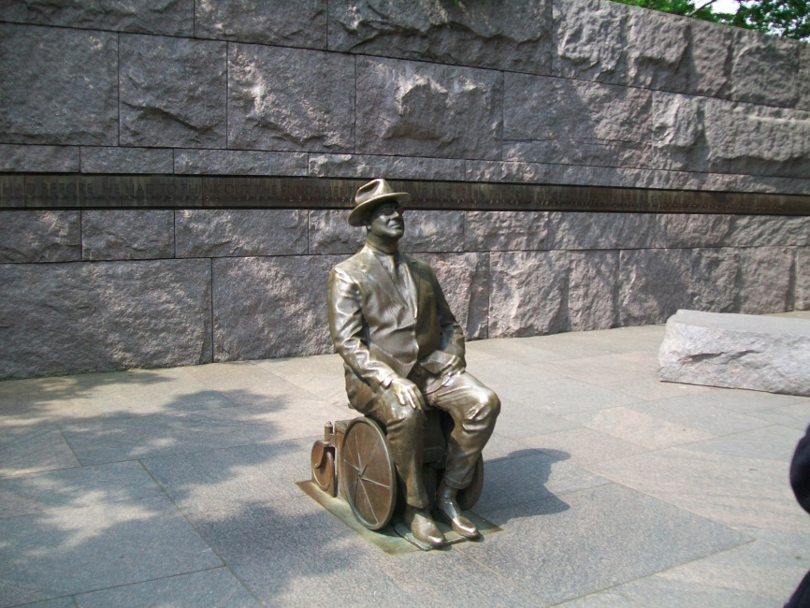
FDR Passes
April 12th, 1945
"Men will thank God on their knees a hundred years from now that Franklin D. Roosevelt was in the White House".

Slide 18
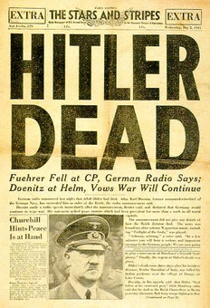
Hitler commits suicide
April 30th, 1945

Slide 19
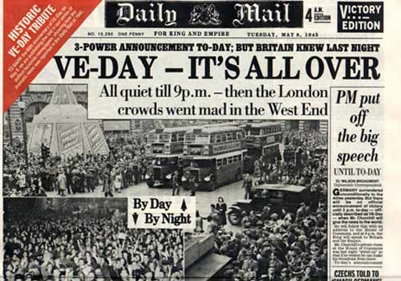
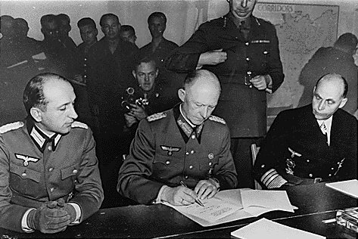
Germany Surrenders
May 7th, 1945

Slide 20
TWO SUPERPOWERS EMERGE

