Slide 1
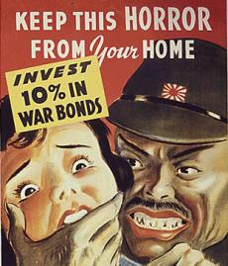
WWII Propaganda

Slide 2
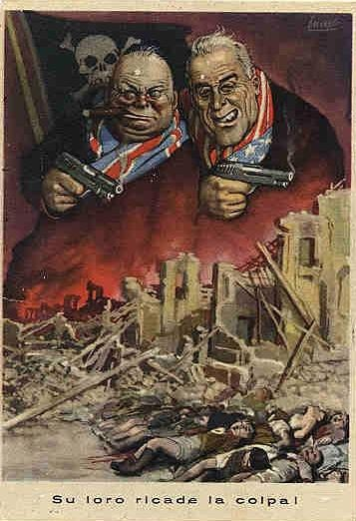
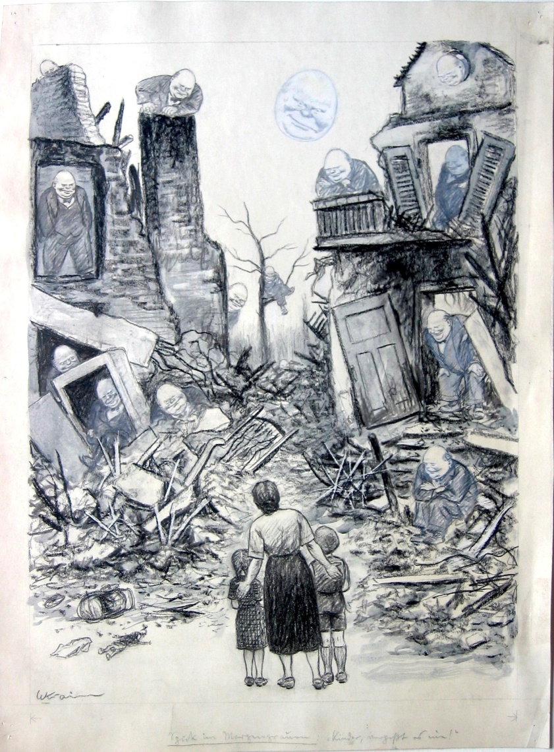
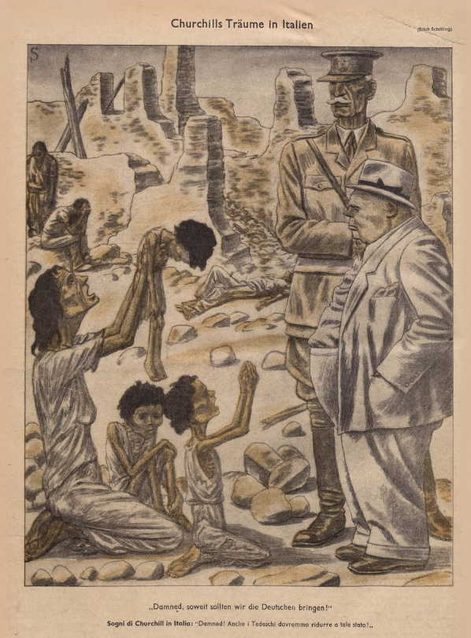
Starter: Decipher the message of this Nazi Propaganda. (interpret 2 ) Background Knowledge: When was this created and who created it? Who is the intended audience? Argument: What is the message of the cartoon? Symbols: What symbols are included? What do they mean? Caricature: What stereotypes, exaggerations, etc. do you see?

Slide 3
Starter:
1. What was the purpose of D-Day?
2. The D-Day invasion was primarily planned by?
3. The Supreme Commander of Allied Forces for D Day was?
4. The D Day invasion occurred where?
5. The Atlantic coast was defended by a series of fortifications known as the?
6. What was the goal of Operation Fortitude?
7. What task did the paratroopers dropped on D-Day fulfill

Slide 4
Media:
Office of War Information/War Production Board:
Government Agency
Present a unified official view of war to citizens
Control media to influence morale of county
Use posters, radio, and Hollywood

Slide 5
Music:
“Remember Pearl Harbor”
“Praise the lord and Pass the Ammunition”

Slide 6
Media:
Themes:
Purposes:
Dehumanization- making the enemy appear inhuman. Demonization- the process of making the enemy appear evil Masculinity/Femininity- Portrayal of women as frail and needing a man to protect them. Fear- Showing something that caused the target audience to fear the enemies causing the audience to take action. Nationalism: Pride in one's nation and the image of your country being threatened by another cause the target audience to take action.
Donations: raise money and food.
Rationing; conserve food, fuel and recourses
Recruitment: recruit men to fight and people to work in war time industries

Slide 7
Get a War Job

Slide 8
Waste Helps the Enemy

Slide 9
Ride-Sharing Club

Slide 10
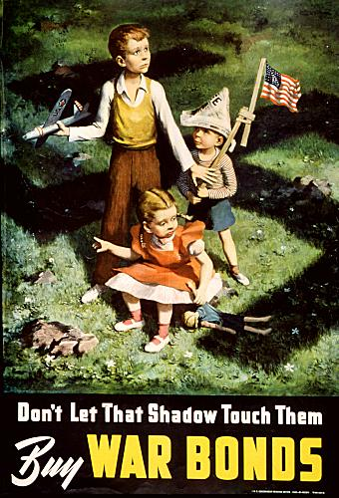
The Shadow

Slide 11
The Sowers

Slide 12
Watchers

Slide 13
Because Somebody Talked

Slide 14
Keep These Hands Off

Slide 18
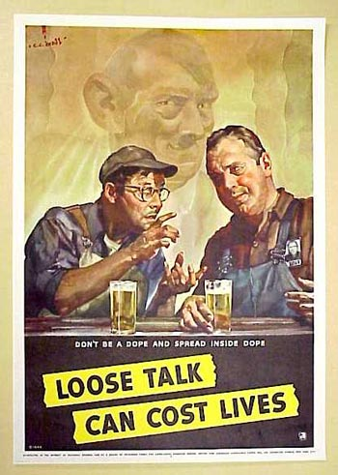

Slide 19
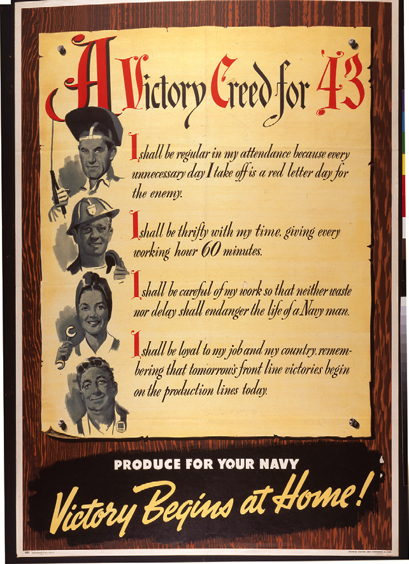

Slide 20
Your Turn:
Create a poster supporting a cause for the home front during WWII.
Select a Theme
Choose a Cause (rationing, war bonds, ride-sharing, conservation, victory gardens, etc.)
Write a slogan
Sketch a picture

