Slide 1
OPERATION TORCH:
Purpose:
Second front in Europe
Alleviate Pressure on Soviet Union in east
Location
Secure N. Africa to invade of S. Europe.

Slide 2
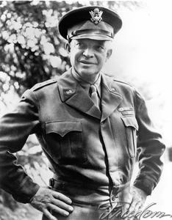
OPERATION TORCH: ALLIED FORCES
Allied “Team” effort
US, British
Supreme Commander:
Dwight D. Eisenhower
General Patton
Inexperienced

Slide 3
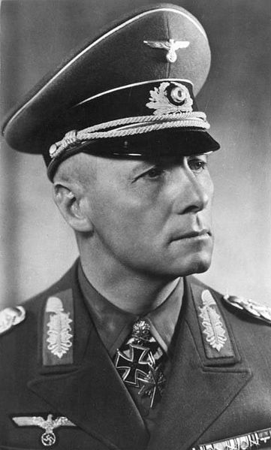
OPERATION TORCH: AXIS FORCES
German, Italian, Vichy French (whose side are they on?)
Field Marshall “Desert Fox” Irwin Rommel
Skilled and aggressive tactics
Undersupplied

Slide 4
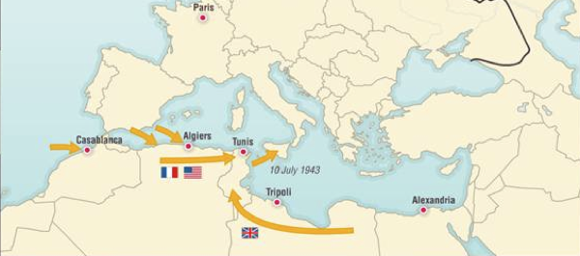
OPERATION TORCH
Battle Plan: Amphibious invasion
Step 1: Sail across the Atlantic
Step 2: Dock on the western coast of French Africa (Casablanca, Oran, Algiers)
Step 3: Secure coast and airfields
Step 4: Defeat Irwin Rommel and secure Africa

Slide 5
OPERATION TORCH
Step 1: Sail Across the Atlantic:
“We were intercepted by German subs. A few ships in our convoy were sunk, including the cargo ship containing ALL of our battalion's trucks and communication gear. We were to land without one telephone, switchboard, wire, or vehicle.
After that sub attack, every distant lightning storm or dark cloud (once even the rising moon) started rumors of another attack. Some men wore their life jackets night and day, and some slept on deck in the cold Atlantic air.”

Slide 6
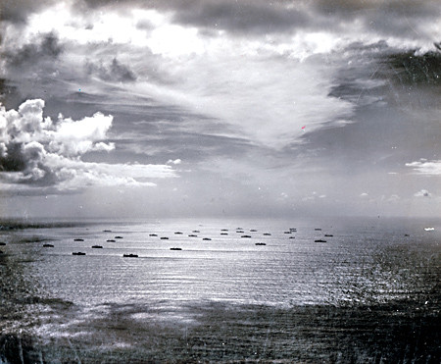
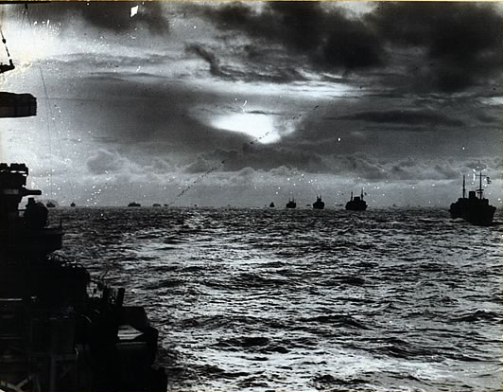
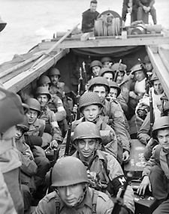
OPERATION TORCH
Step 1: Sail Across the Atlantic:

Slide 7
OPERATION TORCH
Step 2: Dock on the western coast of French Africa (Casablanca, Oran, Algiers)
“Through the Straits of Gibraltar at night, and on towards Oran. On "D" day, November 8, 1942, we climbed down cargo nets into landing craft and went ashore at x beach (Cap Arzew); re-embarked; then landed (two days later, after the majority of the fighting was over) on the breakwater at Oran. It was a mess. We saw tanks on landing rafts tip over and disappear. Some small boats couldn't be started, and some tipped over in the heavy surf. Units fired at each other, as well as at the French defenders.
There was hostile fire. Although prewar in civilian life I had been a hunter, I was one of many who had NEVER fired an army weapon, even in infantry training!”

Slide 8
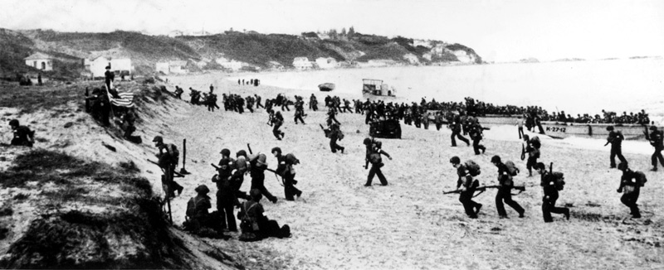
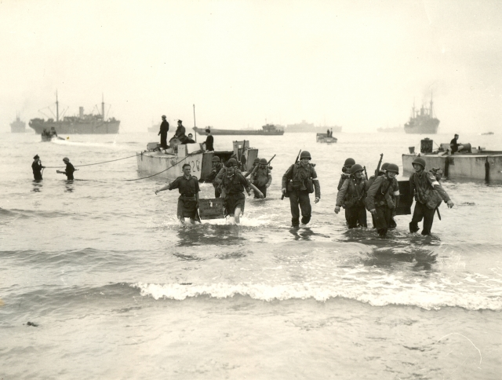
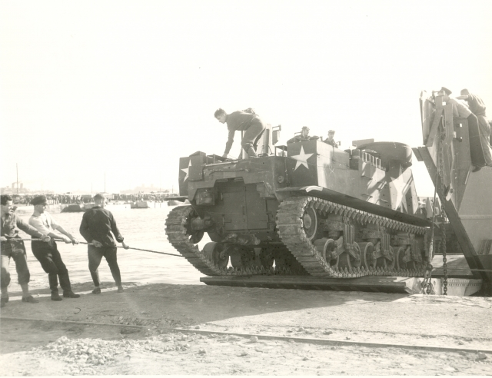
OPERATION TORCH
Step 2: Dock on the western coast of French Africa (Casablanca, Oran, Algiers)

Slide 9
OPERATION TORCH
Step 3: Secure coast and airfields under Vichy French control; Establish communications:
After that short night we marched the few miles to the airfield, our gear arriving in commandeered vehicles. The six of us who had trained in England were in charge of some 200 British troops and their radars (about equal numbers at the three landings at Oran, Algiers, and Casablanca). We erected a radar in its tent at the Oran airport. That evening (D + 3) I "controlled" (talked in on the two way radio) a group of fighter planes (Spitfires) coming from Gibraltar after dark. The airfield had no lights other than kerosene cans lighted at the last moment, nor did the aircraft have landing lights.”
“Some days later the rest of our battalion arrived from Casablanca and Algiers; all "American" radar operations were now centered in Oran. Our commanding officer gave three of the radar officers other duties (one as motor pool officer); three of us were in control of operations.”

Slide 10
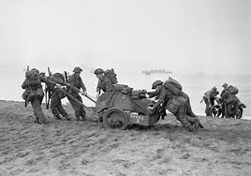
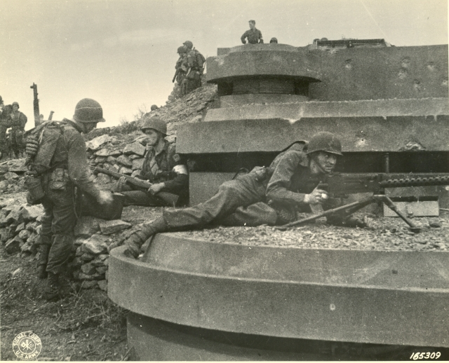
OPERATION TORCH
Step 3: Secure coast and airfields under Vichy French control; Establish communications:

Slide 11
OPERATION TORCH
Step 4: Move east to defeat Erwin Rommel’s Afrikakorps and secure N. Africa.
Rommel attacks Americans at Kasserine Pass

